Slide 1
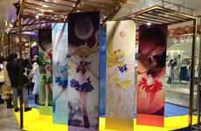
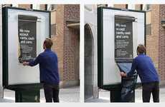
2015
Top 10 Trends & 60+ Examples
Franchise Pop-Up
Automated Discount
Waste Currency
Wearable Payment
Nov 11, 2014 - Copyright © Trend Hunter Inc. This report is for your immediate team’s use only. Please do not distribute, publish or present outside your team. Brought to you by Trend Hunter, the world's most popular, largest trend network, fueled by more than 160,000 contributors and a billion views of data. We help creative innovators like you Find Better Ideas, Faster™

Slide 2
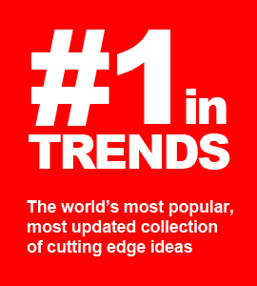
Welcome to 2015!
This year’s Trend Hunter annual report is our best yet because we did roughly 10x more work to filter down to our favorite trends. After pivoting our business to a custom advisory model, we began researching insight with a much larger team, budget and scope, completing roughly 1000 custom research projects. Through that journey we’ve discovered far more inspiring opportunities, with some of our favorites featured in this inspiring report.
Our goal is to help you find better ideas faster. With our data-driven, cost-effective research, we want to help you be more successful with less effort. This year, we are also excited to reveal our groundbreaking trend framework in our upcoming book, “BETTER & FASTER – The Proven Path to Unstoppable Ideas”, coming in March. Put it all together and we want to make this your most inspired year yet!
Be Smarter. Act Faster. Dive Deeper. Save Effort. Win More.
Cheers,
Jeremy Gutsche (jeremy@trendhunter.com)
CEO & Award-Winning Author (JeremyGutsche.com)

Slide 3
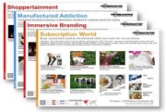
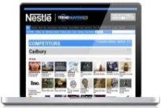
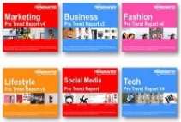
Be More Successful With Less Effort
Our dedicated advisors now help more than a hundred of the world’s top brands to identify opportunity, improve projects and more-quickly explore curiosities
Be Smarter: Identify Opportunity Instead of relying on a guru’s gut instinct, increase certainty with our 100,000,000 person focus group
Save Effort: Get a Dedicated Advisor
Dive Deeper: Improve Projects Find better ideas faster & discover related products that could make project better
Custom Reports
Custom Dashboard
Report
Library
Act Faster: Deep Dive Curiosities Save time & cost-effectively explore curiosities to make sure you never miss a big idea

Slide 4
Get a FREE Sample Custom Report
If you become a Trend Hunter Report customer, let’s hop on the phone for a quick call and we’ll scope out your key topics and show you how incredibly customized we can get!
Retail Tech
Store Apps
In-Store Display
Experience Design
Pop-Up Shops
Store Design
Loyalty Programs
Brand Rituals
Brand Extensions
Co-Branding
Immersive Brand
Digital Branding
Viral Video Strategy
Gen Y Preference
Mommy Bloggers
Meme Culture
Subscriptions
Media Evolution
Personalization
Media Consumption
Custom Design
Adventure Culture
Experience Tourism
Niche Pop Culture
Boomer Wellness
Healthy Living
Health Education
Boomer Apps
Boomer Psychology
Experience Tourism
Young Parents
Teen Culture
DIY Culture
Digital Learning
Night Life
Gen Y Entrepreneurs
Wearable Tech
Mobile Apps
Smart Homes
Future of Interface
Gamification
3D Printing
Digital Marketing
Mobile Marketing
Intentional Viral
QR Codes
Millennial Marketing
Augmented Reality
Digital Education
Superhero Toys
Kids as Adults
Play With Purpose
Buildable Drones
Social Learning
Healthy Snacking
Tricky Diets
Fast Food
Flavor Reversal
Hispanic Flavor
Asian Fusion
Packaging for Pets
Simplicity
Package Innovation
Bottle Innovation
Unique Delivery
Eco Materials
1980s Nostalgia
Retro Americana
Niche Couture
Handbags
Sneaker Culture
Affordable Runway

Slide 5
Find Better Ideas Faster
Learn the award-winning methods we use to accelerate the world's most innovative companies. BETTER and FASTER, our proven method, is launching March 2015 (visit: BetterAndFaster.com)
What great ideas are so close within your grasp?
There are patterns and clues that could lead you to your full potential, but to connect the dots, you'd need to learn a new skill: how to adapt and disrupt. BETTER and FASTER will make you BETTER by teaching you how to overcome evolutionary traps that block smart people and successful teams. Then, it will make you FASTER by teaching you 6 Patterns of Opportunity -- repeatable shortcuts that you can use to find better ideas, faster.
VISIT: BetterAndFaster.com
Pre-order & get FREE research
Buy 4 = Get the Top 40 Trend Report Lite
Buy 24 = Get the 2015 full trend report (worth $1,000)
Buy 100 = Get 3 * 24 Hour Custom Reports (worth $4,500)

Slide 6
10 Sample PRO Trends
Subscribe for 3,000 More!
Enclosed are a few inspiring ideas selected through an internal competition between our editors, each picking their favorite insights from our collection of more than 3,000 PRO Trends.
Copyright © TrendHunter.com. All Rights Reserved

Slide 7
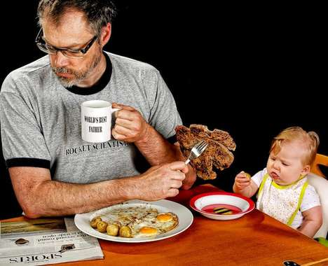
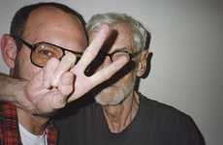
Masculinity Redefined
Fatherly photography suggests a shift toward more familial roles for men
Implications - With women becoming more independent and career-focused due to more open and encouraging educational opportunities, men have subsequently faced a shift in gender roles, integrating themselves into more familial responsibilities that were once dominated by the opposite gender. Reflecting a shift in gender expectations, fatherly photography showcases a turn toward more domestic roles for men, echoing a transformation of traditional familial frameworks.
Poignant Father-Daughter Portraits Ben Nunery and Olivia Reenact Wedding Photos with Late Wife
Adorable Daddy Daughter Selfies This Redditor Took a Bunch of Funny Family Portraits with his Baby
Foxy Father Photoblogs
Adorably Coordinated Familial Shoots
Hilarious Dad-Daughter Portraits World's Best Father by Dave Engledow is Quite the Opposite
Famous Fatherly Photoshoots The Terry Richardson Mom & Dad Book Reveals the Dad behind the Man
Lifestyle
Score:
Popularity
DEMOGRAPHICS
6 Ideas + 54 Related Examples
7.1
Activity
http://www.trendhunter.com/id/235164
Freshness
Copyright © TrendHunter.com. All Rights Reserved

Slide 8
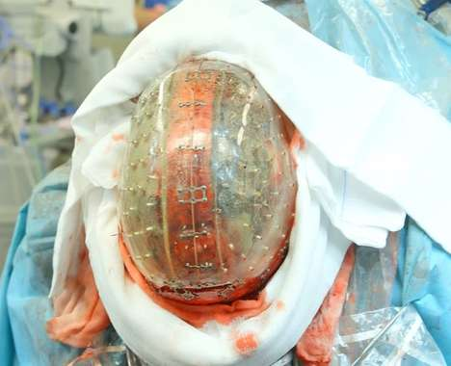
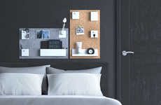
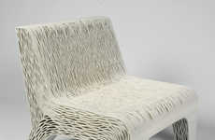
Practical Printing
3D printing expands to offer functional, everyday goods
Implications - The potential of 3D printing is being realized as the market of goods is expanded to include prosthetics, foods, everyday goods and beyond. This shift towards mass adoption of 3D printed goods targets the modern consumer whose preference for convenience and tech-savvy innovations is leading towards full lifestyle immersion.
Wireless Custom Earbuds
3D Printed Facial Surgeries
3D-Printed Home Organizers The Uook Wall Organizer by Build Republic is Customizable
3D Makeup Printers
Edible 3D Drumsticks
3D Printing Food Attachments
3D Printed Skulls Dr. Bon Verweij Successfully Implanted a Tech-Made Cranium in the Netherlands
Flexible Cellular Seating Lilian Van Daal's 3D-Printed Chair is Inspired by Plant Cells
Tech
Fruit-Producing 3D Printers
Score:
Popularity
DEMOGRAPHICS
9 Ideas + 70 Related Examples
8.3
Activity
http://www.trendhunter.com/id/257684
Freshness
Copyright © TrendHunter.com. All Rights Reserved

Slide 9
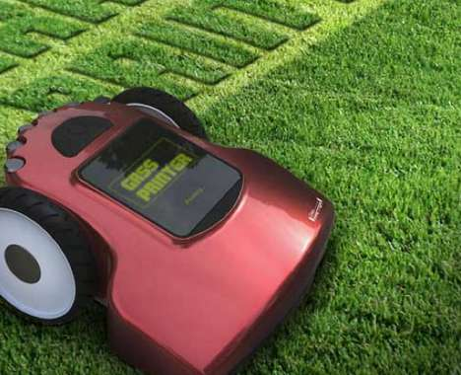
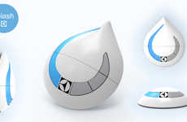
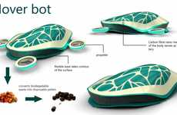
Everyday Robotics
Automatic household devices illustrate a demand for high-tech convenience
Implications - With consumers becoming increasingly busy in their everyday lives, making time to do simple things like chores can be difficult. Robotic household devices seek to make the cleaning process more efficient, allowing consumers the freedom to engage in other activities. This illustrates a growing demand for hyper-convenience.
Sanitizing Robot Snakes The Bio-Cleaner 2 is an Underwater Appliance That Breaks Down Metals
Tiny Window-Washing Bots The Electrolux Splash Scours Every Inch of Exterior Fenestration
Hybrid Vacuum-Mop Robots
Trash-Terminating Robots
Automatic Lawn Letterers The Grass Printer Make Your Yard a Canvas for Literal Communication
Hi-Tech Tortoise Hoovers The Electrolux Hover Bot Cleans Every Surface of Your Home Automatically
Tech
Score:
Popularity
DEMOGRAPHICS
6 Ideas + 53 Related Examples
6.9
Activity
http://www.trendhunter.com/id/228540
Freshness
Copyright © TrendHunter.com. All Rights Reserved

Slide 10
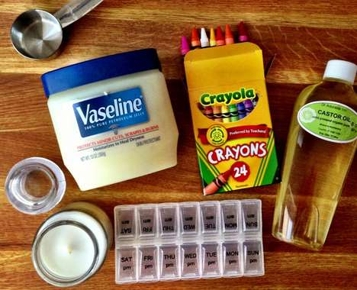
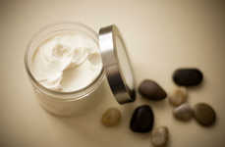
Chemical Revolt
Rebelling against brands, consumers opt to create natural products at home
Implications - While the price of personal care items isn't exceedingly high, the number of chemicals used to create them is, which is a contributing factor as to why DIY cosmetics are becoming more widespread across North America. Able to naturally customize and create only what they'll use, DIY sundries mark a shift towards penny-pinching consumers who also have particular tastes that prefer their own product made just the way they like it.
DIY Beeswax Soap Bars This Easy-to-Make Facial Lotion is Made from All-Natural Products
DIY Body Cream Make Whipped Shea Butter Lotion with This Easy Recipe
DIY Crayon Lip Colours These DIY Crayon Lipsticks Will Save You Cash and Help You Look Impressive
Homemade Hydrating Face Mists Beat the Dry Winter Season with a DIY Beauty Product
Art & Design
Score:
Popularity
DEMOGRAPHICS
4 Ideas + 35 Related Examples
7.9
Activity
http://www.trendhunter.com/id/228495
Freshness
Copyright © TrendHunter.com. All Rights Reserved

Slide 11
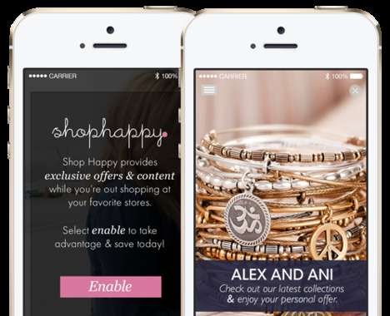
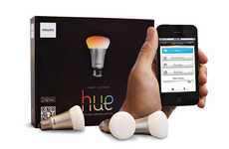
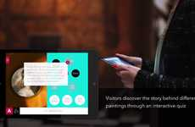
Responsive Retail
Beacon technology is creating a more interactive, streamlined retail experience
Implications - Beacon technology, a responsive innovation creeping its way into the mainstream, is changing the possibilities and capabilities of retail. Able to automate and even customize the shopping experience, this shift will appeal to the tech-savvy consumer looking to streamline everyday tasks. By creating a more straightforward and intuitive shopping experience, brands that adopt this technology will likely lead in terms of attracting consumers who strongly value efficiency over personal connection in their busy lives.
Illuminated Retail Apps Philips Introduces New Connected Retail Lighting System
Futuristic Shopping Beacons The ‘Estimote’ Uses Your Smartphone to Customize Your Shopping Trips
Beacon-Powered Retail Platforms Swirl's Mobile Marketing Platform Engages Consumers on a New Level
Illuminated Personal Shoppers This LED Retail Lighting System Leads Shoppers to Their Product
Interactive Gallery Apps Prophets' Innovative Experience Lets People Interact with Art
Tech
Score:
Popularity
DEMOGRAPHICS
5 Ideas + 42 Related Examples
6.2
Activity
http://www.trendhunter.com/id/237554
Freshness
Copyright © TrendHunter.com. All Rights Reserved

Slide 12
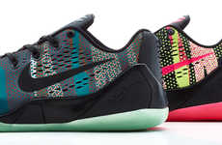
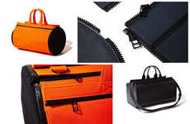
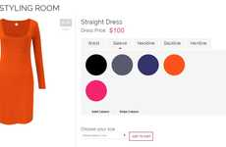
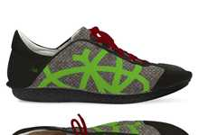
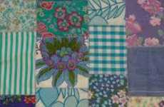
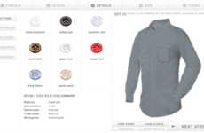
Bespoke E-Commerce
The demand for one-of-a-kind goods sparks an autonomous custom economy
Implications - Custom tailored products are coveted by consumers, which is being addressed by brands with online custom services. As consumers become increasingly dependent on eCommerce, the rise of customized goods ordered online satisfies the the lack of a physical shopping experience.
3D-Printed Product Stores
Customizable Athletic Prosthetics
Customizable Camo Sneakers The Nike Kobe 9 EM 'Pop Art Camo' Collection is Rugged Chic
Makeshift Customizable Handbags These Handbags Make Sure You Never See Someone with the Same Gear
Bespoke Dress Design Platforms Rose Athena's Custom Dress Creations Turn Consumers into Designers
Custom 3D Printed Jewelry
Collapsable Custom Slippers
Customizable Hipster Eyewear
DIY Ethical Urban Sneakers The Po-Zu Customizable Socially Aware Shoe Lets You Adapt the Design
Completely Customizable Menswear Original Stitch Lets Men Make the Shirt of Their Dreams
Custom Shirt Builders Shirts My Way Lets You Create Your Own Tops from Scratch
Fashion
Score:
Popularity
DEMOGRAPHICS
11 Ideas + 98 Related Examples
8.2
Activity
http://www.trendhunter.com/id/258396
Freshness
Copyright © TrendHunter.com. All Rights Reserved

Slide 13
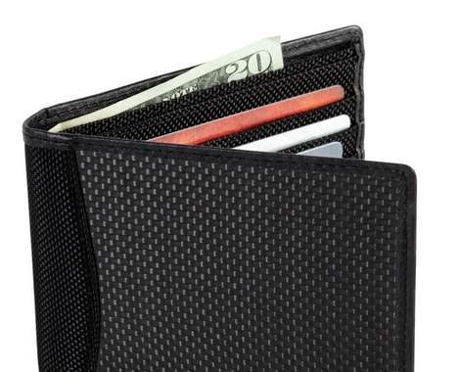
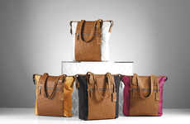
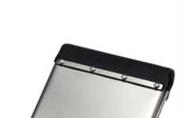
Tech Paranoia
As RFID gains more popularity, consumers protect themselves against theft
Implications - As more credit cards and smartphones adopt RFID technology, the issue of mobile security is taking centerstage for consumers, which is being soothed with anti-wireless theft accessories. The move towards these more formalized ways to prevent wireless theft identifies the strong demand for "tap and go" payment solutions, but also a preference to deal with the associated effects without having to give up convenience technologies.
Anti-Wireless Theft Wallets
Theft-Blocking Wallets
Hacker-Proof Travel Totes The New Tumi ID Lock Collection Blocks RFID Signals
Stainless Steel Wallets
Practical Mesh Wallet Organizers
Anti-Identity Theft Wallets The Anti-Identity Theft Wallet Blocks Radio Signals From Intrusion
Minimalistic Metal Money Holders The Zippo Stainless Steel Wallet is Expertly Crafted
Tech
Score:
Popularity
DEMOGRAPHICS
7 Ideas + 59 Related Examples
6.7
Activity
http://www.trendhunter.com/id/225145
Freshness
Copyright © TrendHunter.com. All Rights Reserved

Slide 14
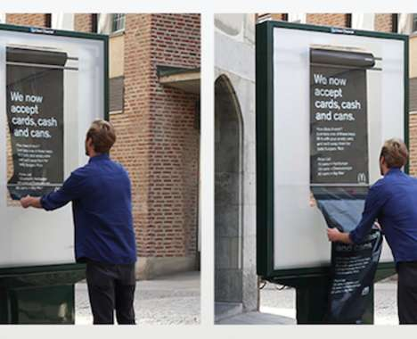
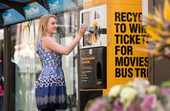
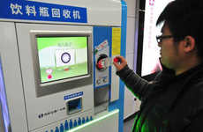
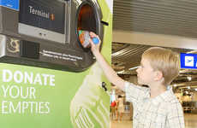
Waste Currency
Brands accept waste as a payment for goods to reinforce positive perceptions
Implications - Consumers are becoming more aware of how their habits affect the environment, which a number of brands are taking in stride by accepting waste as a form of payment. This active push for recycling helps reinforce a positive image of the brand for consumers and align previously wasteful brands with eco-conscious customers.
Incentivized Recycling Machines The Envirobank Recycling Machine Offers Prizes for Cleaning Litter
Bottle Deposit Train Tickets Plastic Recycling Could Get You a Free Transit Pass in Beijing
Can Currency Campaigns McDonald's Stockholm Lets Youth Trade in Bags of Recycled Cans For Burgers
Charitable Airport Regulations The Frankfurt Airport Recycling Bank Makes Giving Up Bottles Easier
Bartering Biomass Teahouses The Methane Cafe is an Eco Cafe in Japan That Trades Trash for Tea
Eco
Score:
Popularity
DEMOGRAPHICS
5 Ideas + 43 Related Examples
8.2
Activity
http://www.trendhunter.com/id/258346
Freshness
Copyright © TrendHunter.com. All Rights Reserved

Slide 15
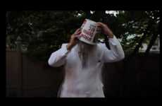
Cause Reappropriation
Brands and activists remix campaigns and causes to be more forward-thinking
Implications - As inequality continues to remain a poignant issue around the world, companies and activists alike are taking a page from one another's manuals to take said issues to a more mainstream audience. Whereas corporations were once encouraged to remain as neutral as possible in regard to controversial issues, it is now understood that in order for a brand to appeal to the impassioned millennial, it must take a stand.
Satirical Olympic Sponsorship Videos
Epic Icy Challenges
LGBT Parody Olympic Sites This Website Protests Sponsorship of the Sochi 2014 Winter Olympic Games
Activist Ice Cream Campaigns
Prideful Gaming Consoles
Patriarchy-Spinning Twitter Accounts
Reappropriated Pride Posters These LGBT Posters Rework Soviet Propoganda into Gay Pride
Charitable Chicken Chain Videos KFC's Colonel Takes on the ALS Ice Bucket Challenge for Charity
Social Good
Scientific LGBT Pride Posters
Score:
Popularity
DEMOGRAPHICS
9 Ideas + 70 Related Examples
7.7
Activity
http://www.trendhunter.com/id/232975
Freshness
Copyright © TrendHunter.com. All Rights Reserved

Slide 16
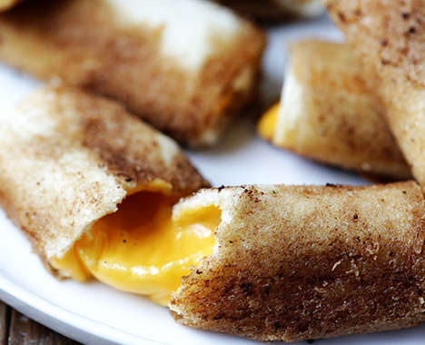
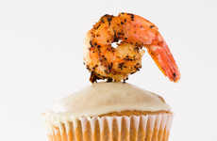
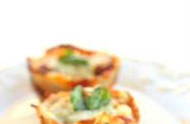
Tiny Indulgence
Smaller sized portions of comfort food meet health concerns with cravings
Implications - Though health consciousness is an increasingly big priority for today's consumer, so to is pleasurable experience. Consumers who feel they shouldn't have to sacrifice flavor for health are instead indulging in smaller portions that are not only more figure-friendly, but better for sharing. Ultimately, consumers are looking to maintain an indulgent lifestyle while still reaping the benefits of sacrifice.
Tiny Savory Treats These Chicken Pot Pie Cupcakes Will Keep You Snacking Sensibly
Compact Sprinkled Snacks The Cupcakes and Cashmere Miniature Baked Donuts Are Tiny
Gooey Grilled Cheese Rolls This Quick Dish Recipe Redesigns a Scrumptious Classic Sandwich
DIY Savory Gumbo Cupcakes Fat Tuesday Meets Mardi Gras with This Gumbo Cupcake Recipe
Bite-Sized Pasta Pastries The 'Girl Who Ate Everything' Lasagna Cupcakes Serve Italian Differently
Lifestyle
Score:
Popularity
DEMOGRAPHICS
5 Ideas + 42 Related Examples
5.1
Activity
http://www.trendhunter.com/id/239020
Freshness
Copyright © TrendHunter.com. All Rights Reserved

Slide 17
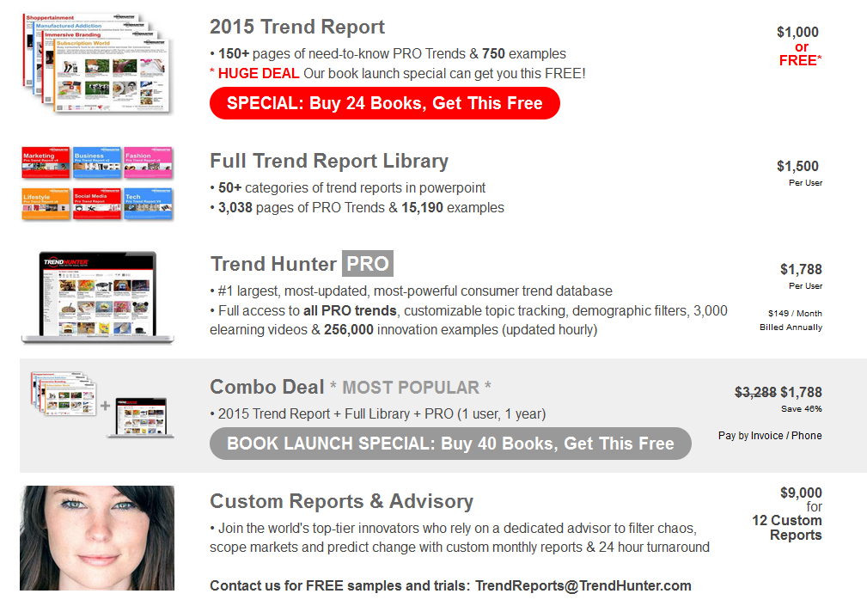
Find Better Ideas in 2015! Order at TrendReports.com
Copyright © TrendHunter.com. All Rights Reserved

Slide 18
Let’s Chat!
Schedule a call or ask a question: TrendReports@TrendHunter.com
Copyright Trend Hunter Inc. - All Rights Reserved. 'Trend Hunter' is the legally registered trademarks of Trend Hunter Inc.

