Slide 1
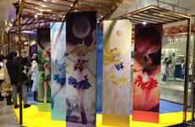
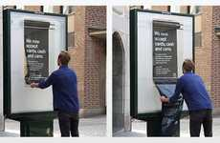
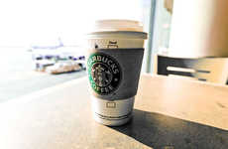
2015
Top 40 Sample Trend Report
Franchise Pop-Up
Automated Discount
Waste Currency
Wearable Payment
Nov 11, 2014 - Copyright © Trend Hunter Inc. This report is for your immediate team’s use only. Please do not distribute, publish or present outside your team. Brought to you by Trend Hunter, the world's most popular, largest trend network, fueled by more than 160,000 contributors and a billion views of data. We help creative innovators like you Find Better Ideas, Faster™

Slide 2
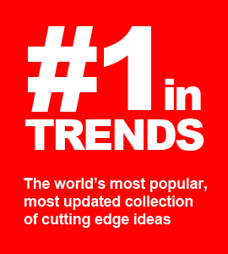
Welcome to 2015!
This year’s Trend Hunter annual report is our best yet because we did nearly 10x more work to filter down to our favorite trends. After pivoting our business to a custom advisory model, we began researching insight with a much larger team, budget and scope, completing roughly 1000 custom research projects. Through that journey we’ve discovered far more inspiring opportunities, with some of our favorites featured in this inspiring report.
Our goal is to help you find better ideas faster. With our data-driven, cost-effective research, we want to help you be more successful with less effort. This year, we are also excited to reveal our groundbreaking trend framework in our upcoming book, “BETTER & FASTER – The Proven Path to Unstoppable Ideas”, coming in March. Put it all together and we want to make this your most inspired year yet!
Be Smarter. Act Faster. Dive Deeper. Save Effort. Win More.
Cheers,
Jeremy Gutsche (jeremy@trendhunter.com)
CEO & Award-Winning Author (JeremyGutsche.com)

Slide 3
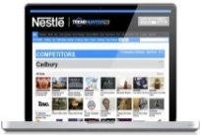
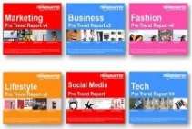
Be More Successful With Less Effort
Our dedicated advisors now help more than a hundred of the world’s top brands to identify opportunity, improve projects and more-quickly explore curiosities
Be Smarter: Identify Opportunity Instead of relying on a guru’s gut instinct, increase certainty with our 100,000,000 person focus group
Save Effort: Get a Dedicated Advisor
Dive Deeper: Improve Projects Find better ideas faster & discover related products that could make project better
Custom Reports
Custom Dashboard
Report
Library
Act Faster: Deep Dive Curiosities Save time & cost-effectively explore curiosities to make sure you never miss a big idea

Slide 4
Get a FREE Sample Custom Report
If you become a Trend Hunter Report customer, let’s hop on the phone for a quick call and we’ll scope out your key topics and show you how incredibly customized we can get!
Retail Tech
Store Apps
In-Store Display
Experience Design
Pop-Up Shops
Store Design
Loyalty Programs
Brand Rituals
Brand Extensions
Co-Branding
Immersive Brand
Digital Branding
Viral Video Strategy
Gen Y Preference
Mommy Bloggers
Meme Culture
Subscriptions
Media Evolution
Personalization
Media Consumption
Custom Design
Adventure Culture
Experience Tourism
Niche Pop Culture
Boomer Wellness
Healthy Living
Health Education
Boomer Apps
Boomer Psychology
Experience Tourism
Young Parents
Teen Culture
DIY Culture
Digital Learning
Night Life
Gen Y Entrepreneurs
Wearable Tech
Mobile Apps
Smart Homes
Future of Interface
Gamification
3D Printing
Digital Marketing
Mobile Marketing
Intentional Viral
QR Codes
Millennial Marketing
Augmented Reality
Digital Education
Superhero Toys
Kids as Adults
Play With Purpose
Buildable Drones
Social Learning
Healthy Snacking
Tricky Diets
Fast Food
Flavor Reversal
Hispanic Flavor
Asian Fusion
Packaging for Pets
Simplicity
Package Innovation
Bottle Innovation
Unique Delivery
Eco Materials
1980s Nostalgia
Retro Americana
Niche Couture
Handbags
Sneaker Culture
Affordable Runway

Slide 5
Find Better Ideas Faster
Learn the award-winning methods we use to accelerate the world's most innovative companies. BETTER and FASTER, our proven method, is launching March 2015 (visit: BetterAndFaster.com)
What great ideas are so close within your grasp?
There are patterns and clues that could lead you to your full potential, but to connect the dots, you'd need to learn a new skill: how to adapt and disrupt. BETTER and FASTER will make you BETTER by teaching you how to overcome evolutionary traps that block smart people and successful teams. Then, it will make you FASTER by teaching you 6 Patterns of Opportunity -- repeatable shortcuts that you can use to find better ideas, faster.
VISIT: BetterAndFaster.com
Pre-order & get FREE research
Buy 24 = Get a custom report (worth $1,000)
Buy 100 = Get 3 * 24 Hour Custom Reports (worth $4,500)

Slide 6
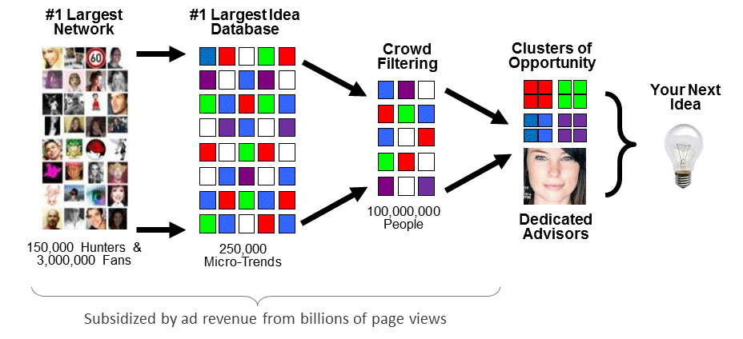
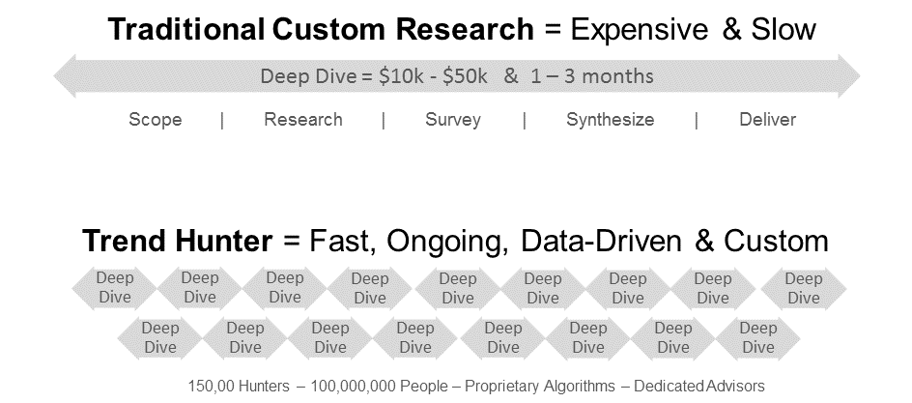
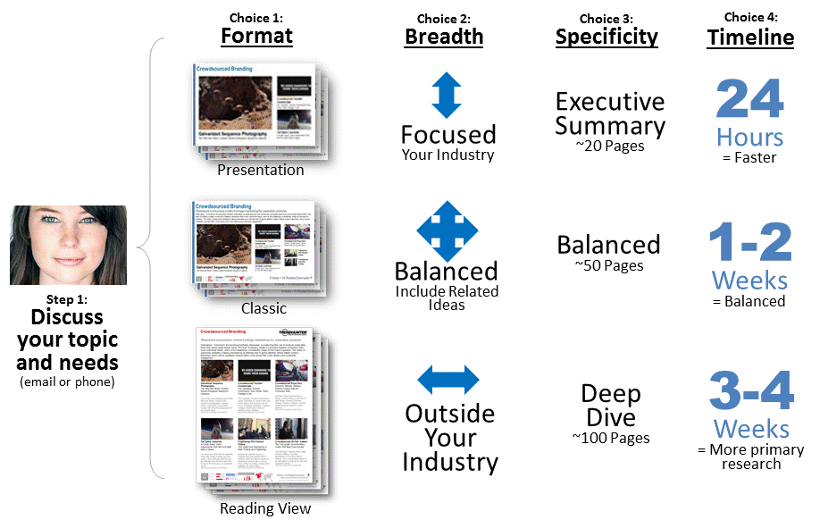
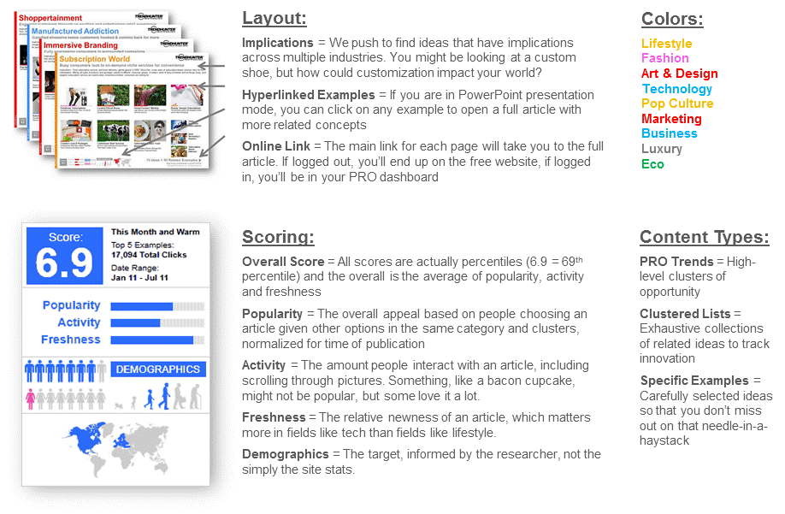
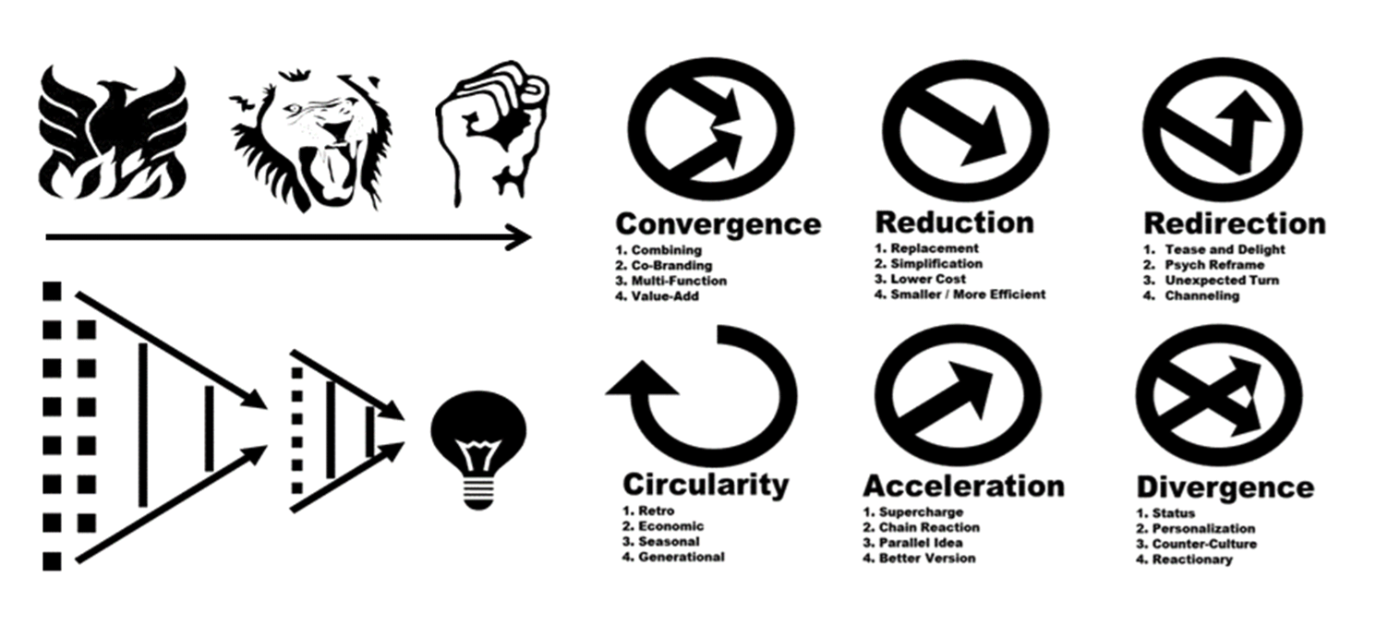
Learn More in the Appendix
For best practices and more info on how we use 150,000 hunters and 100,000,000 people to help you find better ideas faster, check out the appendix
Methodology
Ongoing Deep Dives
Customization Options
Definitions
Online Portal Access
Insight Frameworks

Slide 7
The Top 40
Our Favorite Inspiration for 2015
Our Top 20 Trends are selected through an internal competition between our editors, each picking their favorite insights from our collection of more than 2,000 PRO Trends.
Copyright © TrendHunter.com. All Rights Reserved

Slide 8
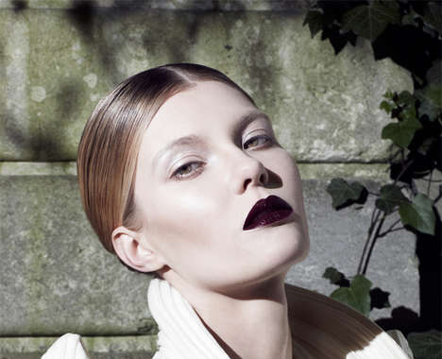
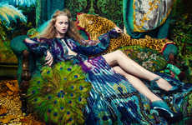
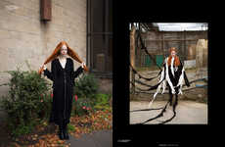
Occult Obsession
Rising witchcraft fascination shows acceptance for counterculture by consumers
Implications - As hipster culture continues to be augmented by consumers looking to stand out, brands are taking notice by highlighting an ethereal, outcast aesthetic as a new way to express individualism. The correlation between a culture shrouded in darkness and counterculture fashion speaks to consumer desire to straddle the line between acceptance and hip, outcast rebel.
Bohemian Nymph Editorials This Photo Series from Absynth Photography is Edgy and Ethereal
Modern Witch Portraits Women of Power by Katarzyna Majak is Full of Magic and Mystery
Witchy Collegiate Catalogs
Occult-Inspired Cosmetic Ads
Neo-Pagan Fashion Editorials This Eclectic Photo Shoot Creates Hidden References to the Occult
Teenage Wiccan Editorials The Little Witch of Greenwich Exclusive for The Ones 2 Watch is Ethereal
Fashion
Score:
Popularity
DEMOGRAPHICS
6 Ideas + 53 Related Examples
7.7
Activity
http://www.trendhunter.com/id/228438
Freshness
Copyright © TrendHunter.com. All Rights Reserved

Slide 9
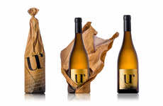
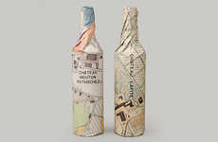
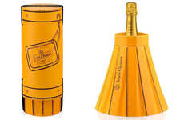
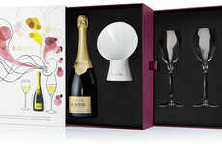
Ritualized Packaging
Brands focus on product experience prior to consumption to enhance prestige
Implications - Adding an additional layer -- figuratively and literally -- to the experience, brands are enhancing the anticipation of products by adding elaborate wrapping or accessories to ritualize the opening. The focus on sensory experience prior to actually consuming the product adds a level of prestige as the ritual requires more time to appreciate and a distinct attention to novelty.
Crumpled Paper Bag Packaging The UR Wine Bottle Comes in a Wrinkled Brown Paper Bag
Topographic Wine Packaging The Waddesdon Wine Rothschild Collection Features a Map Design
Tabbed Bottle Branding OAC Liqueur Packaging Features a Tag for Scribbling a Festive Message
Transformative Champagne Chillers 'Fashionably Clicquot' Changes Shape to Keep Champagne Cold
Sound-Enhancing Champagne Amplifiers Krug Champagne Amplifier Lets You Hear the Sound of Bubbles
Lifestyle
Score:
Popularity
DEMOGRAPHICS
5 Ideas + 41 Related Examples
6.5
Activity
http://www.trendhunter.com/id/227876
Freshness
Copyright © TrendHunter.com. All Rights Reserved

Slide 10
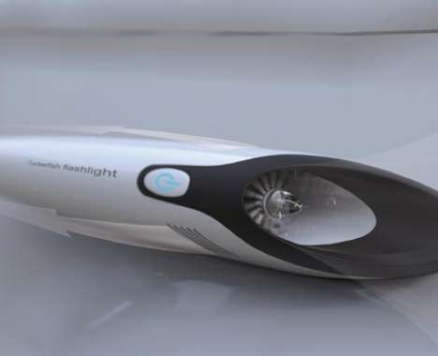
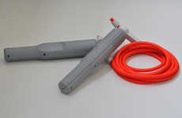
Ecoternative Energy
Moving past solar power, charging devices evolve to be even more efficient
Implications - While the topic of renewable energy is constantly on the lips of politicians and consumers alike, brands are taking the initiative to make the transition to alternative energy seamless and efficient with devices that harness lost energy from mundane tasks. This concept of superfluous energy rebrands green alternatives as an easy way to adopt an eco lifestyle, but only if the means by which to do so is cost-effective and non-invasive.
Parasitic Tablet Enhancers The Wise Pad Integrates a Detachable Device for Calling and Charging
Phone-Charging Exercise Ropes The PULSE Jump Rope Powers Electronics with Play
Parasitic Eco Flashlights The Suckerfish Attaches to Automobiles to Harness Energy to Operate
Bike-Harnessing Power Clips The 'Charging Clip' Powers Your Phone by Leveraging Bikes
Eco
Score:
Popularity
DEMOGRAPHICS
4 Ideas + 35 Related Examples
7.6
Activity
http://www.trendhunter.com/id/229819
Freshness
Copyright © TrendHunter.com. All Rights Reserved

Slide 11
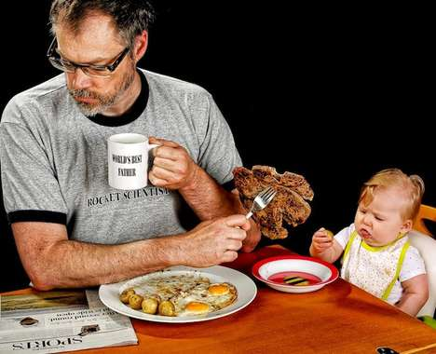
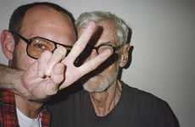
Masculinity Redefined
Fatherly photography suggests a shift toward more familial roles for men
Implications - With women becoming more independent and career-focused due to more open and encouraging educational opportunities, men have subsequently faced a shift in gender roles, integrating themselves into more familial responsibilities that were once dominated by the opposite gender. Reflecting a shift in gender expectations, fatherly photography showcases a turn toward more domestic roles for men, echoing a transformation of traditional familial frameworks.
Poignant Father-Daughter Portraits Ben Nunery and Olivia Reenact Wedding Photos with Late Wife
Adorable Daddy Daughter Selfies This Redditor Took a Bunch of Funny Family Portraits with his Baby
Foxy Father Photoblogs
Adorably Coordinated Familial Shoots
Hilarious Dad-Daughter Portraits World's Best Father by Dave Engledow is Quite the Opposite
Famous Fatherly Photoshoots The Terry Richardson Mom & Dad Book Reveals the Dad behind the Man
Lifestyle
Score:
Popularity
DEMOGRAPHICS
6 Ideas + 54 Related Examples
7.1
Activity
http://www.trendhunter.com/id/235164
Freshness
Copyright © TrendHunter.com. All Rights Reserved

Slide 12
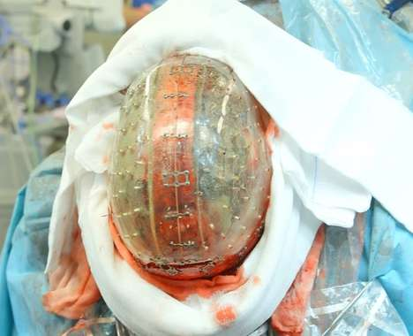
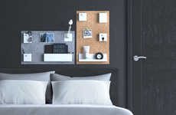
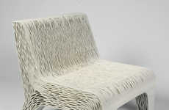
Practical Printing
3D printing expands to offer functional, everyday goods
Implications - The potential of 3D printing is being realized as the market of goods is expanded to include prosthetics, foods, everyday goods and beyond. This shift towards mass adoption of 3D printed goods targets the modern consumer whose preference for convenience and tech-savvy innovations is leading towards full lifestyle immersion.
Wireless Custom Earbuds
3D Printed Facial Surgeries
3D-Printed Home Organizers The Uook Wall Organizer by Build Republic is Customizable
3D Makeup Printers
Edible 3D Drumsticks
3D Printing Food Attachments
3D Printed Skulls Dr. Bon Verweij Successfully Implanted a Tech-Made Cranium in the Netherlands
Flexible Cellular Seating Lilian Van Daal's 3D-Printed Chair is Inspired by Plant Cells
Tech
Fruit-Producing 3D Printers
Score:
Popularity
DEMOGRAPHICS
9 Ideas + 70 Related Examples
8.3
Activity
http://www.trendhunter.com/id/257684
Freshness
Copyright © TrendHunter.com. All Rights Reserved

Slide 13
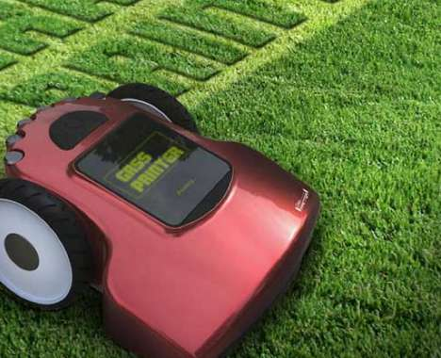
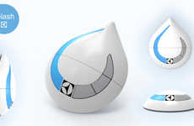
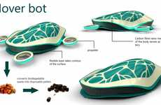
Everyday Robotics
Automatic household devices illustrate a demand for high-tech convenience
Implications - With consumers becoming increasingly busy in their everyday lives, making time to do simple things like chores can be difficult. Robotic household devices seek to make the cleaning process more efficient, allowing consumers the freedom to engage in other activities. This illustrates a growing demand for hyper-convenience.
Sanitizing Robot Snakes The Bio-Cleaner 2 is an Underwater Appliance That Breaks Down Metals
Tiny Window-Washing Bots The Electrolux Splash Scours Every Inch of Exterior Fenestration
Hybrid Vacuum-Mop Robots
Trash-Terminating Robots
Automatic Lawn Letterers The Grass Printer Make Your Yard a Canvas for Literal Communication
Hi-Tech Tortoise Hoovers The Electrolux Hover Bot Cleans Every Surface of Your Home Automatically
Tech
Score:
Popularity
DEMOGRAPHICS
6 Ideas + 53 Related Examples
6.9
Activity
http://www.trendhunter.com/id/228540
Freshness
Copyright © TrendHunter.com. All Rights Reserved

Slide 14
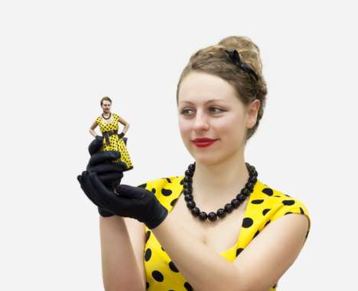
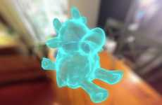
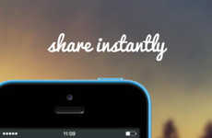
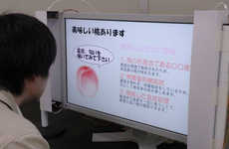
Beyond Visual
Technology that crosses senses adds appeal for consumers
Implications - Synesthesia, a talent once seen as a disability, is the ability to mentally cross senses. A step further, it has become an inspiration for innovation in the tech realm, as consumers seek more unique forms of entertainment. The appeal of being able to hear an image or smell a sound is not just a novelty, it's a means of using technology to break natural boundaries and ultimately, redefine communication.
3D Selfie Apps The 'Itseez3D' App Converts Your Selfies into 3D Images
Visual Social Search Engines The Jelly Visual Search Engine Has Heart
3D-Printed Selfies Using 3D Printing Technology, Shapify Lets You Print Yourself
Embedded Sound Photo Apps The Melodigram App Adds Sounds and Music to Photos
Scent-Infused Television The IEEE Virtual Reality Orlando Conference Unveils Novel Shows
Tech
Score:
Popularity
DEMOGRAPHICS
5 Ideas + 45 Related Examples
7.4
Activity
http://www.trendhunter.com/id/255659
Freshness
Copyright © TrendHunter.com. All Rights Reserved

Slide 15
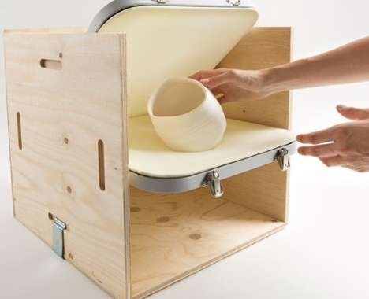
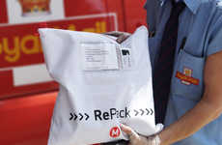
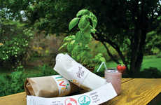
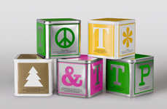
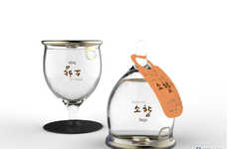
Reusable Packaging
Offering a fun, eco alternative, brands focus on use after consumption
Implications - A product design that is too disposable is being panned by consumers for the harsh effect it can have on the environment, which has resulted in packaging designed for a second use or purpose. This shift appeals to the eco-friendly consumer, but also those interested in novel product design and function.
Reusable E-Retail Packaging RePack is a Concept That Helps Online Retailers Reduce Waste
Plantable Gourmet Packaging Live Food Bar Packaging by Amelia Roblin Grows Garden Herbs
Reusable Protective Packaging Fragile by Mireia Gordi Vila Could Do Away with Styrofoam Peanuts
Alphabetic Block Branding Johan & Nystrom Tea Packaging Embodies the Basics in Form and Principle
Topsy-Turvy Drink Containers This Concept Drink Packaging Design Features Single RTD Portions
Eco
Score:
Popularity
DEMOGRAPHICS
5 Ideas + 45 Related Examples
7.8
Activity
http://www.trendhunter.com/id/256871
Freshness
Copyright © TrendHunter.com. All Rights Reserved

Slide 16
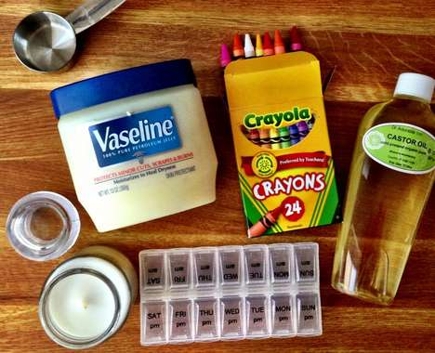
Chemical Revolt
Rebelling against brands, consumers opt to create natural products at home
Implications - While the price of personal care items isn't exceedingly high, the number of chemicals used to create them is, which is a contributing factor as to why DIY cosmetics are becoming more widespread across North America. Able to naturally customize and create only what they'll use, DIY sundries mark a shift towards penny-pinching consumers who also have particular tastes that prefer their own product made just the way they like it.
DIY Beeswax Soap Bars This Easy-to-Make Facial Lotion is Made from All-Natural Products
DIY Body Cream Make Whipped Shea Butter Lotion with This Easy Recipe
DIY Crayon Lip Colours These DIY Crayon Lipsticks Will Save You Cash and Help You Look Impressive
Homemade Hydrating Face Mists Beat the Dry Winter Season with a DIY Beauty Product
Art & Design
Score:
Popularity
DEMOGRAPHICS
4 Ideas + 35 Related Examples
7.9
Activity
http://www.trendhunter.com/id/228495
Freshness
Copyright © TrendHunter.com. All Rights Reserved

Slide 17
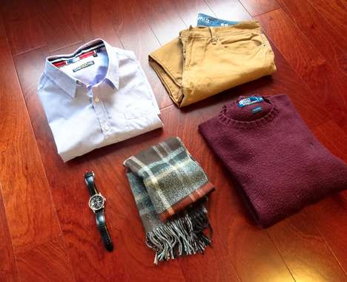
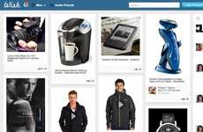
Clairvoyant E-Tail
Instead of shopping, consumers are told what to buy from in-the-know retailers
Implications - While the push towards customization in retail has been beneficial for both buyer and seller, consumers are craving the next level of shopping, which consists of being told precisely what to purchase. Offering minimal choice and requiring little effort by the consumer, brands direct buyers to the exact items they should buy to satisfy a desire for hyper-personalization.
Price-Based Search Engines WannaSpend Suggests Gift Ideas That Match Your Budget to Save Time
Interactive High-Tech Mannequins teamLabHanger Created Virtual Mannequins That are Hanger-Signaled
Monthly Menswear Clothing Subscriptions The Mr. Club Lets Men Borrow and Buy Outfits Monthly
Single Dress Retailers The 'One Dress a Day' Platform Will Sell a New Dress Every Day
Clairvoyant Shopping Apps The 'Wish' App Knows What You Want Before You Do
Business
Score:
Popularity
DEMOGRAPHICS
5 Ideas + 44 Related Examples
6.5
Activity
http://www.trendhunter.com/id/228194
Freshness
Copyright © TrendHunter.com. All Rights Reserved

Slide 18
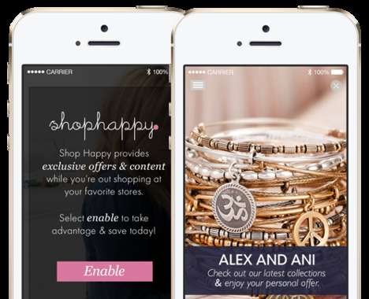
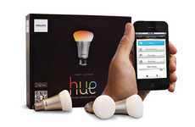
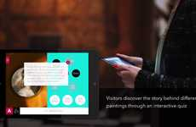
Responsive Retail
Beacon technology is creating a more interactive, streamlined retail experience
Implications - Beacon technology, a responsive innovation creeping its way into the mainstream, is changing the possibilities and capabilities of retail. Able to automate and even customize the shopping experience, this shift will appeal to the tech-savvy consumer looking to streamline everyday tasks. By creating a more straightforward and intuitive shopping experience, brands that adopt this technology will likely lead in terms of attracting consumers who strongly value efficiency over personal connection in their busy lives.
Illuminated Retail Apps Philips Introduces New Connected Retail Lighting System
Futuristic Shopping Beacons The ‘Estimote’ Uses Your Smartphone to Customize Your Shopping Trips
Beacon-Powered Retail Platforms Swirl's Mobile Marketing Platform Engages Consumers on a New Level
Illuminated Personal Shoppers This LED Retail Lighting System Leads Shoppers to Their Product
Interactive Gallery Apps Prophets' Innovative Experience Lets People Interact with Art
Tech
Score:
Popularity
DEMOGRAPHICS
5 Ideas + 42 Related Examples
6.2
Activity
http://www.trendhunter.com/id/237554
Freshness
Copyright © TrendHunter.com. All Rights Reserved

Slide 19
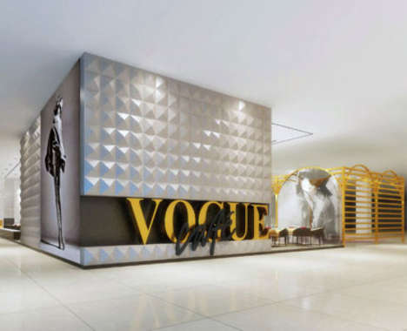
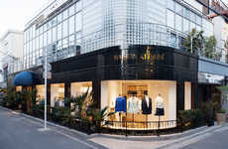
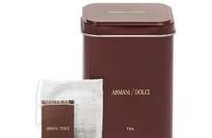
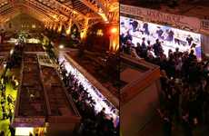
Expanded Luxury
Luxury brands expand with more approachable services for consumer appeal
Implications - While luxury retailers often rely on consumer loyalty and brand recognition, such singular marketing tactics often prevent exposure to more diverse audiences. Expanding appeal, couture brands are opening up cafes and food venues to offer everyday approachability to their brand experience.
Contemporary Fashion Cafes The Maison Kitsune Tokyo Store is an Intergrated Model
Haute Couture Coffeeshops The New 'Armani/Caffé' Boutique Combines High Fashion a
Fashion Magazine-Branded Cafes The Vogue Cafe is a New Addition to the Dubai Mall
Converted Upscale Market Venues The Prada Market is a Grocery Store Turned Event Venue
Business
Score:
Popularity
DEMOGRAPHICS
4 Ideas + 36 Related Examples
6.5
Activity
http://www.trendhunter.com/id/246642
Freshness
Copyright © TrendHunter.com. All Rights Reserved

Slide 20
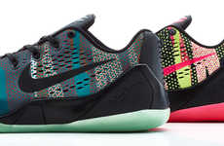
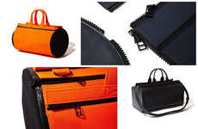
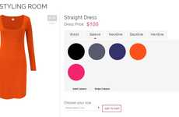
Bespoke E-Commerce
The demand for one-of-a-kind goods sparks an autonomous custom economy
Implications - Custom tailored products are coveted by consumers, which is being addressed by brands with online custom services. As consumers become increasingly dependent on eCommerce, the rise of customized goods ordered online satisfies the the lack of a physical shopping experience.
3D-Printed Product Stores
Customizable Athletic Prosthetics
Customizable Camo Sneakers The Nike Kobe 9 EM 'Pop Art Camo' Collection is Rugged Chic
Makeshift Customizable Handbags These Handbags Make Sure You Never See Someone with the Same Gear
Bespoke Dress Design Platforms Rose Athena's Custom Dress Creations Turn Consumers into Designers
Custom 3D Printed Jewelry
Collapsable Custom Slippers
Customizable Hipster Eyewear
DIY Ethical Urban Sneakers The Po-Zu Customizable Socially Aware Shoe Lets You Adapt the Design
Completely Customizable Menswear Original Stitch Lets Men Make the Shirt of Their Dreams
Custom Shirt Builders Shirts My Way Lets You Create Your Own Tops from Scratch
Fashion
Score:
Popularity
DEMOGRAPHICS
11 Ideas + 98 Related Examples
8.2
Activity
http://www.trendhunter.com/id/258396
Freshness
Copyright © TrendHunter.com. All Rights Reserved

Slide 21
Haute Unkempt
As brands aim to appear approachable, high fashion is given an unpolished overhaul
Implications - While the traditional route for fashion brands is to create a lifestyle to aspire to, the roles have been reversed with models made to look less polished. This highlighting of imperfection relates to consumers on a more personal level and creates a relationship where viewers feel less intimidated.
Mud-Splattered Editorials This Fall Fashion Editorial Comes From Die Presse Magazine
Muddy Model Closeups Tyler Maher Stars in the Hackney Boy Editorial for F****** Young! Online
Troubled Model Captures F****** Young! Online's Psychosis Editorial Deals with Dark Subjects
Mud-Splattered Model Closeups Sergio Garcia's Dirt Editorial Highlights Gritty Imagery
Fashion
Score:
Popularity
DEMOGRAPHICS
4 Ideas + 36 Related Examples
6.4
Activity
http://www.trendhunter.com/id/256778
Freshness
Copyright © TrendHunter.com. All Rights Reserved

Slide 22
Tech Paranoia
As RFID gains more popularity, consumers protect themselves against theft
Implications - As more credit cards and smartphones adopt RFID technology, the issue of mobile security is taking centerstage for consumers, which is being soothed with anti-wireless theft accessories. The move towards these more formalized ways to prevent wireless theft identifies the strong demand for "tap and go" payment solutions, but also a preference to deal with the associated effects without having to give up convenience technologies.
Anti-Wireless Theft Wallets
Theft-Blocking Wallets
Hacker-Proof Travel Totes The New Tumi ID Lock Collection Blocks RFID Signals
Stainless Steel Wallets
Practical Mesh Wallet Organizers
Anti-Identity Theft Wallets The Anti-Identity Theft Wallet Blocks Radio Signals From Intrusion
Minimalistic Metal Money Holders The Zippo Stainless Steel Wallet is Expertly Crafted
Tech
Score:
Popularity
DEMOGRAPHICS
7 Ideas + 59 Related Examples
6.7
Activity
http://www.trendhunter.com/id/225145
Freshness
Copyright © TrendHunter.com. All Rights Reserved

Slide 23
Waste Currency
Brands accept waste as a payment for goods to reinforce positive perceptions
Implications - Consumers are becoming more aware of how their habits affect the environment, which a number of brands are taking in stride by accepting waste as a form of payment. This active push for recycling helps reinforce a positive image of the brand for consumers and align previously wasteful brands with eco-conscious customers.
Incentivized Recycling Machines The Envirobank Recycling Machine Offers Prizes for Cleaning Litter
Bottle Deposit Train Tickets Plastic Recycling Could Get You a Free Transit Pass in Beijing
Can Currency Campaigns McDonald's Stockholm Lets Youth Trade in Bags of Recycled Cans For Burgers
Charitable Airport Regulations The Frankfurt Airport Recycling Bank Makes Giving Up Bottles Easier
Bartering Biomass Teahouses The Methane Cafe is an Eco Cafe in Japan That Trades Trash for Tea
Eco
Score:
Popularity
DEMOGRAPHICS
5 Ideas + 43 Related Examples
8.2
Activity
http://www.trendhunter.com/id/258346
Freshness
Copyright © TrendHunter.com. All Rights Reserved

Slide 24
Compostable Couture
Biodegradable fashion rises as the eco boom wavers on
Implications - The eco movement is expanding into unexpected markets like fashion to the delight of consumers. The rise of biodegradable clothing supports the fast fashion economy that's centered around disposability, and broadens the market appeal for consumers concerned with sustainable production practices.
Compostable Wedding Dresses This Biodegradable Clothing Line Consists of Fungus-Grown Gowns
Compost-Friendly Fabrics F-abric is Designed to Biodegrade Quickly Once Placed in a Compost Heap
Printed One-Use Undergarments Always Have Clean Delicates with 3D-Printed Disposable Underwear
Biodegradable Eco-Friendly Eyewear Protect Your Eyes & the Planet with these Sustainable Shades
Disintegrating Dust Jewelry Designer Agusta Sveinsdottir's Jewelry is Coated with Dust Particles
Eco
Score:
Popularity
DEMOGRAPHICS
5 Ideas + 44 Related Examples
7.6
Activity
http://www.trendhunter.com/id/259211
Freshness
Copyright © TrendHunter.com. All Rights Reserved

Slide 25
Ritualized Collaboration
Brands expand the product lifestyle with 'aftermarket' mods
Implications - The days of singular products are numbered as the notion of co-branding and collaboration take center stage in the market. Iconic products or celebrity endorsements are pushing into new areas of marketing that ritualize two seemingly separate products. Creating a market where one seemingly requires the other to be complete, brands are evolving the traditional notion of collaboration to the point of perceived dependence for consumers looking for ways to expand their own personal repertoire of brand prowess.
Stemware-Inspired Cups The Coca-Cola + Riedel Glass was Sculpted to Enhance Beverage Enjoyment
Beer-Branded Denim The Heineken X Neighborhood Denim Collection Exudes Quality
Boy Band Cosmetic Collections
Famous DJ Skateboard Art
Designer Headphone Collaborations The Dr. Dre Alexander Wang Beats Produce the Sounds of Luxury
Superhero Skincare Brandings Kiehl's Facial Fuel Heavy Lifting Cream is Captain America-Approved
Marketing
Score:
Popularity
DEMOGRAPHICS
6 Ideas + 54 Related Examples
5.8
Activity
http://www.trendhunter.com/id/234525
Freshness
Copyright © TrendHunter.com. All Rights Reserved

Slide 26
Upscaled Convenience
Microwaved goods are upgraded to satiate consumer demands for fast indulgence
Implications - While microwaved goods are associated with convenience for consumers, they're also viewed as being the lesser option, which is being changed with products and recipes that upscale the final product. The products marry time savings and flavor, creating even more incentive to choose a convenient option.
1-Minute Microwave Donuts Kirbie Cravings Creates an Easy Chocolate Dessert
Canned Cake Batter The Spray Cake is Premade Cake Batter in an Aerosol Can
Quick Microwave Quiches Daisy Bun of Full Thyme Student Shares an Easy Healthy Recipe
Microwaveable Breakfast Meals 'Hormel Compleats Good Mornings' is a Line of Microwave Breakfasts
Family-Friendly Microwaveable Treats These Farm Rich Snacks Include Both Savory & Sweet Offerings
Lifestyle
Score:
Popularity
DEMOGRAPHICS
5 Ideas + 24 Related Examples
5.4
Activity
http://www.trendhunter.com/id/256174
Freshness
Copyright © TrendHunter.com. All Rights Reserved

Slide 27
Routine Rental
Rental services offer more basic consumer goods for practicality
Implications - While rental services often sway toward more high-end services, a growth in more compact and sustainable living has consumers seeking out more basic rental options. Offering the temporary use of kitchen appliances and children's toys, unique rental options provide individuals with the convenience of basic goods without any long-term commitment.
Cell Rental Kiosks
Camping Gear Rentals
Bike-Promoting Community Companies 'Get Cycling' is a Social Enterprise Promoting a Healthy Life
Hair Extension Rental Services
Cooking Appliance Rentals
Toy Rental Services Pley Lets People Rent LEGO Sets Instead of Buying Them
Toy Car Rental Agencies Hot Wheels' Rental Car Agency Helps Determine the Hottest Models
Business
Score:
Popularity
DEMOGRAPHICS
7 Ideas + 54 Related Examples
7.0
Activity
http://www.trendhunter.com/id/260107
Freshness
Copyright © TrendHunter.com. All Rights Reserved

Slide 28
Artificial Emotion
Stretching beyond the idea of artificial intelligence in robotics
Implications - Though the initial intention of robotics is to automate, today's individuality-driven consumer is seeking something less cold from their automatons. This stretches past artificial intelligence and into the realm of artificial emotion. Robots are being programmed to respond, conversate and nurture to provide the tech-obsessed consumer with a companion, not just a helper.
Self-Teaching Robots
Humanizing Robot Sensors
Emotional Humanoid Robots Alderbaran Created the World's First Emo Robot
Responsive Robots
Charmingly Conversational Talking Teddies
Hyperreal Android Newscasters Hiroshi Ishiguro Created Life-Like Robots That Relay the News
Autism Assisting Robots The NAO Robot Helps to Teach Children with Autism
Tech
Score:
Popularity
DEMOGRAPHICS
7 Ideas + 61 Related Examples
6.3
Activity
http://www.trendhunter.com/id/261195
Freshness
Copyright © TrendHunter.com. All Rights Reserved

Slide 29
Social Rebranding
Big brands turn to niche networking to create a more genuine overall appeal
Implications - As companies grow in size, so too do their marketing approaches, often resulting in campaigns that feel overly exaggerated and hard to relate to. Seeking to acquire more of a genuine appeal that often falls in line with smaller, start-up retailers, big name brands are turning to social media platforms to engage with consumers on a more interactive, and personal level. Targeting consumers and their need for social communication, conglomerates are using conversational techniques to bring an air of humor and approachability to large-scale, corporate enterprises.
Chocolate Social Media Feuds Kit Kat Challenges Oreo to Twitter Tic-Tac-Toe with Hilarious Results
Planetwide Selfie Campaigns For Earth Day 2014, NASA is Helping the Earth Take a Selfie from Space
Social Media Tribute Beers
Social Media Burger Songs
Bribing Social Campaigns This Newcastle Brown Ale Twitter Campaign Will Pay You $1 for Following
Fast Food Launching Snaps The McDonald's Snapchat Account Will Feature LeBron James
Marketing
Score:
Popularity
DEMOGRAPHICS
6 Ideas + 54 Related Examples
6.2
Activity
http://www.trendhunter.com/id/240349
Freshness
Copyright © TrendHunter.com. All Rights Reserved

Slide 30
Shopping Independence
High-tech retail locations offer single shoppers a streamlined experience
Implications - Consumers often opt to shop with companions, but as daily demands rise and many shop solo, brands are offering assistance through technological innovations. This shift towards catering to the individual shopper is drawing consumers who would otherwise shop online back into stores, and offers an experience that suits their schedule.
Instantly Shoppable Ads Le Fast Shopping Lets You Scan an Ad, Buy & Receive Within 48 Hours
Interactive Storefront Displays +rehabstudio Integrates Shopping with Technology
Simulated Shop Assistants
Lifelike Shopping Apps
Shopping Consultation Apps The Fitt App Provides a Second Opinion When Shopping
Retail Recommending Booths Inspiration Corridor Offers Fashion Suggestions and Helps Locate Items
Business
Score:
Popularity
DEMOGRAPHICS
6 Ideas + 49 Related Examples
6.9
Activity
http://www.trendhunter.com/id/250357
Freshness
Copyright © TrendHunter.com. All Rights Reserved

Slide 31
Anti-Social Media
Users rebel against social media to show disdain for its ubiquitous nature
Implications - While the number of users on social networks continues to rise, those who negate the usage of the tools are making opinions heard by spoofing and shaming the interactions that have become commonplace in society. The surge of anti-social media followers highlights the spastic nature of millennial demographics and an insatiable tendency to gravitate towards counterculture ideas.
Online Friendship-Testing Stunts Greg Benson Goes Out to Visit His Real Life Facebook Friends
Ironic Social Media Shirts People Who Hate People Who Over Tag Should Wear the Hashtag T-Shirt
Selfie Shaming Sites The Selfie Police Website Asks Self-Portrait Offenders to Pay Up for Charity
Anti-Tweeting Spoof Songs Chescaleigh's Song About Twitter is Set to No Doubt's 'Don't Speak'
Pop Culture
Score:
Popularity
DEMOGRAPHICS
4 Ideas + 35 Related Examples
6.5
Activity
http://www.trendhunter.com/id/228580
Freshness
Copyright © TrendHunter.com. All Rights Reserved

Slide 32
Digital De-Stress
As overworking becomes commonplace, consumers look to tech for comfort
Implications - As consumers become anxious as a result of constant connectivity, the subsequent reliance has many looking to technology for relief. The rise of tech-based anxiety management and monitoring denotes a preference for quick, familiar conveniences over those requiring additional time or resources.
Stress Management Selfie Apps The Dina Re:lax Stress Measurement Tool Measures Pulse with Selfies
Anxiety-Tracking Underwear The Stress-Monitoring Bra by Microsoft Research Pinpoints Moodswings
Stress-Relieving Massage Helmets
App-Connected Meditation Flowers
Hi-Tech Stress Balls Bossy is a Unique Stress Ball Will a Ton of Tech Capabilities
Breath-Monitoring Wearables This Activity Tracker App and Stone is Designated for State of Mind
Tech
Score:
Popularity
DEMOGRAPHICS
6 Ideas + 53 Related Examples
6.1
Activity
http://www.trendhunter.com/id/256706
Freshness
Copyright © TrendHunter.com. All Rights Reserved

Slide 33
Pinocchioism
Inanimate objects come to life to the delight of consumers
Implications - As technology advances and consumers attention spans shrink, it becomes harder to advertise without some level of novelty. Bringing inanimate objects to life through augmented reality provides this novelty while simultaneously adding a sense of fantasy to a consumer's (otherwise mundane) day.
Simulated Shop Assistants Clarins Promotes the Alien Eau Extraordinaire with a Virtual Assistant
Movement-Mimicking Mannequins The United Arrows Marionettebots Attract Customers Through Motion
Yeti Storybook Window Displays The Saks Fifth Avenue Holiday Window is an Interactive Experience
Augmented Reality Bus Ads The Pepsi MAX Ad Creates Shocking Scenes for People Waiting for Buses
Marketing
Score:
Popularity
DEMOGRAPHICS
4 Ideas + 36 Related Examples
6.8
Activity
http://www.trendhunter.com/id/255929
Freshness
Copyright © TrendHunter.com. All Rights Reserved

Slide 34
Socialized Purchase
Offering guidance, social media apps offer accessible advice when shopping
Implications - As social media continues to become further integrated into consumer behavior, traditional methods of retail and peer-to-peer interaction are being replaced with more high-tech, social alternatives. Turning shopping experiences into opportunities to network, consumers are utilizing apps like Instagram and Twitter to get recommendations on style and fit, reflecting a desire for peer approval.
Crowdsourced Fashion Retail A New Site Could Completely Change Plus Size Online Shopping
Social Media Retail Stores The Paytagz Website Makes a Full Retail Experience Out of Instagram
Shopping Consultation Apps The Fitt App Provides a Second Opinion When Shopping
Hashtag-Driven Fashion Recommendations Zappos Teams with Instagram to send #OOTD Shopping Tips
Photo-Based Retail Services Hashbag's Marketplace Service Identifies Items for Sale on Instagram
Business
Score:
Popularity
DEMOGRAPHICS
5 Ideas + 45 Related Examples
7.2
Activity
http://www.trendhunter.com/id/246516
Freshness
Copyright © TrendHunter.com. All Rights Reserved

Slide 35
Multisensory Marketing
A desire to connect with consumers has brands targeting different senses
Implications - Seeking to interact with consumers on a deeper level, brands are turning to campaigns that target different senses. Integrating features like touch and smell into their advertisements, brands are using dynamic campaigns to encourage user participation, reflecting a desire for marketing tactics that go above and beyond aesthetic interest.
Touch-Activated Denim Ads Hiut Denim Co.'s Interactive Shop Window Encourages People to Touch
Sound-Producing Posters The Sound of Taste Reacts to a Person's Touch
Interactive Floral Walls Gucci's Infinity of Flowers Lets Shoppers Interact with Digital Petals
Cheesy Museum Pop-Ups Castello's Pop-Up Cheese Tasting Appeals to Multiple Senses
Interactive Shadow Booths K&H's Interactive Mobile Ad Stages a Phone-Activated Shadow Play
Marketing
Score:
Popularity
DEMOGRAPHICS
5 Ideas + 45 Related Examples
7.0
Activity
http://www.trendhunter.com/id/261301
Freshness
Copyright © TrendHunter.com. All Rights Reserved

Slide 36
Social Crowdfunding
Goods are now being crowd financed via niche online communities
Implications - With the popularity of crowdfunding platforms such as Kickstarter and RocketHub growing fast, these virtual marketplaces have had an enormous impact on entrepreneurship, consumerism and the way we think about business as a whole. Consumers are now eager to become more involved -- on a more public, shareable platform -- with the companies they purchase their goods from.
Social Crowdfunding Platforms
Curated Crowdfunded Marketplaces
Neighborhood Crowdfunding Websites Spacehive is a Fundraising Platform for Public Space Projects
Community Funding Platforms
Crowdfunded Computer Development
Crowdfunding for Social Start-ups
Crowdfunding Apps SellanApp Lets Anyone Gain Funding and Connect with Developers
Crowdfunded Social Innovator Sites â€˜StartSomeGood' Grows Purpose-Driven Initiatives
Business
Score:
Popularity
DEMOGRAPHICS
8 Ideas + 59 Related Examples
4.8
Activity
http://www.trendhunter.com/id/184566
Freshness
Copyright © TrendHunter.com. All Rights Reserved

Slide 37
Constricting Consumption
Consumers monitor utility usage in a bid to drastically decrease usage
Implications - Taking an even more restrictive approach to the green movement, consumers are opting for devices and solutions that put a cap on consumption to ensure they only use within certain limits. This attention to utility constriction is a consumer-driven acceptance of an inability to be mindful of consumption. Speaking also to those unscathed by high utility use, the products induce guilt to make consumers who are unaware of resource depletion more mindful.
Energy-Monitoring Devices Schneider Electric Wiser Measures Domestic Electricity Consumption
Smart Eco Adapters The Parce One Disconnects Your Plugged-In Devices When They're Not Needed
Shame-Inducing Shower Heads The Uji Shower Head Ensures People Don't Waste Water
Appliance-Controlling Adapters The Zuli Smartplug Turns Lights on Automatically When You Enter
Dictatorial Energy Systems The Valta Energy Management System Gives You Complete Energy Control
Eco
Score:
Popularity
DEMOGRAPHICS
5 Ideas + 45 Related Examples
5.7
Activity
http://www.trendhunter.com/id/229382
Freshness
Copyright © TrendHunter.com. All Rights Reserved

Slide 38
Social Exclusivity
Seeking confidentiality, consumers turn to private methods of online engagement
Implications - With online engagement offering a conveniently instantaneous mode of communication, public scrutiny and mass involvement can make personal interaction problematic. Seeking methods of socialization in a more exclusive manner, tech-savvy consumers are turning to ultra-private mobile features that help limit users and disguise messages in the blink of an eye. This reflects a shift towards more intimate, yet equally social methods of peer-to-peer engagement.
Anonymous Social Apps
Incognito Flirting Apps
Anonymity-Protecting Smartphones Protect Your Privacy with the New Blackphone
Ultra-Secure Smartphones
Self-Destructing Messaging Apps
Private Picture Posting Apps
Secret Social Chat Apps This Exclusive Social Network App Only Works In Applebee's Restaurants
Vanishing Message Apps The Confide App Shows off Its Snapchat-Like Messaging at CES 2014
Tech
Score:
Popularity
DEMOGRAPHICS
8 Ideas + 69 Related Examples
5.7
Activity
http://www.trendhunter.com/id/245768
Freshness
Copyright © TrendHunter.com. All Rights Reserved

Slide 39
Cause Reappropriation
Brands and activists remix campaigns and causes to be more forward-thinking
Implications - As inequality continues to remain a poignant issue around the world, companies and activists alike are taking a page from one another's manuals to take said issues to a more mainstream audience. Whereas corporations were once encouraged to remain as neutral as possible in regard to controversial issues, it is now understood that in order for a brand to appeal to the impassioned millennial, it must take a stand.
Satirical Olympic Sponsorship Videos
Epic Icy Challenges
LGBT Parody Olympic Sites This Website Protests Sponsorship of the Sochi 2014 Winter Olympic Games
Activist Ice Cream Campaigns
Prideful Gaming Consoles
Patriarchy-Spinning Twitter Accounts
Reappropriated Pride Posters These LGBT Posters Rework Soviet Propoganda into Gay Pride
Charitable Chicken Chain Videos KFC's Colonel Takes on the ALS Ice Bucket Challenge for Charity
Social Good
Scientific LGBT Pride Posters
Score:
Popularity
DEMOGRAPHICS
9 Ideas + 70 Related Examples
7.7
Activity
http://www.trendhunter.com/id/232975
Freshness
Copyright © TrendHunter.com. All Rights Reserved

Slide 40
Tiny Indulgence
Smaller sized portions of comfort food meet health concerns with cravings
Implications - Though health consciousness is an increasingly big priority for today's consumer, so to is pleasurable experience. Consumers who feel they shouldn't have to sacrifice flavor for health are instead indulging in smaller portions that are not only more figure-friendly, but better for sharing. Ultimately, consumers are looking to maintain an indulgent lifestyle while still reaping the benefits of sacrifice.
Tiny Savory Treats These Chicken Pot Pie Cupcakes Will Keep You Snacking Sensibly
Compact Sprinkled Snacks The Cupcakes and Cashmere Miniature Baked Donuts Are Tiny
Gooey Grilled Cheese Rolls This Quick Dish Recipe Redesigns a Scrumptious Classic Sandwich
DIY Savory Gumbo Cupcakes Fat Tuesday Meets Mardi Gras with This Gumbo Cupcake Recipe
Bite-Sized Pasta Pastries The 'Girl Who Ate Everything' Lasagna Cupcakes Serve Italian Differently
Lifestyle
Score:
Popularity
DEMOGRAPHICS
5 Ideas + 42 Related Examples
5.1
Activity
http://www.trendhunter.com/id/239020
Freshness
Copyright © TrendHunter.com. All Rights Reserved

Slide 41
Competitive Reward
Brands heighten rewards by offering game-like challenges
Implications - Turning brand involvement into a competitive activity, retailers are using challenges to incite consumer interest. Requiring strategic thought and dedication, these reward-driven activities help consumers become more personally invested in the experience, providing a sense of satisfaction and fulfillment.
Geeky Code-Revealing Graffiti This UK Graffiti Project Challenges Geeks to Crack a Secret Code
Remote High-Five Challenges KLM's Fun Campaign Challenged People to Virtually High Five Someone
Competition Driven Travel Apps The Voyando Travel Site Makes Hunting for Deals a Competition
Rewarding Fruit Harvest Games Japanese Game 'Gochipon' Doles Out Real Watermelons to Top Players
Business
Score:
Popularity
DEMOGRAPHICS
4 Ideas + 36 Related Examples
6.0
Activity
http://www.trendhunter.com/id/259922
Freshness
Copyright © TrendHunter.com. All Rights Reserved

Slide 42
Action-Less Interface
Surfing and interactivity online is now achieved with little to no effort
Implications - Technology is created for the purpose of convenience, and taking that to the next level, sites and apps are boasting intuitive software and voice activation that doesn't even require one to click a mouse. This speaks in the human desire to do as little as possible yet still enjoy results.
Artisan Sketch Tablets The Wacom Drawing Tablet and Intuos Pen Lets You Sketch Digitally
Realistically Responsive Software MAKO Obeys Voice Commands Like 'Read' or 'Write'
Voice Command Computer Software MAKO Aids the Impaired for a Very Affordable Price Each Month
Audio-controlled Search Engines The Okay Google Device Enables Users to Surf Via Voice Commands
Gesture-Tracking Keyboard Research Microsoft's Motion Sensing Keyboard was Explored as a Prototype
Tech
Score:
Popularity
DEMOGRAPHICS
5 Ideas + 45 Related Examples
5.6
Activity
http://www.trendhunter.com/id/245624
Freshness
Copyright © TrendHunter.com. All Rights Reserved

Slide 43
Swap Commerce
Offering discounts for product exchanges, brands push for continued patronage
Implications - In an age where online shopping is growing even more ubiquitous each quarter, the scramble to encourage continued patronage when competition is virtually endless is intensifying the focus for retailers more than ever. As such, the seemingly retro concept of exchange for a discount is being adopted as a means to fulfill consumer demand for savings and brand requirement to have them return. This business model is also augmenting brands to be more ecologically sustainable as a result, thus broadening consumer perception.
Food-Swapping Websites 'Foodsharing.de' Community Exchanges Edibles to Reduce Waste
Bottle-Eliminating Perfume Refillers Thierry Mugler Brings an Eco-Friendly Approach to Cosmetics
Food Waste Discounts Diners Exchange Food Waste for Reduced Restaurant Rates
Recycling Bin Beer Dispensers 'Sol Beer' Showcases Strangers Exchanging Their Ties for Beers
Digital Consignment Boutiques The Trend Trunk Helps You Sell Your Unwanted Clothes Online
Lifestyle
Score:
Popularity
DEMOGRAPHICS
5 Ideas + 45 Related Examples
5.3
Activity
http://www.trendhunter.com/id/237113
Freshness
Copyright © TrendHunter.com. All Rights Reserved

Slide 44
Meta-Marketing
Brands thrive for authenticity, making use of self-aware marketing tactics
Implications - The shift from over-the-top marketing campaigns to more subtle forms of print and television ads has become apparent. Particularly with the rise of millennial purchasing power, brands are looking for ways to appeal "real" to this consumer segment and self-mockery is becoming a fast track to become relatable to Gen Y. This form of advertising is now moving beyond marketing and beginning to bleed into other areas such as packaging and retail spaces.
Hilarious Anchorman Auto Ads
Comedic Toilet Humor Ads
Celebrity Parody Beer Ads Anna Kendrick Lends a Helping Hand in This Newcastle Brown Ale Ad
Compliant Beer Ads
Stereotype-Busting Auto Ads
Mysteriously Nutty Teaser Ads
Nonsense-Spotting Apps DDB Tribal Dusseldorf's Bingo App Points Out the BS in Advertising
Hilarious Slo-Mo Booze Ads Seth & Riley's Garage Hard Lemonade Brands Itself as 'Genius, Kind Of'
Marketing
Viral Commercial Parodies
Score:
Popularity
DEMOGRAPHICS
9 Ideas + 81 Related Examples
5.9
Activity
http://www.trendhunter.com/id/255616
Freshness
Copyright © TrendHunter.com. All Rights Reserved

Slide 45
Omnipresent Entertainment
Hyper-convenient media streaming means there's never an absence of fun
Implications - At this point in the digital revolution, most consumers are at least passively plugged in to some sort of device at all times. Making this connection more active means creating more omnipresent entertainment through hyper-convenient media streaming. This satiates the consumer desire for constant stimulation, as well as ease of everyday living.
Portable Gaming Tablets
Portable Mixed Media Streamers
Live Broadcast Apps Liveguide Compiles a Comprehensive Live Stream Schedule of Internet Content
Curated Streaming Services
Mini Media Streaming Devices
History Channel Streaming Apps
Aggregated Video Applications The Mela System Allows Users to Collaborate on Smartphone Films
Disney Movie Streaming Apps The Disney Movies Anywhere App Allows You to Watch Favorites On the Go
Tech
Score:
Popularity
DEMOGRAPHICS
8 Ideas + 62 Related Examples
5.6
Activity
http://www.trendhunter.com/id/260897
Freshness
Copyright © TrendHunter.com. All Rights Reserved

Slide 46
Generation Merging
Seniors embrace aspects of millennial lifestyle for an enhanced retirement
Implications - While it's often said that the elderly will refute the advancements of the next generation, the opposite is taking place as things like ride sharing and apps are embraced by seniors. Making the most of retirement and aging, seniors are treating their twilight years as a time to expand cultural horizons.
Senior Social Media Apps This 7-In-1 App For Seniors Supports Facebook, Email & More
Senior Transportation Services Lift Hero Offers Friendly Ride Sharing for Elderly Passengers
Intergenerational Learning Programs The Learner Link Lets Seniors & Teens Learn From Each Other
Senior Music Videos The Waverley Mansion Encourages Activity and Education Through Music Videos
Elderly-Educating Tech Programs Non Profit Organizations Urge Seniors to Learn About Social Media
Life-Stages
Score:
Popularity
DEMOGRAPHICS
5 Ideas + 38 Related Examples
5.5
Activity
http://www.trendhunter.com/id/261973
Freshness
Copyright © TrendHunter.com. All Rights Reserved

Slide 47
Biometric Capture
Biometric technology becomes commonplace in wearable cameras and beyond
Implications - Consumers are becoming comfortable with the implementation of biometric technology, which has prompted it to be introduced to the camera market. Utilizing human emotion and brainwaves as a basis to capture footage, this further connects consumers with technology on a basic, interactive level.
Emotion-Recognizing Smart Glasses The Emotient App Will Let Google Glass Read Human Emotion
Brainwave-Controlled Cameras Neurocam is a Hands Free Camera that Uses Brain Activity
Road Rage-Detecting Cameras This Technology Uses Cameras to Detect Angry and Irritated Drivers
Behavior-Monitoring Bicycle Cameras The Fly6 Captures the Behavior of People Around the Rider
Emotion-Detecting Cameras Researchers Introduce Emotion-Detecting Camera for Cars
Tech
Score:
Popularity
DEMOGRAPHICS
5 Ideas + 44 Related Examples
4.4
Activity
http://www.trendhunter.com/id/256184
Freshness
Copyright © TrendHunter.com. All Rights Reserved

Slide 48
Appendix
Get More From Your Experience
Your Trend Hunter custom reports are customized using the world’s most advanced, most powerful trend platform. Your dedicated advisor can help you get the most of it. This appendix shows you a few of the options that you have at your disposal and how other top-tier innovators rely on our service in different ways that could help you be more successful with less effort
Copyright © TrendHunter.com. All Rights Reserved

Slide 49
Special Features & Definitions
Don’t forget that every image is hyperlinked to a full article online, more stats & related articles
Layout:
Implications = We push to find ideas that have implications across multiple industries. You might be looking at a custom shoe, but how could customization impact your world?
Hyperlinked Examples = If you are in PowerPoint presentation mode, you can click on any example to open a full article with more related concepts
Online Link = The main link for each page will take you to the full article. If logged out, you’ll end up on the free website, if logged in, you’ll be in your PRO dashboard
Colors:
Lifestyle
Fashion
Art & Design
Technology
Pop Culture
Marketing
Business
Luxury
Eco
Scoring:
Overall Score = All scores are actually percentiles (6.9 = 69th percentile) and the overall is the average of popularity, activity and freshness
Popularity = The overall appeal based on people choosing an article given other options in the same category and clusters, normalized for time of publication
Activity = The amount people interact with an article, including scrolling through pictures. Something, like a bacon cupcake, might not be popular, but some love it a lot.
Freshness = The relative newness of an article, which matters more in fields like tech than fields like lifestyle.
Demographics = The target, informed by the researcher, not the simply the site stats.
Content Types:
PRO Trends = High-level clusters of opportunity
Clustered Lists = Exhaustive collections of related ideas to track innovation
Specific Examples = Carefully selected ideas so that you don’t miss out on that needle-in-a-haystack

Slide 50
Context: #1 in Trends
Trend Hunter is the largest, most-updated, most-popular trend service with 250,000 ideas and 2 billion views (10x – 50x more than any trend competitor)
#1 Largest Trend Spotting Network (by 50x) #1 Most Popular Trend Website (by 10x) #1 Largest Database of Ideas (by 20x)
350,000 Online References
1,000+ Interviews
“Cosmopolitan to WIRED”

Slide 51
Your Unrivaled, Data-Driven Advantage
We make you BETTER with 150,000 people hunting ideas for you & we’re here to make you FASTER by custom filtering your research for you
#1 Largest Network
#1 Largest Idea Database
Crowd Filtering
Clusters of Opportunity
Your Next Idea
100,000,000 People
Dedicated Advisors
150,000 Hunters & 3,000,000 Fans
250,000 Micro-Trends
Subsidized by ad revenue from billions of page views

Slide 52
Be Smarter, Act Faster & Dive Deeper
Instead of resorting to generic research or infrequent deep dives, our advisory clients are perpetually finding opportunity with ongoing, fast, data-driven and cost-effective research
Traditional Custom Research = Slow & Expensive
Scope > Research > Survey > Synthesize > Deliver
1 Custom Report = $10k-$50k & 1-3 Months
Trend Hunter = Fast, Data-Driven, Cost-Effective & Custom
Deep Dive
Deep Dive
Deep Dive
Deep Dive
Deep Dive
Deep Dive
Deep Dive
Deep Dive
Deep Dive
SPECIAL TRIAL: Get 12 Custom Reports for $9k Total (and a $24k Custom Platform, FREE)

Slide 53
Need to Spark Innovation?
Ignite your culture of innovation with our award-winning CEO’s keynotes: JeremyGutsche.com
“Gutsche is one of the most sought-after keynote speakers on the planet, well-regarded as the top trend-spotter in the world... The most energizing, inspiring and applicable piece of stand-up I have ever seen. And I've heard Bill Clinton... Bill Gates... and Tony Robbins.” – The Sun Newspaper

Slide 54
Let’s Chat!
Schedule a call or ask a question: TrendReports@TrendHunter.com
Copyright Trend Hunter Inc. - All Rights Reserved. 'Trend Hunter' is the legally registered trademarks of Trend Hunter Inc.

