Slide 1
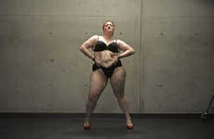
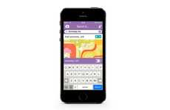
Top 10 PRO 2016 Trend Report
Bodily Esteem
Branded Cognition
Momentary Marketing
Retail Community
Oct 15, 2015 - Copyright © Trend Hunter Inc. This report is for internal use within your company. Please do not distribute, publish or present outside your team. Brought to you by Trend Hunter, the world's most popular, largest trend network, fueled by more than 100,000 contributors and 2 billion views of data. We help creative innovators like you Find Better Ideas, Faster™

Slide 3
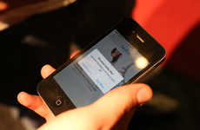
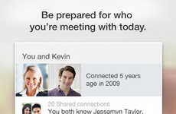
Highlights
Featured Pro Trends
Matchmaking Adulthood
Big and small decision making takes a page from Tinder
Adhesive Tech
Wearable technology is reformatted for bodily use
Appified Entrepreneur
Tech-savvy consumers turn to mobile apps for business building
Retail Community
Stores offer value beyond mere products by serving as community hubs
Resource Sharing
Share culture moves past renting and into giving
Copyright © TrendHunter.com. All Rights Reserved

Slide 4
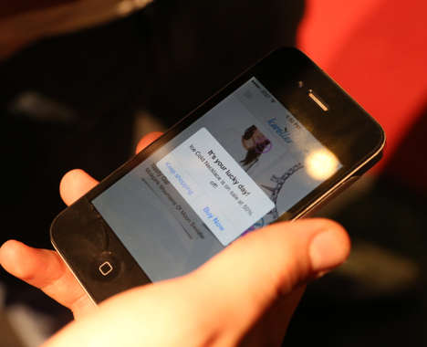
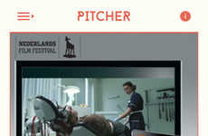
Matchmaking Adulthood
Big and small decision making takes a page from Tinder
Implications - As Millennials reach adulthood and more important decisions need to be made, the question of how to capture the generation with a notoriously low attention span becomes more pressing. As a result, many organizations are implementing gamified, Tinder and Uber-style systems for purchasing, and for big decision making. This speaks to the Millennial desire to maintain personal brand, and for quick and easy tech transactions.
Matchmaking Employment Apps The Jobr App Lets You Search for Employment Like Matches on Tinder
Agency Matchmaking Apps Pitcher Helps You Find an Ad Agency as You Would Dates on Tinder
Swiping Fashion Retail Apps Kwoller's Fashion Price Tracking Feature Adds to a Tinder-Inspired App
Car Shopping Quizzes TMatch Narrows Down Choices When Purchasing a Vehicle
Dealership Messaging Services Go Auto Uses Text Messaging to Make Interactions Stress-Free
Score:
Popularity
DEMOGRAPHICS
5 Ideas + 53 Related Examples
7.2
Activity
http://www.trendhunter.com/id/289062
Freshness
Copyright © TrendHunter.com. All Rights Reserved

Slide 5
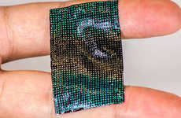
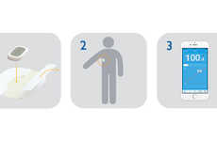
Adhesive Tech
Wearable technology is reformatted for bodily use
Implications - The world of wearable technology is evolving to include devices that attach directly onto users' skin. This new form of wearable device is not only more discrete, but often more accurate in its bodily observations. Adhesive wearables indicate how technology can transform the health industry, as well as reveal an underlying desire on the part of consumers to manage and monitor their day-to-day lives.
Disease-Fighting Smart Bandages MultiSense Memory is a Wearable Sensor that Safely Tracks Illness
NFC Skin Patches Researchers are Developing NFC Tech to Collect and Send Bio-Medical Information
Chic Blood Sugar Bands Hi-Tech Wearable Accessory Measures Glucose Levels by a Futuristic Fashion
Smart Temperature Patches STEMP Notifies iPhones When a Person is Running a Fever
Score:
Popularity
DEMOGRAPHICS
4 Ideas + 35 Related Examples
6.7
Activity
http://www.trendhunter.com/id/275555
Freshness
Copyright © TrendHunter.com. All Rights Reserved

Slide 6
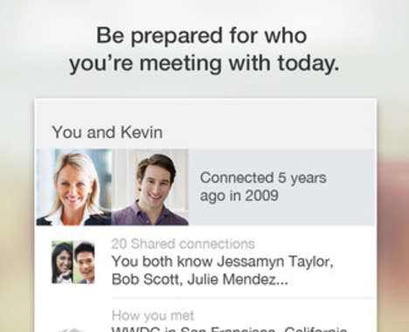
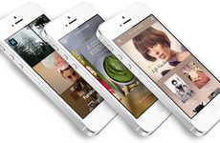
Appified Entrepreneur
Tech-savvy consumers turn to mobile apps for business building
Implications - Taking a streamlined approach to business, modern entrepreneurs are utilizing mobile apps as a means to efficiently build their brand. By allowing tech-savvy users to build their network, gain insight and even socialize with others in the industry, these apps speak to a shift toward more autonomous, yet equally social, methods of entrepreneurship.
Business Card Creation Apps The Haystack App Lets You Easily Make and Digitize Contact Cards
Business Insight Apps Teradata's Aster AppCenter Makes Big Data for Business Comprehensible
Professional Networking Apps LinkedIn's Connected App Strengthens Business Relationships
App-Creating Apps The Dwnld App Cuts Out the Middle Man
Professional Messaging Apps Caliber is a Business App to Connect Colleagues and New Contacts
Score:
Popularity
DEMOGRAPHICS
5 Ideas + 45 Related Examples
5.5
Activity
http://www.trendhunter.com/id/284805
Freshness
Copyright © TrendHunter.com. All Rights Reserved

Slide 7
Retail Community
Stores offer value beyond mere products by serving as community hubs
Implications - Tapping into the modern consumer's emotional need to connect to a larger cause, brands are beginning to re-imagine the retail experience as a place for building relationships and cultivating community. The re-positioning of retail destinations as centers of local culture also speaks to the consumer interest in seeking out opportunities for sparking real-world connections in an ever-increasing digital era.
Cozy Retailer Lifestyle Villages The Urban Outfitters Village is a Town Built by Retailers
Menswear Brand Cafes The Frank & Oak Toronto Flagship Houses Cafe St Viateur
Community Hub Supermarkets This Award-Winning Whole Foods Austin Location is Retail Playground
VR-Powered Hybrid Retail The Ted Baker Shoreditch Store Has a Barbershop and VR Technology
Car Dealership Spas The Mercedes-Benz Burlington Location Boasts a Spa and Cafe
Score:
Popularity
DEMOGRAPHICS
5 Ideas + 45 Related Examples
7.7
Activity
http://www.trendhunter.com/id/286244
Freshness
Copyright © TrendHunter.com. All Rights Reserved

Slide 8
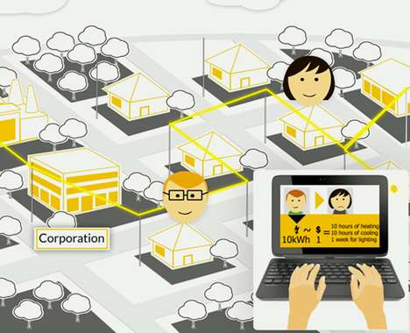
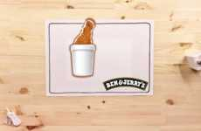
Resource Sharing
Share culture moves past renting and into giving
Implications - The modern consumer has a strong sense of community created by the feeling of closeness created by online interaction. This is the reason for the rise of share and rental culture. Using this idea for more noble causes, consumers are seeking ways to share intangible goods with the less fortunate by lending necessary resources.
Generous Foodsharing Campaigns Ben & Jerry's Food Waste Campaign Shares What You Don't Eat
Social Meal-Sharing Initiatives Social Feed Proposes Online Sharing as a Way to Feed Hungry Kids
Energy-Sharing Networks The Gridmates Platform Allows Users to Donate Energy to Their Neighbors
Community Service-Settling Bills The Water Supplier Lets Poor Customers Pay by Exchanging Services
Score:
Popularity
DEMOGRAPHICS
4 Ideas + 44 Related Examples
5.6
Activity
http://www.trendhunter.com/id/270981
Freshness
Copyright © TrendHunter.com. All Rights Reserved

Slide 9
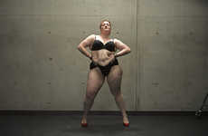
Bodily Esteem
Consumers challenge the mainstream by openly celebrating body diversity
Implications - The fashion industry claims to have embraced body diversity, but its definition of "plus-size" remains narrow. As a result, consumers feeling overlooked by the industry are gravitating towards fashion and media channels that make bold, celebratory political statements surrounding the issue. This shift towards bodily esteem suggests that consumers are searching for transparency, as well as representation, from fashion media.
Plus-Size Dancer Portraits Toby Burrows Photographs Fat Dancers for the Nothing to Lose Project
Sultry Plus-Size Campaigns The #ImNoAngel Lingerie Ads Assert That Full Figures are Seductive
Plus-Size Padding Portraits Refinery29 Uncovers a Plus-Size Practice That's Bad for Body Image
Model Diversity Documentaries A Perfect 14 is an Upcoming Documentary on Plus-Size Modelling
Score:
Popularity
DEMOGRAPHICS
4 Ideas + 27 Related Examples
8.8
Activity
http://www.trendhunter.com/id/275923
Freshness
Copyright © TrendHunter.com. All Rights Reserved

Slide 10
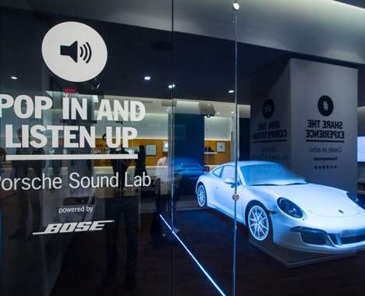
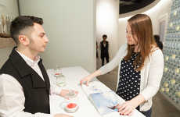
Branded Cognition
Multisensory experiences create emotional connections within consumers
Implications - Branded multisensory experiences covertly engage consumers on an emotional level, strengthening pre-existing ties to the brand and boosting subconscious accessibility. In playing up subtle yet recognizable stimuli, brands can reach consumers in an intimate, emotional way that is sure to resonate as a more positive and memorable relationship.
Scent-Driven Mall Activations
Fragrant Travel Globes
Fragrant Experiential Pop-Ups Glade's Pop-Up Boutique is Branded as One That 'Sells Feelings'
Rapper-Curated Event Soundtracks
Multi-Sensory Dining Experiences
In-Flight Musical Meal Pairing
Multisensory Automotive Lounges The Sound of Porsche Pop-Up is Like a Modern Record Store
Music-Pairing Bubbly Apps The Krug Champagne App Uses Science to Appeal to the Senses
Score:
Popularity
DEMOGRAPHICS
8 Ideas + 71 Related Examples
6.8
Activity
http://www.trendhunter.com/id/279468
Freshness
Copyright © TrendHunter.com. All Rights Reserved

Slide 11
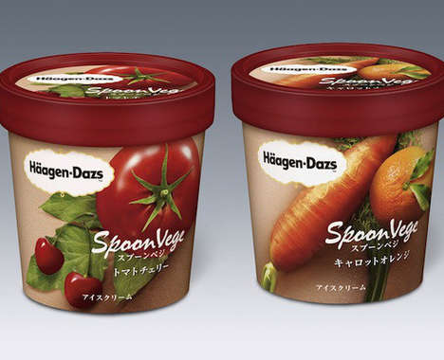
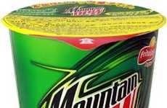
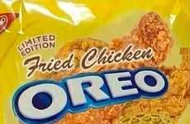
Viral Oddity
Novel versions of well-known brands spark worldwide attention
Implications - Novelty and oddity reign supreme in the foodie world, but for the mass majority of consumers, full-blown exoticism is still intimidating. Oddball special edition products from familiar brands satiate both needs. This allows consumers to explore within comfortable perimeters, while opening the value of these staple products up to a whole new market.
Sugary Cinnamon Snacks Cheetos' New Cinnamon Puff Snack Goes by the Name Sweetos
Pop-Inspired Cheesy Snacks Mountain Dew Cheetos Makes for a Strange Combination
Vegetable-Flavored Ice Creams The 'Spoon Vege' Haagen Daz Ice Cream Features Carrots and Tomatoes
Poultry-Flavored Cookies The Latest Rumored Bizarre Oreo Flavor is Fried Chicken
Score:
Popularity
DEMOGRAPHICS
4 Ideas + 33 Related Examples
5.8
Activity
http://www.trendhunter.com/id/272375
Freshness
Copyright © TrendHunter.com. All Rights Reserved

Slide 12
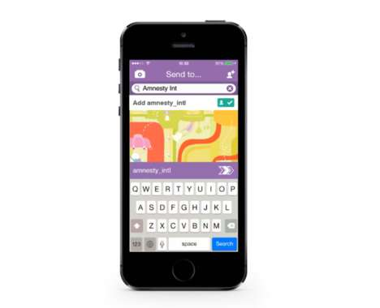
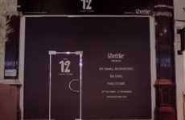
Momentary Marketing
Brands capitalize on the ephemeral nature of emerging social media
Implications - Brands aware of the ephemeral direction that social media is moving towards have redirected marketing efforts to follow suit. By using transient social platforms like Snapchat, or devising temporary marketing schemes, brands are appealing to a desire amongst people to consume smaller forms of content in a way that is both easy and efficient.
Secretive Party Campaigns
Melting Icy Coupons
Temporary 12-Hour Stores iZettle's Temporary Store Hosts Small Businesses for Just 12 Hours
Ephemeral Awareness Ads
Social Media Brand Advocates
Activist App Campaigns Amnesty International's Report Without Fear Campaign Utilizes Snapchat
Secretive Gaming Campaigns This Call of Duty Video Game Advertising Stunt Covertly Uses Snapchat
Score:
Popularity
DEMOGRAPHICS
7 Ideas + 61 Related Examples
6.6
Activity
http://www.trendhunter.com/id/280317
Freshness
Copyright © TrendHunter.com. All Rights Reserved

Slide 13
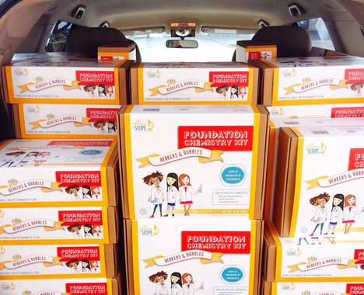
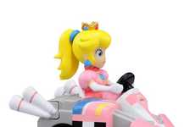
STEMinine Play
Young girls get involved in the academic disciplines
Implications - As the disciplines of science, technology, engineering and math become more and more in demand, forward-thinking parents seek ways to not only teach their children, but specifically their girls, how to get ahead in this sphere. Simultaneously battling the misconceptions of STEM being boring and not for girls, this wave of academic toys shows action taken to ensure children achieve the modern notion of success.
Skill-Building Toy Shops Amazon Launched a Store for Featuring Educational and Fun STEM Toys
Girl-Targeted Tech Programs This 3D Printing Project Enables You to Invest in Girls' Education
Girl-Targeted Science Kits Yellow Scope Produces Creative and Rigorous Science Kits for Girls
Empowering Engineering Toy Ads This Ad for Goldiblox' Toys for Girls Shows Your Brain on Princess
Girly Video Game Toys The Princess Peach Remote-Control Car is Fun and Feminine
Score:
Popularity
DEMOGRAPHICS
5 Ideas + 43 Related Examples
5.4
Activity
http://www.trendhunter.com/id/282062
Freshness
Copyright © TrendHunter.com. All Rights Reserved

Slide 14
Table of Contents
4) Matchmaking Adulthood
5) Adhesive Tech
6) Appified Entrepreneur
7) Retail Community
8) Resource Sharing
9) Bodily Esteem
10) Branded Cognition
11) Viral Oddity
12) Momentary Marketing
13) STEMinine Play

