Slide 1
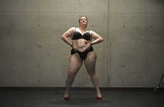
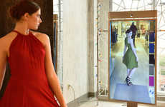
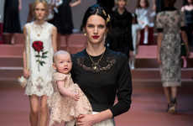
2016 Sample
Top 25 Trends & 60+ Examples
Bodily Esteem
Connected Vanity
Upscaling Motherhood
Streamlined Feedback
Sep 17, 2015 - Copyright © Trend Hunter Inc. This report is for internal use within your company. Please do not distribute, publish or present outside your team. Brought to you by Trend Hunter, the world's most popular, largest trend network, fueled by more than 100,000 contributors and 2 billion views of data. We help creative innovators like you Find Better Ideas, Faster™

Slide 2
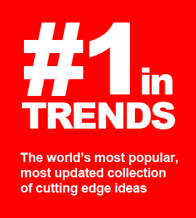
Learn how Samsung, Adidas and Nestle accelerate research with the #1 trend platform
Join hundreds of the world’s most powerful innovators who “Find BETTER Ideas FASTER” with our data-driven, cost-effective custom research, like this sample custom report. With a dedicated advisor, 160,000 people hunting ideas for you and our 100,000,000 person virtual focus group, you will dramatically enhance insight while extracting costs.
Cheers,
Jeremy Gutsche - jeremy@trendhunter.com
CEO & NY Times Bestselling Author - JeremyGutsche.com

Slide 3
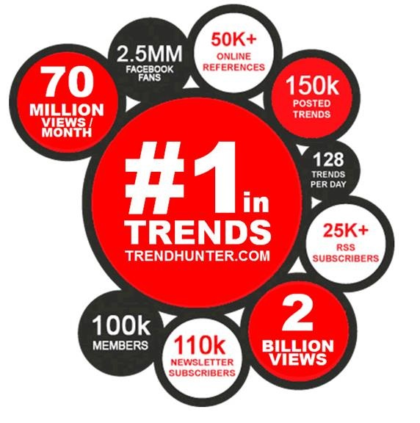
1. For context, Trend Hunter is the #1 largest, most-popular, most-powerful trend platform
#1 Largest Trend Spotting Network (by 50x) #1 Most Popular Trend Website (by 10x) #1 Largest Database of Ideas (by 20x)
350,000 Online References
1,000+ Interviews Relied Upon by 1,000s of Journalists

Slide 4
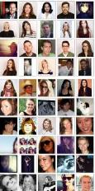
2. It’s unlike anything ever before possible because it’s fueled by 170,000 hunters + a 130,000,000 people
#1 Largest Network
#1 Largest Idea Database
Crowd Filtering
Data-Driven Opportunities
Dedicated Advisors
+
130,000,000 People (1 in 60 on the planet)
170,000 Hunters (8 arenas’ worth)
5,000 Ideas / Month (280,000 Total)
Subsidized by the ad revenue from billions of page views

Slide 5
3. The problem: most people lose time scouring for insight & connecting the dots
Published Reports not specific; lots to filter
Typical Trend Sites too high-level
Google random; what ranks well “needle in a haystack”
Twitter low level & just buzz “Justin Bieber”
Custom Research
Typically too expensive
Industry Sites
niche and newsy
$$$

Slide 6
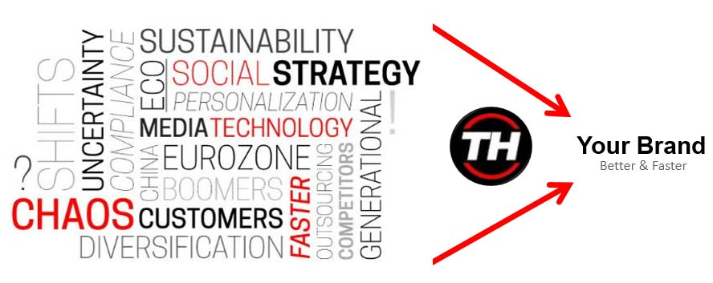
4. We can find BETTER ideas, FASTER, with big data, monthly custom reports and the #1 trend platform

Slide 7
5. Our most popular service involves ongoing custom research because we extract 90% of the traditional costs
Traditional Research - Slow & Expensive
Procure > Scope > Research > Survey > Synthesize > Deliver
Trend Hunter - Fast & Cost-Effective
Deep Dive
Deep Dive
Deep Dive
Deep Dive
Deep Dive
Deep Dive
Deep Dive
Deep Dive
Deep Dive
Implications For Your Brand:
Be Smarter, Act Faster, Dive Deeper

Slide 8
6. Instead of high-level reports, we can get project- specific with 50+ page, data-driven reports as low as $500
Retail Tech
Store Apps
In-Store Display
Experience Design
Pop-Up Shops
Store Design
Loyalty Programs
Brand Rituals
Brand Extensions
Co-Branding
Immersive Brand
Digital Branding
Viral Video Strategy
Gen Y Preference
Mommy Bloggers
Meme Culture
Subscriptions
Media Evolution
Personalization
Media Consumption
Custom Design
Adventure Culture
Experience Tourism
Niche Pop Culture
Boomer Wellness
Healthy Living
Health Education
Boomer Apps
Boomer Psychology
Experience Tourism
Young Parents
Teen Culture
DIY Culture
Digital Learning
Night Life
Gen Y Entrepreneurs
Wearable Tech
Mobile Apps
Smart Homes
Future of Interface
Gamification
3D Printing
Digital Marketing
Mobile Marketing
Intentional Viral
QR Codes
Millennial Marketing
Augmented Reality
Digital Education
Superhero Toys
Kids as Adults
Play With Purpose
Buildable Drones
Social Learning
Healthy Snacking
Tricky Diets
Fast Food
Flavor Reversal
Hispanic Flavor
Asian Fusion
Packaging for Pets
Simplicity
Package Innovation
Bottle Innovation
Unique Delivery
Eco Materials
1980s Nostalgia
Retro Americana
Niche Couture
Handbags
Sneaker Culture
Affordable Runway

Slide 9
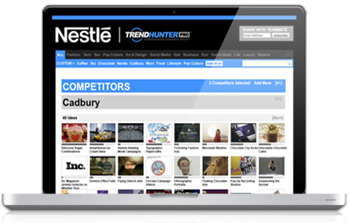
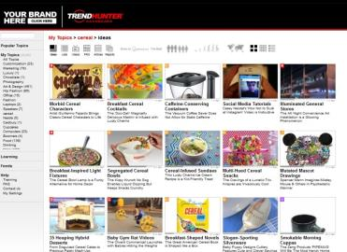
7. Plus, our PRO platform has 80+ categories of reports, special tools, 15,000 trackable topics & 300,000 ideas
400,000 Ideas 30,000 Clusters 50,000 Videos 1,500,000 Pictures
80+ Report Categories
3,000 eLearning Videos
Your Dashboard
Customizable Save Your Topics Filter Demographics Create Your Reports
Powerful Filters
Updated Hourly
Find Better Ideas, Faster
TM
TrendHunter.com/dashboard

Slide 10
8. Join us at Future Festival, where the world’s top innovators gather to prototype their future (Oct 5-7)
> rated by 76% as the best business event they’ve ever attended
FutureFestival.com

Slide 11
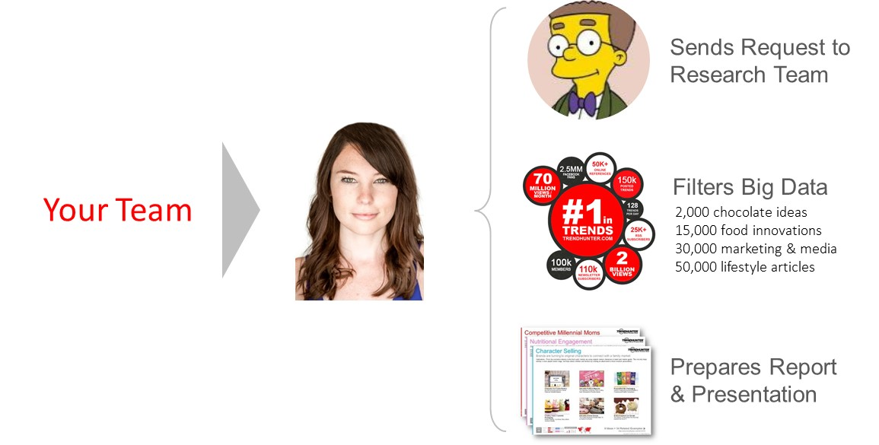
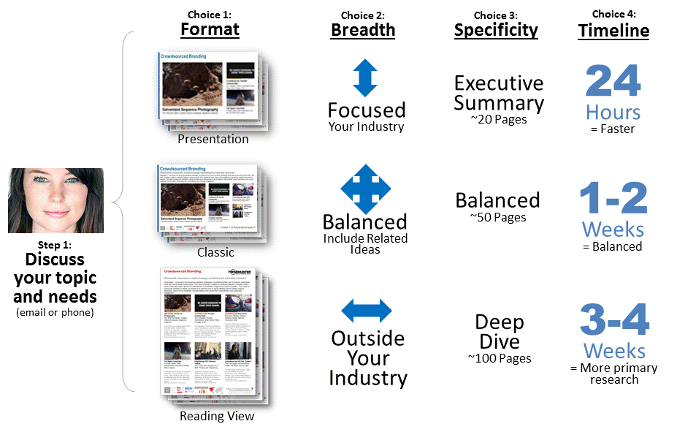
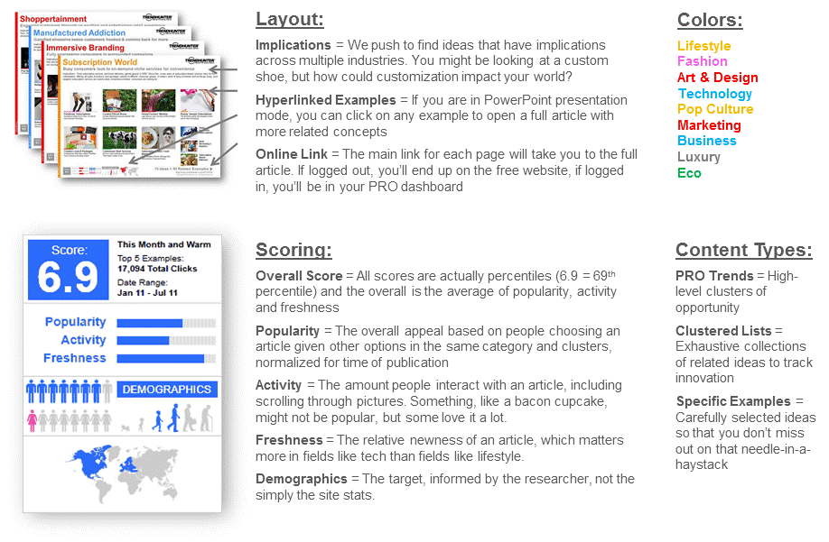
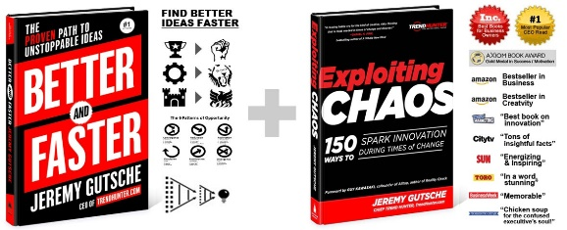
Schedule a call to learn more, or check out our methodology in the appendix
Our Services
Our Process
Customization Options
Definitions
The #1 Trend Platform
Award-Winning Methods

Slide 12
25 Sample PRO Trends
Subscribe for 3,500 More!
PRO Trends are the crown jewel of Trend Hunter. They are premium, subscriber-only articles based on clusters of consumer insight. Each insight is identified using our crowdsourced, crowd-filtered methodology. We use a combination of algorithms, consumer data and editorial curation to identify patterns of ideas that score highly among our audience. PRO Trends are intended to teach you about creativity in other industries, so that you can bring unique, high-level creativity to your own brand. Competitive advantage comes not from closely benchmarking yourself to the developments of your competitor, but by looking for inspiration that can revolutionize your industry.
Copyright © TrendHunter.com. All Rights Reserved

Slide 13
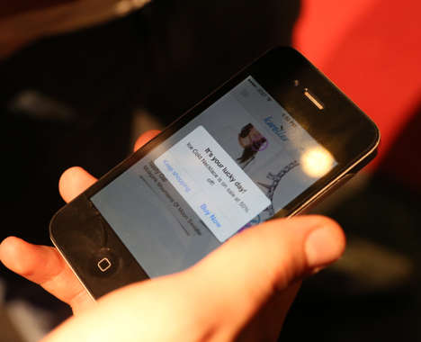
Matchmaking Adulthood
Big and small decision making takes a page from Tinder
Implications - As Millennials reach adulthood and more important decisions need to be made, the question of how to capture the generation with a notoriously low attention span becomes more pressing. As a result, many organizations are implementing gamified, Tinder and Uber-style systems for purchasing, and for big decision making. This speaks to the Millennial desire to maintain personal brand, and for quick and easy tech transactions.
Matchmaking Employment Apps The Jobr App Lets You Search for Employment Like Matches on Tinder
Agency Matchmaking Apps Pitcher Helps You Find an Ad Agency as You Would Dates on Tinder
Swiping Fashion Retail Apps Kwoller's Fashion Price Tracking Feature Adds to a Tinder-Inspired App
Car Shopping Quizzes TMatch Narrows Down Choices When Purchasing a Vehicle
Dealership Messaging Services Go Auto Uses Text Messaging to Make Interactions Stress-Free
Score:
Popularity
DEMOGRAPHICS
5 Ideas + 53 Related Examples
7.4
Activity
http://www.trendhunter.com/id/289062
Freshness
Copyright © TrendHunter.com. All Rights Reserved

Slide 14
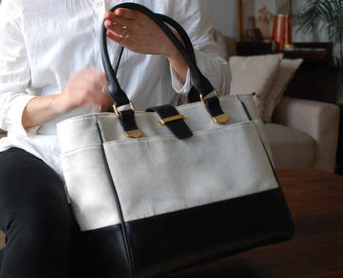
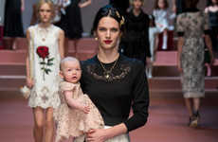
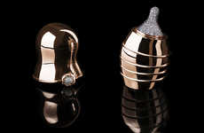
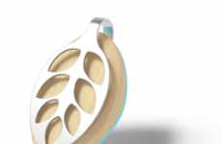
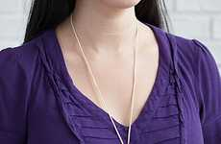
Upscaling Motherhood
Brands targeting mothers turn to all things high end for modern parents
Implications - E-commerce channels are birthing a new generation of modern mothers who are well-versed in high-end consumer offerings. As such, brands catering to this demographic are developing upscale products for young female parents who, in contrast to established norms, are replacing frugality with luxury. This niche will be appreciated by millennial families who are more affluent than their younger counterparts.
Opulent Maternal Fashion The Latest Dolce and Gabbana Fashion Pays Tribute to Motherhood
$270,000 Baby Bottles The Doll Luxury Baby Bottle by Suommo is Made with Rose Gold and Diamonds
Disguised Diaper Totes Nest Designs' Bags Conceal Baby Products with a Sophisticated Exterior
Pregnancy Tracker Jewelry Bellabeat Leaf is an Activity and Wellness Tracker Expecting Moms
Chic Silver Teething Jewelry This Sterling Teething Jewelry for Moms & Babies is Sophisticated
Score:
Popularity
DEMOGRAPHICS
5 Ideas + 45 Related Examples
7.5
Activity
http://www.trendhunter.com/id/286947
Freshness
Copyright © TrendHunter.com. All Rights Reserved

Slide 15
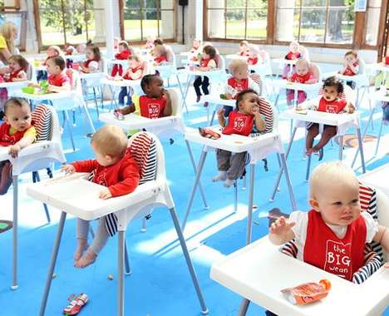
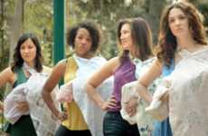
Parenting Authenticity
Brands connect with millennial parents through marketing transparency
Implications - As millennials begin to have children of their own, many of the values associated with the demographic are carried over into parenting purchases. In the hopes of building trust among young millennial parents, brands are highlighting a dedication to health and sustainability with comedic, honest representations of the complexities of modern parenting.
Father-Anthem Cereal Ads Peanut Butter Cheerios #HowtoDad Campaign is Hilariously Endearing
Comical Parenting Ads Similac's Commercial Reveals the Realities of Competitive Parenting
New Dad Ads
Playful Child Athlete Campaigns
Baby Food Brand Activations Ella's Kitchen Hosted a Pop-up Event Featuring 150 Baby Consumers
Parenting Baby Wipes Tommee Tippee's 'Advice Wipes' are Made From Recycled Parenting Publications
Score:
Popularity
DEMOGRAPHICS
6 Ideas + 54 Related Examples
6.3
Activity
http://www.trendhunter.com/id/286925
Freshness
Copyright © TrendHunter.com. All Rights Reserved

Slide 16
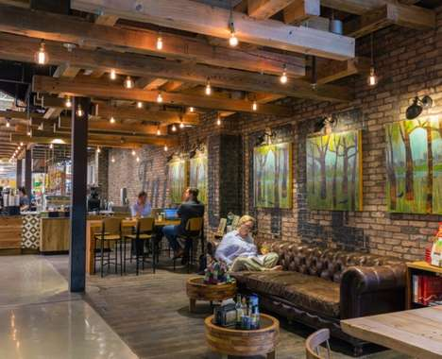
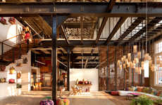
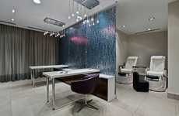
Retail Community
Stores offer value beyond mere products by serving as community hubs
Implications - Tapping into the modern consumer's emotional need to connect to a larger cause, brands are beginning to re-imagine the retail experience as a place for building relationships and cultivating community. The re-positioning of retail destinations as centers of local culture also speaks to the consumer interest in seeking out opportunities for sparking real-world connections in an ever-increasing digital era.
Cozy Retailer Lifestyle Villages The Urban Outfitters Village is a Town Built by Retailers
Menswear Brand Cafes The Frank & Oak Toronto Flagship Houses Cafe St Viateur
Community Hub Supermarkets This Award-Winning Whole Foods Austin Location is Retail Playground
VR-Powered Hybrid Retail The Ted Baker Shoreditch Store Has a Barbershop and VR Technology
Car Dealership Spas The Mercedes-Benz Burlington Location Boasts a Spa and Cafe
Score:
Popularity
DEMOGRAPHICS
5 Ideas + 45 Related Examples
7.8
Activity
http://www.trendhunter.com/id/286244
Freshness
Copyright © TrendHunter.com. All Rights Reserved

Slide 17
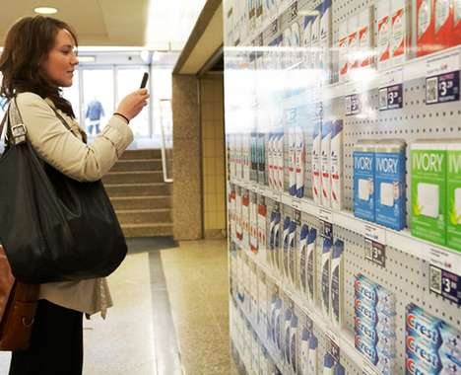
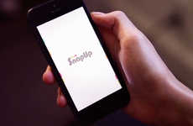
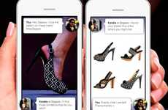
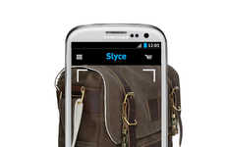
Recognition Purchasing
Brands convert product interaction into direct sales channels
Implications - Innovative shopping apps that use image recognition technology in order to customize recommendations provide a personalized and convenient digital shopping experience. By enabling customers to add items to their shopping carts through taking a photo or scanning bar codes, brands are able to streamline the path to purchase.
Furniture Identifying Apps This App Will Find Decor For You Using Visual Recognition Technology
Deal-Finding Shopping Apps The SnapUp App is Made for Money Savvy Individuals
Virtual Drug Stores Well.Ca's Virtual Shopping Experience Features Scannable Products
Personal Shopping Services Zappos' Free Personal Web Shopper Service Suggests Style Matches
Visual Product Search Platforms The Slyce Product-Scanning App Makes Shopping a Breeze
Score:
Popularity
DEMOGRAPHICS
5 Ideas + 45 Related Examples
8.0
Activity
http://www.trendhunter.com/id/286196
Freshness
Copyright © TrendHunter.com. All Rights Reserved

Slide 18
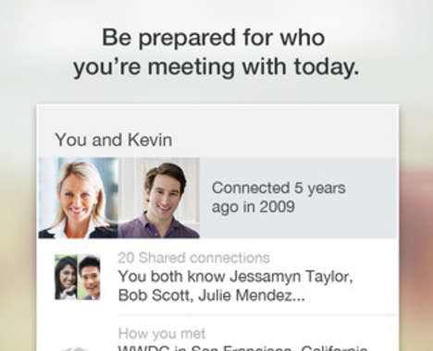
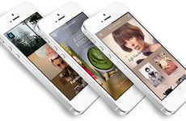
Appified Entrepreneur
Tech-savvy consumers turn to mobile apps for business building
Implications - Taking a streamlined approach to business, modern entrepreneurs are utilizing mobile apps as a means to efficiently build their brand. By allowing tech-savvy users to build their network, gain insight and even socialize with others in the industry, these apps speak to a shift toward more autonomous, yet equally social, methods of entrepreneurship.
Business Card Creation Apps The Haystack App Lets You Easily Make and Digitize Contact Cards
Business Insight Apps Teradata's Aster AppCenter Makes Big Data for Business Comprehensible
Professional Networking Apps LinkedIn's Connected App Strengthens Business Relationships
App-Creating Apps The Dwnld App Cuts Out the Middle Man
Professional Messaging Apps Caliber is a Business App to Connect Colleagues and New Contacts
Score:
Popularity
DEMOGRAPHICS
5 Ideas + 45 Related Examples
5.6
Activity
http://www.trendhunter.com/id/284805
Freshness
Copyright © TrendHunter.com. All Rights Reserved

Slide 19
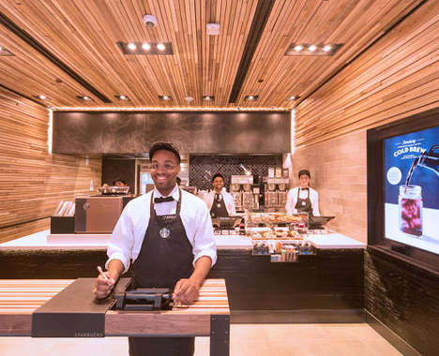
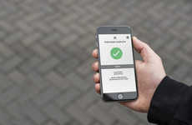
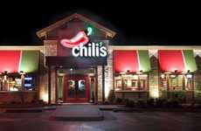
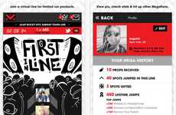
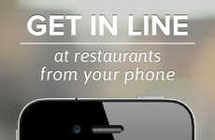
Digitized Queue
Consumers skip wait times by ordering ahead with innovative apps
Implications - As the progression toward streamlining everyday tasks continues, consumers are being enticed by tech-powered services that enable ordering ahead of time or allow for skipping of queues altogether. The emergence of fast-lane apps is representative of the modern consumer's desire to save time wherever possible, while also adding an element of exclusivity.
Footwear Availability Apps Adidas's Confirmation is a Reservation App for Limited Edition Sneakers
Line-Skipping Dining Apps The Chili's Waitlisting App Will Launch in Summer 2015
No-Wait Coffee Shops The Starbucks Line is Eliminated with an Efficient Location in New York City
Interactive Virtual Lineups The Virgin Mega App is a Hype Machine for Limited Releases
Virtual Restaurant Queue Apps The NoWait App Makes Waiting for a Table Painless
Score:
Popularity
DEMOGRAPHICS
5 Ideas + 45 Related Examples
6.4
Activity
http://www.trendhunter.com/id/284545
Freshness
Copyright © TrendHunter.com. All Rights Reserved

Slide 20
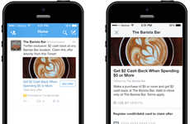
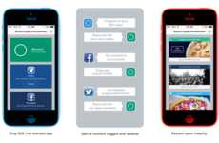
Socialized Reward
Points programs are integrated into common social networks for youth appeal
Implications - Seeking to connect with Millennial consumers in a more approachable manner, brands are using social platforms to offer perks and discounts. Allowing buyers to collect points and earn rewards through platforms like Twitter and Instagram, brands are seeking to transform typically routine, solo activities into more memorable, social experiences that allow more intimate consumer-brand relationships to take place.
Social Cashback Rewards Twitter Offers is a Seamless and Simple Way to Shop and Get Cash Back
Engaging Loyalty Platforms Kiip Helps Brands Reward Fans with Specialized Perks
Social Loyalty Apps This Loyalty App Leverages Instagram to Offer Unique Deals to Shoppers
Crowdsourced Reward Apps MoPals' Rewards App Provides Incentives to Share Photos, Reviews & Posts
Score:
Popularity
DEMOGRAPHICS
4 Ideas + 29 Related Examples
6.9
Activity
http://www.trendhunter.com/id/284112
Freshness
Copyright © TrendHunter.com. All Rights Reserved

Slide 21
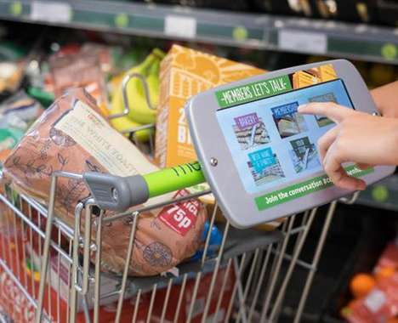
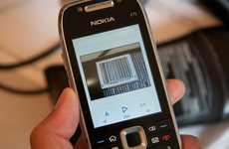
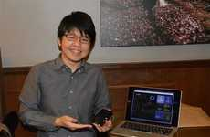
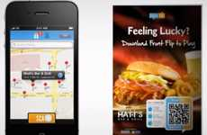
Streamlined Feedback
Brands encourage customer feedback through user-friendly technology
Implications - Sites like Yelp have made feedback unavoidable for restaurants and retailers, but for brands who don't regularly hear from their customers, getting honest feedback can be a challenge. To combat this, brands are implementing apps and tech kiosks that not only make the process easy, but in some cases incentivize customer engagement. This is consistent with an increasingly customized, consumer-driven approach to customer service.
Responsive Digital Receipts The Square Feedback Digital Receipt Lets Buyers and Sellers Chat
Incentivized Barcode Research Customer Feedback is Given on Free Products by Scanning Unique Codes
Shopping Survey Tablets Co-operative Food's Smart Shopping Cart Asks Customers for Feedback
Analytical Retail Beacons Shaftsbury Square's Use of iBeacon Tech Also Offers Feedback for Shops
Customer Gifting Apps Front Flip App Lets Store Owners Interact with and Reward Loyal Customers
Score:
Popularity
DEMOGRAPHICS
5 Ideas + 44 Related Examples
7.4
Activity
http://www.trendhunter.com/id/283022
Freshness
Copyright © TrendHunter.com. All Rights Reserved

Slide 22
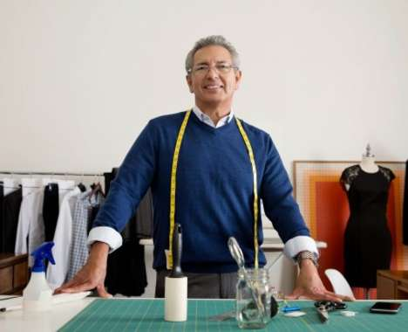
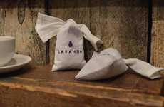
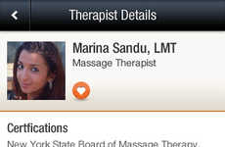
Peer-to-Peer Luxury
Unique apps leverage the peer-to-peer economy for typically high-end services
Implications - The rise in the peer-to-peer economy has seen the emergence of app-driven on-demand services that extend to the luxury end of the spectrum. While in the past, mainly affluent consumers may have had access to such typically high-end amenities, the accessibility and convenience of peer-to-peer services offered instantly through a digital means provide a cost-efficient, quick alternative.
Digital Laundry Services Lavanda is a London-Based Uber for Laundry
Personal Chef Apps Hao Chushi Connects Users with Chefs Who Prepare Meals Within One's Home
On-Demand Alterations zTailors Delivers Affordable Tailor Services Directly to Your Home
On-Demand Masseuse Services Zeel Offers In-Home Massage Services with Speedy Same-Day Bookings
Dog Walker Apps 'Wag!' is a New App for Dog Owners That Will Find You a Dog Walker on Demand
Score:
Popularity
DEMOGRAPHICS
5 Ideas + 44 Related Examples
4.8
Activity
http://www.trendhunter.com/id/282524
Freshness
Copyright © TrendHunter.com. All Rights Reserved

Slide 23
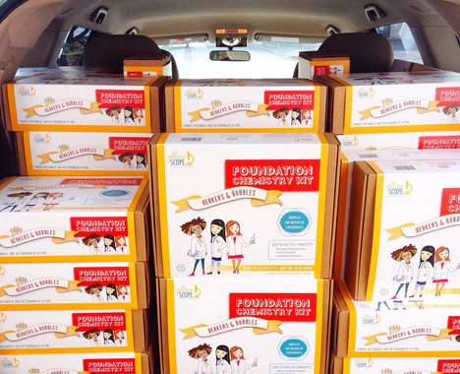
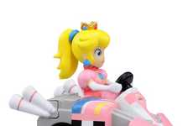
STEMinine Play
Young girls get involved in the academic disciplines
Implications - As the disciplines of science, technology, engineering and math become more and more in demand, forward-thinking parents seek ways to not only teach their children, but specifically their girls, how to get ahead in this sphere. Simultaneously battling the misconceptions of STEM being boring and not for girls, this wave of academic toys shows action taken to ensure children achieve the modern notion of success.
Skill-Building Toy Shops Amazon Launched a Store for Featuring Educational and Fun STEM Toys
Girl-Targeted Tech Programs This 3D Printing Project Enables You to Invest in Girls' Education
Girl-Targeted Science Kits Yellow Scope Produces Creative and Rigorous Science Kits for Girls
Empowering Engineering Toy Ads This Ad for Goldiblox' Toys for Girls Shows Your Brain on Princess
Girly Video Game Toys The Princess Peach Remote-Control Car is Fun and Feminine
Score:
Popularity
DEMOGRAPHICS
5 Ideas + 43 Related Examples
5.6
Activity
http://www.trendhunter.com/id/282062
Freshness
Copyright © TrendHunter.com. All Rights Reserved

Slide 24
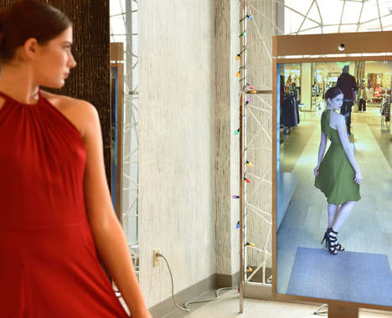
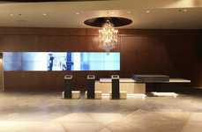
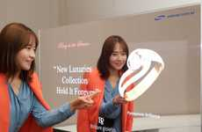
Connected Vanity
Industrial spaces incorporate digitally optimized mirrors for user appeal
Implications - Mirrors have been optimized for digital use in a variety of public spaces, ranging from retail locations to gyms. These next-generation mirrors present a benefit that is two-fold: they play upon consumers' narcissistic tendencies, while simultaneously offering a form of interactivity and connectivity that's now demanded in both public settings and personal devices.
Photo-Snapping Mirrors
Digitally Connected Mirrors
High-Tech Retail Hubs Harvey Nichols' Newest Retail Store Design Boasts Engaging Details
Smart Weightlifting Mirrors
Feel-Good Retail Mirrors
Outfit-Modeling Mirrors Neiman Marcus' Memory Mirror Digitally Compares Outfits
Interactive Retail Mirrors Samsung's Mirror and Transparent OLED Makes Retail Visually Engaging
Score:
Popularity
DEMOGRAPHICS
7 Ideas + 60 Related Examples
7.5
Activity
http://www.trendhunter.com/id/281319
Freshness
Copyright © TrendHunter.com. All Rights Reserved

Slide 25
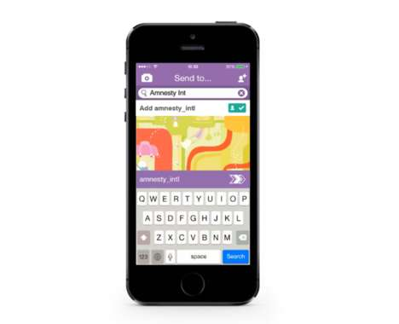
Momentary Marketing
Brands capitalize on the ephemeral nature of emerging social media
Implications - Brands aware of the ephemeral direction that social media is moving towards have redirected marketing efforts to follow suit. By using transient social platforms like Snapchat, or devising temporary marketing schemes, brands are appealing to a desire amongst people to consume smaller forms of content in a way that is both easy and efficient.
Secretive Party Campaigns
Melting Icy Coupons
Temporary 12-Hour Stores iZettle's Temporary Store Hosts Small Businesses for Just 12 Hours
Ephemeral Awareness Ads
Social Media Brand Advocates
Activist App Campaigns Amnesty International's Report Without Fear Campaign Utilizes Snapchat
Secretive Gaming Campaigns This Call of Duty Video Game Advertising Stunt Covertly Uses Snapchat
Score:
Popularity
DEMOGRAPHICS
7 Ideas + 61 Related Examples
6.8
Activity
http://www.trendhunter.com/id/280317
Freshness
Copyright © TrendHunter.com. All Rights Reserved

Slide 26
Branded Cognition
Multisensory experiences create emotional connections within consumers
Implications - Branded multisensory experiences covertly engage consumers on an emotional level, strengthening pre-existing ties to the brand and boosting subconscious accessibility. In playing up subtle yet recognizable stimuli, brands can reach consumers in an intimate, emotional way that is sure to resonate as a more positive and memorable relationship.
Scent-Driven Mall Activations
Fragrant Travel Globes
Fragrant Experiential Pop-Ups Glade's Pop-Up Boutique is Branded as One That 'Sells Feelings'
Rapper-Curated Event Soundtracks
Multi-Sensory Dining Experiences
In-Flight Musical Meal Pairing
Multisensory Automotive Lounges The Sound of Porsche Pop-Up is Like a Modern Record Store
Music-Pairing Bubbly Apps The Krug Champagne App Uses Science to Appeal to the Senses
Score:
Popularity
DEMOGRAPHICS
8 Ideas + 71 Related Examples
6.9
Activity
http://www.trendhunter.com/id/279468
Freshness
Copyright © TrendHunter.com. All Rights Reserved

Slide 27
Curated Dining
Consumers seek out a cost-effective way to curate custom meals
Implications - Moving beyond mere food delivery, consumers are turning to services that help curate entire dining experiences for customized appeal. By bringing 5-star dinner services into the comfort of people's homes, these meal options allow consumers to enjoy the extravagance that often comes with eating out at a fraction of the cost, all while maintaining the familiarity and comfort of ordering in.
Dinner Party Services Kitchit Offers a Customized Catered Meal and a Personal Chef at Your Home
SMS Lunch Services Toronto's Gob is a Service That Lets You Order Lunch by Text Message
Executive Meal Subscriptions Chef's Plate Offers Chef-Designed Meals for Quality Convenience
Personal Chef Apps Hao Chushi Connects Users with Chefs Who Prepare Meals Within One's Home
Score:
Popularity
DEMOGRAPHICS
4 Ideas + 34 Related Examples
5.6
Activity
http://www.trendhunter.com/id/278770
Freshness
Copyright © TrendHunter.com. All Rights Reserved

Slide 28
Branded Milestone
Brands step in to create memorable milestone experiences for consumers
Implications - Brands today are aiming to feel less like anonymous corporate entities, and more like a comforting presence in consumers' lives. Wanting to further this quality in the consumer-brand relationship, many brands are offering custom online experiences that celebrate events and milestones in consumers' lives. This shift demonstrates that the stronger the brand humanization, the more willing consumers are to share intimate parts of their lives.
Virtual Wedding Ceremonies The IKEA Online Wedding Lets You Plan and Hold Your Nuptials On the Web
Celebrity Motherhood Rings Mila Kunis' Motherhood Ring Celebrates Moms Everywhere
Dinner Party Services Kitchit Offers a Customized Catered Meal and a Personal Chef at Your Home
Virtual Baby Showers Shakira, Gerard Pique and UNICEF Team Up for a Facebook Celebration
Virtual Reality Births Samsung's LifeLIVE Helps a Father Connect as His Baby is Born
Score:
Popularity
DEMOGRAPHICS
5 Ideas + 45 Related Examples
4.9
Activity
http://www.trendhunter.com/id/276586
Freshness
Copyright © TrendHunter.com. All Rights Reserved

Slide 29
Bodily Esteem
Consumers challenge the mainstream by openly celebrating body diversity
Implications - The fashion industry claims to have embraced body diversity, but its definition of "plus-size" remains narrow. As a result, consumers feeling overlooked by the industry are gravitating towards fashion and media channels that make bold, celebratory political statements surrounding the issue. This shift towards bodily esteem suggests that consumers are searching for transparency, as well as representation, from fashion media.
Plus-Size Dancer Portraits Toby Burrows Photographs Fat Dancers for the Nothing to Lose Project
Sultry Plus-Size Campaigns The #ImNoAngel Lingerie Ads Assert That Full Figures are Seductive
Plus-Size Padding Portraits Refinery29 Uncovers a Plus-Size Practice That's Bad for Body Image
Model Diversity Documentaries A Perfect 14 is an Upcoming Documentary on Plus-Size Modelling
Score:
Popularity
DEMOGRAPHICS
4 Ideas + 27 Related Examples
8.9
Activity
http://www.trendhunter.com/id/275923
Freshness
Copyright © TrendHunter.com. All Rights Reserved

Slide 30
Crowdsourced Reward
Enterprises crowdsource rewards to give back to consumers
Evolving to become more than just a place for marketing and developing products, crowdfunding and crowdsourcing platforms are putting a greater emphasis on the consumer by openly giving prizes and rewards instead of asking for something in return. Utilizing the power of social platforms to grant wishes and raise funds for people like athletes, enterprises are publicly promoting rewards to connect with consumers in a more heartfelt manner. This signifies a turn toward more consumer-focused online endeavors.
Crowdfunded Olympic Teams The Jamaican Olympic Team Raised the Funds It Needed Online
Crowdsourced Reward Apps MoPals' Rewards App Provides Incentives to Share Photos, Reviews & Posts
Crowdsourced Wish-Granting Services (UPDATE) The Crowdwish Site Works to Make Wishes Come True
Athlete Incentive Platforms FanPay Rewards Student Athletes with a Crowdfunded Graduation Gift
Score:
Popularity
DEMOGRAPHICS
4 Ideas + 36 Related Examples
6.2
Activity
http://www.trendhunter.com/id/275722
Freshness
Copyright © TrendHunter.com. All Rights Reserved

Slide 31
In-Store Projected
Projected displays create whimsy, interactivity and prestige
Implications - As consumers become more and more exposed to multimedia entertainment, it becomes increasingly difficult to capture their attention through advertising and retail displays. Projected displays add a multi-sensory, interactive element to branding that not only captures attention, but creates more opportunity for brand interaction.
Interactive In-Store Displays Kate Spade Introduces Perch Technology to Better Customer Experience
Projected Design Previews The Smart Projection Device Helps With Upholstery and Furniture Shopping
Virtual Technology Shops Google's Virtual Shop Simulates its Branded Retail Space in London
Digital Product Showrooms Made.com's Display Shows Off Items Available Online and In-Store
Digital Retail Showrooms Tommy Hilfiger's High Tech Retail Concept Gets Introduced in Amsterdam
Score:
Popularity
DEMOGRAPHICS
5 Ideas + 45 Related Examples
7.2
Activity
http://www.trendhunter.com/id/275023
Freshness
Copyright © TrendHunter.com. All Rights Reserved

Slide 32
Automated Creation
Consumers move from curating to creating with art-encouraging resources
Implications - The younger generation is obsessed with avoiding the tedious professions that wreak havoc on their parents, resulting in a need to create. Many online resources and apps have been released as a result. This suits the desire to create, instead of simply curate, artistic content, accelerating the content creation abilities granted to consumers via Twitter and other micro-blogging sites.
Photo-Focused Journalism Apps
Collaborative Design Platforms
Music-Making Apps Humtap by Tamer Rashad Creates Full Compositions Through Hums and Taps
Social Reading Campaigns
Crowdsourced Writing Apps
Simplified Website Publishing Platforms Make Your Own Beautiful Website On Squarespace
Beat-Making Apps Auxy for iPad Provides a Digital Mobile Space to Create Electronic Music
Score:
Popularity
DEMOGRAPHICS
7 Ideas + 58 Related Examples
6.9
Activity
http://www.trendhunter.com/id/273596
Freshness
Copyright © TrendHunter.com. All Rights Reserved

Slide 33
Experiential Flavoring
Moving beyond mere taste, consumers turn to interactive flavor enhancements
Implications - Moving beyond the allure of exotic flavoring, brands are turning to flavor enhancements that tantalize both taste buds and provide sensory experiences. Using things like flavored straws and powders to encourage user participation, brands are seeking to not only heighten engagement, but make the process of enhancing flavors more customized to consumer tastes.
Beer-Flavoring Powders Ajigen's Powdered Packets Let You Customize a Beer Flavor
Spinning Alcohol Infusers Sempli's Incanter Helps You Add Flavor to Spirits at Home
Water-Flavoring Bottles The Core Flavored Water Bottle Concept Infuses Drinks with Fruity Flavors
Flavored Drinking Straws Tubulars' Straws Infuse Plain Milk with Tasty Flavors
Score:
Popularity
DEMOGRAPHICS
4 Ideas + 36 Related Examples
6.7
Activity
http://www.trendhunter.com/id/272690
Freshness
Copyright © TrendHunter.com. All Rights Reserved

Slide 34
Viral Oddity
Novel versions of well-known brands spark worldwide attention
Implications - Novelty and oddity reign supreme in the foodie world, but for the mass majority of consumers, full-blown exoticism is still intimidating. Oddball special edition products from familiar brands satiate both needs. This allows consumers to explore within comfortable perimeters, while opening the value of these staple products up to a whole new market.
Sugary Cinnamon Snacks Cheetos' New Cinnamon Puff Snack Goes by the Name Sweetos
Pop-Inspired Cheesy Snacks Mountain Dew Cheetos Makes for a Strange Combination
Birthday Cake Pastries
Cookie Themed Milk
Vegetable-Flavored Ice Creams The 'Spoon Vege' Haagen Daz Ice Cream Features Carrots and Tomatoes
Poultry-Flavored Cookies The Latest Rumored Bizarre Oreo Flavor is Fried Chicken
Score:
Popularity
DEMOGRAPHICS
6 Ideas + 50 Related Examples
4.8
Activity
http://www.trendhunter.com/id/272375
Freshness
Copyright © TrendHunter.com. All Rights Reserved

Slide 35
Resource Sharing
Share culture moves past renting and into giving
Implications - The modern consumer has a strong sense of community created by the feeling of closeness created by online interaction. This is the reason for the rise of share and rental culture. Using this idea for more noble causes, consumers are seeking ways to share intangible goods with the less fortunate by lending necessary resources.
Energy-Sharing Networks The Gridmates Platform Allows Users to Donate Energy to Their Neighbors
Social Meal-Sharing Initiatives Social Feed Proposes Online Sharing as a Way to Feed Hungry Kids
Generous Foodsharing Campaigns Ben & Jerry's Food Waste Campaign Shares What You Don't Eat
Community Service-Settling Bills The Water Supplier Lets Poor Customers Pay by Exchanging Services
Score:
Popularity
DEMOGRAPHICS
4 Ideas + 44 Related Examples
5.7
Activity
http://www.trendhunter.com/id/270981
Freshness
Copyright © TrendHunter.com. All Rights Reserved

Slide 36
Reactive Fashion
As fashion and technology merge, sensor-integrated apparel takes center stage
Implications - Going beyond aesthetic design, fashion retailers are turning to responsive technology for customized appeal. Using sensors to help track and perfect body movements, brands are transforming the way consumers interact with clothing, providing not only function, but also a heightened sense of control.
Movement-Memorizing Ballet Shoes The E-Traces Pointe Shoes are Fitted with Arduino Technology
Robotic Fashion Fabrics These Active Garments Offer an Endless List of Convenient Uses
Hi-Tech Workout Gear Athos is a Line that Senses the Activity Inside of Muscle Fibers
Score:
Popularity
DEMOGRAPHICS
3 Ideas + 36 Related Examples
6.2
Activity
http://www.trendhunter.com/id/268237
Freshness
Copyright © TrendHunter.com. All Rights Reserved

Slide 37
Appendix
Get More From Your Experience
Your Trend Hunter custom reports are customized using the world’s most advanced, most powerful trend platform. Your dedicated advisor can help you get the most of it. This appendix shows you a few of the options that you have at your disposal and how other top-tier innovators rely on our service in different ways that could help you be more successful with less effort
Copyright © TrendHunter.com. All Rights Reserved

Slide 38
Our History: $1 Billion of Innovation Expertise
Our CEO is an award-winning innovator who grew a $1 billion business which inspired Trend Hunter
Dedicated Advisors
Custom Reports
Custom Dashboards
Director of Innovation at a Bank
Created an Idea Pipeline & $1 Billion Business
Built a Giant Research Lab to Study Ideas
Custom
Presentations
New York Times Bestselling Methods

Slide 39
Our Process: Fast, Ongoing Custom Research
Every month, your advisor creates custom research for your exact projects and curiosities
Sends Request to Research Team
Filters Big Data
Your Team
2,000 chocolate ideas
15,000 food innovations 30,000 marketing & media
50,000 lifestyle articles
Prepares Report & Presentation

Slide 40
New Levels of Customization
You can choose from dozens of customization options, which we continue to enhance
Format
Timeline
Breadth
Depth
~20 Pages
24 Hours (Faster)
Focused Your Industry
Presentation
Classic
Balanced Include Related Ideas
1-2 Weeks
(Deeper)
Step 1: Discuss Topic & needs via phone or email
Outside Your Industry
~100 Pages
Reading View

Slide 41
Special Features & Definitions
Don’t forget that every image is hyperlinked to a full article online, more stats & related articles
Layout:
Implications = We push to find ideas that have implications across multiple industries. You might be looking at a custom shoe, but how could customization impact your world?
Hyperlinked Examples = If you are in PowerPoint presentation mode, you can click on any example to open a full article with more related concepts
Online Link = The main link for each page will take you to the full article. If logged out, you’ll end up on the free website, if logged in, you’ll be in your PRO dashboard
Colors:
Lifestyle
Fashion
Art & Design
Technology
Pop Culture
Marketing
Business
Luxury
Eco
Scoring:
Overall Score = All scores are actually percentiles (6.9 = 69th percentile) and the overall is the average of popularity, activity and freshness
Popularity = The overall appeal based on people choosing an article given other options in the same category and clusters, normalized for time of publication
Activity = The amount people interact with an article, including scrolling through pictures. Something, like a bacon cupcake, might not be popular, but some love it a lot.
Freshness = The relative newness of an article, which matters more in fields like tech than fields like lifestyle.
Demographics = The target, informed by the researcher, not the simply the site stats.
Content Types:
PRO Trends = High-level clusters of opportunity
Clustered Lists = Exhaustive collections of related ideas to track innovation
Specific Examples = Carefully selected ideas so that you don’t miss out on that needle-in-a-haystack

Slide 42
Learn How We Accelerate Top-Tier Brands
Check out our latest New York Times Best Seller, BETTER and FASTER, to learn the award-winning methods we use to accelerate the world's most innovative companies

Slide 43
Need to Spark Innovation?
We can bring innovation to life EITHER with quarterly in-office presentations from your trend advisor, or game-changing workshops from our CEO: JeremyGutsche.com
“Gutsche is one of the most sought-after keynote speakers on the planet, well-regarded as the top trend-spotter in the world... The most energizing, inspiring and applicable piece of stand-up I have ever seen. And I've heard Bill Clinton... Bill Gates... and Tony Robbins.” – The Sun Newspaper

