Slide 1
SAMPLE
2012 TREND REPORT SAMPLE Nov 1, 2011 - Brought to you by Trend Hunter - the world's most popular, largest trend network. From CEOs to entrepreneurs, our trend reports are routinely sourced by those looking for new ideas.

Slide 2
COPYRIGHT Please share only with your immediate teams
The TREND HUNTER Trend Report is for your immediate team’s use only.
Please do not distribute, publish or present outside your team
Trademarks & Copyright
'Trend Hunter' is the legally registered trademarks of Trend Hunter Inc. Trend Hunter and its corporate graphics are copyright © Trend Hunter Inc.
Images posted in our articles are readily available in various places on the Internet and believed to be in public domain. Images posted are believed to be posted within our rights according to the U.S. Copyright Fair Use Act (title 17, U.S. Code.) If you believe that any content appearing on Trend Hunter infringes on your copyright, please contact us and the infringing material will be removed as soon as possible.

Slide 3
THANK YOU Thanks for Supporting Trend Hunter
Thank you for checking out the TREND HUNTER Trend Report. You are joining leading brands who use our "unrivaled trend report platform" to deeply understand consumer trends, identify opportunities and make decisions with more confidence.
This year, we’ve unveiled a powerful new, customizable trend report platform that enables you to identify emerging opportunities & track innovation in your market. You can access this at TrendHunter.com/dashboard It was developed for the world's brightest innovators, like Google, eBay and Pepsico, as a tool to replace gut instinct with quantified insight.
You’ve gained access to the world's largest, most updated trend research. Instead of relying on a few trend spotters, you can now leverage the collective insight of ~80,000+ Trend Hunters and the patterns that emerge from 700,000,000 views of data.
Now more than ever, economic uncertainty is giving birth to new consumer needs and opportunity. Be there first!
Jeremy Gutsche
Chief Trend Hunter, TrendHunter.com
jeremy@trendhunter.com / jeremygutsche.com

Slide 4
6 THINGS TO KNOW Your new report has several distinctions you should know
1. Custom Trend Platform (NEW!)
2. Crowdsourced & Crowd Filtered
3. Hyperlinked Reports
4. Measured Scores With Demographics
5. Webinars & Advisor Services
6. Acclaimed Content

Slide 5
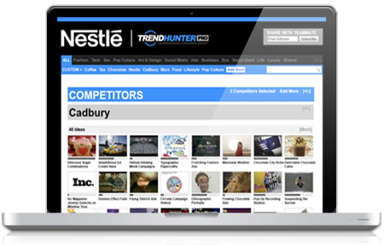
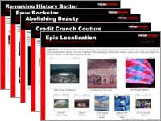
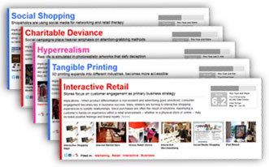
1. CUSTOM TREND PLATFORM Our revolutionary new platform enables you to track the topics, categories and markets that are most important to your business
New! Dashboards
Filter through the best PRO Trends and innovations with a customizable dashboard at TrendHunter.com/dashboard
CUSTOMIZABLE - Track innovations and trends based on your industry, keywords and competitors.
CUSTOM LISTS - Create custom lists, filters and reports.
HOURLY UPDATES - Stay cutting edge with hourly updates!

Slide 6
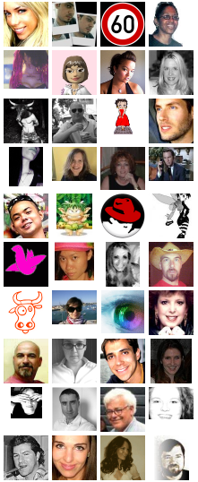
2. CROWDSOURCED & FILTERED The reports are global, based on crowdsourced and crowd filtered content from Trend Hunter, the world’s #1 trend site
CROWDSOURCED World’s Largest Trend Network
CROWD FILTERED 300,000,000+ Page Views
INSIGHT Inspirational Ideas
80,000 Trend Hunters
120,000 Micro Trends
40,000 Micro-Trends “The Best”
1,200+ PRO Trends

Slide 7
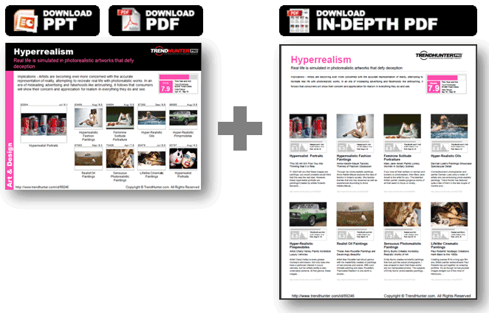
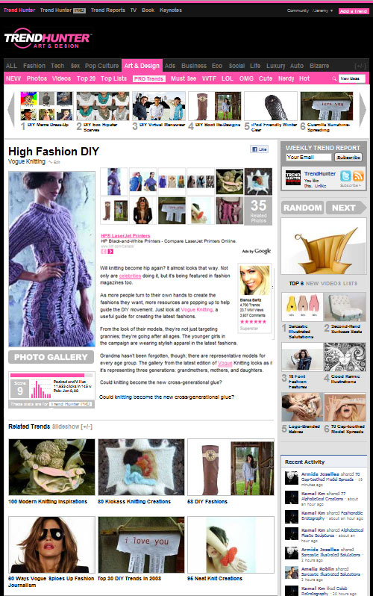
3. HYPERLINKED 4 MORE Each report examples is hyperlinked to our free online articles, which in many cases include galleries and videos
Get More:
Details
Galleries
Videos
Sources

Slide 8
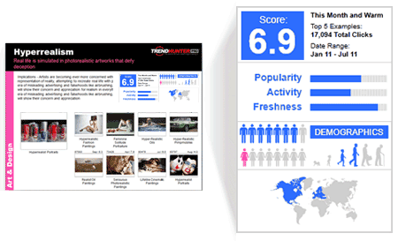
4. MEASURED We score micro-trends for popularity, leveraging 700,000,000+ views. High scores excite consumers!
Overall Score
The average of popularity, activity and freshness for all the included examples.
Popularity
The relative number of visitors who were interested in an innovation compared to all the other innovations during the same time.
Activity
The amount of interaction readers had with an idea, in terms of gallery views, shares, etc.
Freshness
A logarithmic score of newness
Gender, Age and Region
An editorial assessment of who the idea is best suited for
Gender: mostly female, female, neutral, male, mostly male
Age: 0-2 3-12 12-18 18-35 35-55 55+
Region: By continent

Slide 9
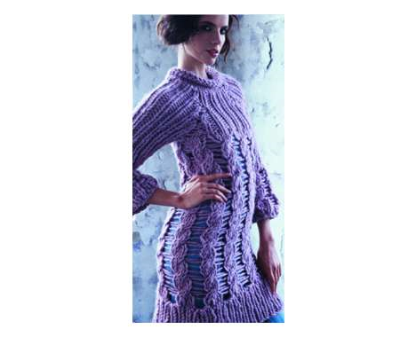
4b. MEASURED [HOW TO READ] Each of the micro-trends includes useful information including discovery date and the relative traffic score
Trend ID
Open any trend using its id:
TrendHunter.com/id/XXXX
Discovery Date
This may be before or after the product has been released, but discovery is a useful measure because it reflects when the web community took notice.
12843
June / 8.0
Traffic Score
Out of 10, this is a measure of traffic relative to other posts on Trend Hunter during the same month.
>5 : Above Average
>7 : Hot
>9 : On Fire
Vogue Knitting
Hyperlinked Picture
Click on any picture (in PRESENTATION MODE) to open the full article. This can include galleries, videos, and product links

Slide 10
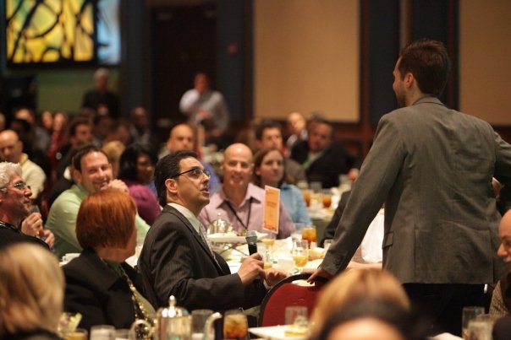
5. WEBINARS & ADVISORS If you want to take innovation to the next level, Platform/Report subscribers get free webinars, and we offer Advisor services.
More Info:
TrendHunter.com/advisor

Slide 11
6. ACCLAIMED CONTENT Last, enjoy the content! You’re reading examples from the freshest source for cutting edge trends!

Slide 12
BONUS: HOW TO INNOVATE To get the most of a subscription, watch our 30 minute video of EXPLOITING CHAOS, and get your team to browse our book
Free 30 Minute Training Video Video at: JeremyGutsche.com
Innovation Book Now enhanced with video1

Slide 13
SAMPLE
TOP 20 TRENDS
2012 TREND REPORT
Copyright © TrendHunter.com. All Rights Reserved

Slide 14
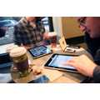
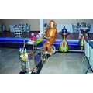
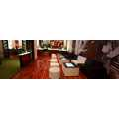
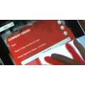
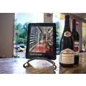
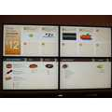
Digital Eating
Interactivity becomes essential in the culinary experience
Implications - Because competition in the food service industry calls for players to be on top of the latest innovations, more and more restaurants are combining computers and cuisine to provide patrons with an interactive, digital experience every time they visit. Apps and other digital devices are being applied to menus, wait staff and more, adding a modern touch to mealtime to enhance engagement and brand loyalty among customers.
Score:
Popularity
6.7
Activity
Freshness
DEMOGRAPHICS
98968
Jan / 7.6
95482
Dec / 7.6
76874
May / 6.1
80635
Jul / 6.3
Robot-Ran Restaurants
Internet Martini Bars
Interactive Restaurant Menus
82355
Jul / 6.3
87407
Sep / 3.7
Art & Design
Paperless Cafe Newsstands
iPad Menus
Social Media Fast Foods
http://www.trendhunter.com/id/99655 Copyright © TrendHunter.com. All Rights Reserved

Slide 15
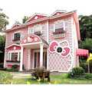
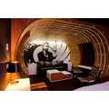
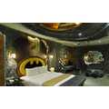
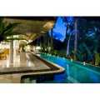
Pop Culture Vacations
Hotels are taking inspiration from movies and media to attract visitors
Implications - The numerous references made to pop culture and media within today's society has inspired those running vacation spots and hotels to do the same in hopes to attract more visitors. Targeting fans of much-loved pop culture characters like Batman and James Bond, those in the travel business are sure to appeal to movie fans with their creative themed designs.
Score:
Popularity
7.7
Activity
Freshness
DEMOGRAPHICS
100660
Jan / 8.1
90190
Oct / 6.6
106065
Mar / 7.8
Extravagant Fantasy Vacations
Superhero Hotel Rooms
66213
Jan / 5.4
World
Pop Culture Toon Hotels
Pandora-Like Vacation Villas
http://www.trendhunter.com/id/113559 Copyright © TrendHunter.com. All Rights Reserved

Slide 16
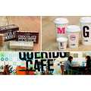
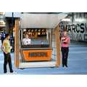
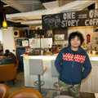
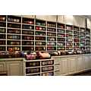
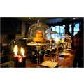
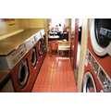
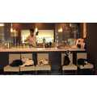
Renovated Tradition
Classic coffeehouses are reinterpreted for the contemporary coffee crowd
Implications - From classic, cozy and independent coffeehouses to "fast food" cafes like Starbucks, coffee shops have evolved tremendously over the last century. Now, coffee-drinkers are turning to contemporary, one-of-a-kind cafes, with some even offering other services--like knitting and pets--along with coffee. These revitalized cafes appeal to the modern caffeine-lover with a specific interest or someone who wants, in addition to a simple cup of joe, an entire experience.
Score:
Popularity
6.8
Activity
Freshness
DEMOGRAPHICS
108852
Apr / 8.5
106599
Mar / 8.2
104953
Mar / 7.6
Eclectic Coffee Shop Redesigns
Pop-Up Portable Coffee Shops
Hidden Coffee Shops
96483
Dec / 5.8
105508
Mar / 4.3
101416
Feb / 5.1
106008
Mar / 6.2
102279
Feb / 6.3
Lifestyle
Crafty Cafes
Tattoo Tea Parlors
Micro Theater Coffee Houses
Clothes-Cleaning Cafes
Pet Store Cafes
http://www.trendhunter.com/id/109407 Copyright © TrendHunter.com. All Rights Reserved

Slide 17
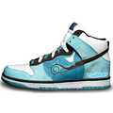
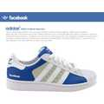
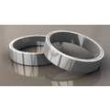
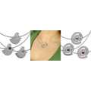
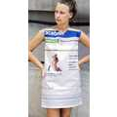
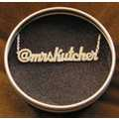
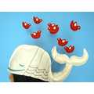
Virtual Fashion
Social media brands are creatively integrated into apparel
Implications - Consumers are beginning to demand social media in everything they do; apparel brands are taking note and cleverly integrating sites like Twitter and Facebook into their fashion products. Designers and businesses creating these products hope to appeal to the technology-focused youth demographic and feed the social media hype, providing digital-savvy individuals with a way to front their social brand loyalty with pride.
Score:
Popularity
7.2
Activity
Freshness
DEMOGRAPHICS
77021
May / 7.7
94473
Nov / 7.8
99307
Jan / 6.7
Twitter High-Tops
Social Media Shoes
Social Media Wedding Bands
99206
Jan / 5.9
92166
Oct / 6.4
54722
Sep / 4.4
93676
Nov / 5.4
Marketing
Social Media Jewelry
Social Media Frocks
Twitterific ID Necklaces
Social Media Caps
http://www.trendhunter.com/id/110214 Copyright © TrendHunter.com. All Rights Reserved

Slide 18
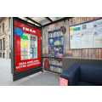
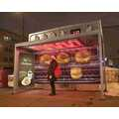
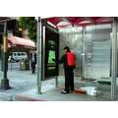
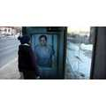
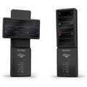
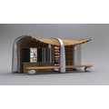
Interactive Out of Home
Branded transit stops capture attention from bored commuters
Implications - Bus stop advertisements now comprise more attention-grabbing branding than ever before. However, it's not just about advertising--it's about drawing in the consumer any way possible during this optimal time when boredom is heightened. For the anxiously waiting commuter, bus stop branding that asks them to relax on a sofa, read a book or "save a life" offers a welcome reprieve from watch-checking, foot-tapping and general irritability spawning from impatience.
Score:
Popularity
6.8
Activity
Freshness
DEMOGRAPHICS
96105
Dec / 7.1
98767
Jan / 8.3
99649
Jan / 7.9
109698
Apr / 6.5
People-Warming Ovens
Gaming Bus Stops
LIfe-Saving Bus Ads
93503
Nov / 4.2
103759
Feb / 4.8
Marketing
Cozy Commuter Couches
Interactive Bus Stops
Bookworm Bus Shelters
http://www.trendhunter.com/id/110032 Copyright © TrendHunter.com. All Rights Reserved

Slide 19
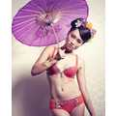
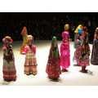
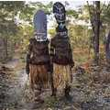
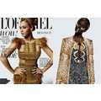
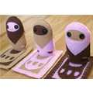
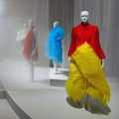
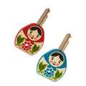
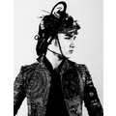
Adapted Ethnicity
Ethnic influences redefine national culture and pop culture
Implications - With increasing immigration, acculturation in foreign countries and international access to the Internet, globalization is becoming more of a reality with each passing day. A specific region's pop culture and customs can be far-reaching, such that a single national culture no longer defines a country's residents. In order to succeed in what is becoming a smaller and smaller world, companies must take a holistic view of the world while acknowledging its many subparts.
Score:
Popularity
7.1
Activity
Freshness
DEMOGRAPHICS
90422
Oct / 7.4
90346
Oct / 7.3
104642
Feb / 6.5
Sensational Ethnic Spreads
Cultural Costume Fashion
Masked Tribal Portraits
104395
Feb / 7.4
91991
Oct / 7
91433
Oct / 4.7
102995
Feb / 4.1
103239
Feb / 4.7
Fashion
Face Paint Controversies
Cuddly Culture Dolls
Haute Ethnic Tributes
Cultural Key Covers
Elaborate Heritage Shoots
http://www.trendhunter.com/id/106496 Copyright © TrendHunter.com. All Rights Reserved

Slide 20
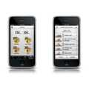
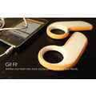
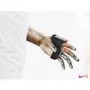
Social Fitness
The ability to share health and fitness progress enhances consumer motivation
Implications - Many people exercise with friends, which can be more motivating than working out alone. With the rise of social media fitness apps, consumers can now exercise with all 500 of their friends if they wish. The ability to track and share exercise or diet activities makes one accountable to their network, which may be all the incentive necessary for one to continue striving towards health and fitness goals.
Score:
Popularity
4.7
Activity
Freshness
DEMOGRAPHICS
78508
Jun / 6
95226
Dec / 3.9
101247
Feb / 4.1
Feminine Fitness Apps
Interactive Exercise Apps
73017
Apr / 3.7
103758
Feb / 3.4
Technology
Fitness Gaming Evolutions
Funky Fitness Monitors
Smartphone Exercise Devices
http://www.trendhunter.com/id/105661 Copyright © TrendHunter.com. All Rights Reserved

Slide 21
Ecoducation
Green learning becomes an integral part of modern academia
Implications - Students today understand the importance of eco-friendly living; some classrooms are even becoming a mecca for eco-conscious learning and initiatives. More and more students are doing their parts and contributing to the cause, and schools everywhere are being built with the environment in mind. Thus, a merge has begun between eco-minded businesses, green organizations and educational institutions alike.
Score:
Popularity
5.5
Activity
Freshness
DEMOGRAPHICS
103584
Feb / 4.9
60986
Dec / 5.3
65294
Jan / 3.2
Treetop Playgrounds
Edible Schoolyards
104788
Mar / 4.5
77711
Jun / 4.6
Eco
Ultra-Green Theaters
Zero Energy Schools
Mandatory Environmental Education
http://www.trendhunter.com/id/114226 Copyright © TrendHunter.com. All Rights Reserved

Slide 22
Instant Entrepreneurship
Products that make launching a business easy serve a growing niche
Implications - Digital business networks are allowing entrepreneurs to connect to thousands of like-minded people at the click of a button, while products, apps and special services are helping aspiring business owners realize their dreams quickly and easily. The era of "instant" entrepreneurship is here, in which anyone can become their own boss almost overnight.
Score:
Popularity
5.9
Activity
Freshness
DEMOGRAPHICS
93013
Nov / 7.4
71371
Mar / 6.5
76492
May / 5.1
Bad Branding Services
Trend Forecast Maps
Online Ad Creators
94349
Nov / 6.6
83085
Jul / 3.3
82096
Jul / 3.7
83669
Aug / 5
Technology
Entrepreneur Flash Games
MBA Graduate Marketplaces
Entrepreneurial Retail Games
Future-Predicting Sites
http://www.trendhunter.com/id/99740 Copyright © TrendHunter.com. All Rights Reserved

Slide 23
Superhero Reality
Real-life superhero innovations give consumers something to believe in
Implications - Children have traditionally looked up to superheros, who encourage them to be "brave" during times of despair. Today's adult consumer isn't afraid to carry on their vigilante obsession, looking for inspiration anywhere they can during times of extreme stress. Luckily, there is a slew of hero-inspired products available to encourage consumers to stay strong and brave no matter how tough life gets.
Score:
Popularity
6.7
Activity
Freshness
DEMOGRAPHICS
105921
Mar / 6.6
104936
Mar / 6
100080
Jan / 6
99012
Jan / 5.9
103323
Feb / 7.6
Graphic Novel Jewelry
Heroic Cooking Clothing
Superhero Comic Cosmetics
Superhero Dating Sites
Badass Superhero Kicks
102330
Feb / 7.3
98068
Jan / 6.5
104345
Feb / 5.4
99440
Jan / 5.5
Pop Culture
Sci-Fi Superhero Suits
Real-Life Superhero T-Shirts
Heroic Car Shoots
Rad Superhero Kicks
http://www.trendhunter.com/id/106322 Copyright © TrendHunter.com. All Rights Reserved

Slide 24
Digital Decor
Wallpaper designs are infused with hi-tech elements for renewed appeal
Implications - The classic interior design staple, wallpaper, is getting a technological overhaul. LED lights, heat-sensitivity and other hi-tech elements are breathing life into traditional décor, creating space that is both aesthetically cool and provides functionality. Whether hi-tech or technology-themed, home décor is seeing a new direction, one that lets consumers turn the online world into reality.
Score:
Popularity
7.1
Activity
Freshness
DEMOGRAPHICS
86050
Aug / 6.6
94038
Nov / 7.2
96261
Dec / 7.7
94903
Dec / 7.1
Vivid Virtual Wallpaper
Windows Error Art
Magical Morphing Decor
88751
Sep / 6.5
94902
Dec / 6.3
Art & Design
Life-Saving Wallpaper
Glistening Wall Decor
Social Media Wallpaper
http://www.trendhunter.com/id/99084 Copyright © TrendHunter.com. All Rights Reserved

Slide 25
Augmented Reality Shopping
Virtual interactivity is changing the traditional purchasing experience
Implications - The way we shop is undergoing a radical change, as retailers incorporate augmented reality by infusing traditional services with a virtual twist. The augmented reality shopping experience creates an increased ability to test out products and locate places to buy specific items, which may cause a shift in buyer behavior as the physical aspect of shopping becomes increasingly unnecessary.
Score:
Popularity
6.5
Activity
Freshness
DEMOGRAPHICS
93309
Nov / 6.9
66887
Feb / 6.5
60840
Dec / 6
Augmented Reality Retailers
Virtual Makeup Mirrors
Brew Finder Apps
95235
Dec / 5.5
60378
Nov / 6
87195
Sep / 4.9
66295
Feb / 5.4
90621
Oct / 5.9
Business
Interactive Fitting Rooms
Fitting Room Simulators
Augmented Reality Postage
Webcam-Ready Valentines
Virtual Interior Design
http://www.trendhunter.com/id/95865 Copyright © TrendHunter.com. All Rights Reserved

Slide 26
Plastic Rebellion
Consumers fight back against the growth of a "plastic planet"
Implications - With almost 9.5 million cosmetic procedures conducted in 2010 (as reported by the American Society for Aesthetic Plastic Surgery), it doesn't seem likely that consumers are shying away from plastic surgery. Yet, a rise in "anti-plastic" ads and photography may indicate otherwise. Making a profound statement on the industry, these often hard-to-stomach images show that true beauty can't be reached with a knife. Like the fight against too-skinny models, this plastic rebellion reminds consumers of the consequences of emphasizing outer beauty over inner beauty.
Score:
Popularity
8.6
Activity
Freshness
DEMOGRAPHICS
73451
Apr / 7.4
85851
Aug / 8.1
116063
Jun / 8.9
Extreme Plastic Surgery Shoots
Exaggerated Runway Faces
Incisive Plastic Surgery Photography
95974
Dec / 7.1
81174
Jul / 7.5
92713
Nov / 7.3
99237
Jan / 4.4
Fashion
Surgery-Ready Shoots
Shoulder Architecture
Hacksaw Surgery Shoots
Reverse Liposuction
http://www.trendhunter.com/id/117065 Copyright © TrendHunter.com. All Rights Reserved

Slide 27
Social Profiling
Social networking culture becomes more evident with stereotypes
Implications - Social media users are being separated into stereotypical groups of people who share the same preferences and characteristics. With more and more sites and illustrations dedicating their time to profiling the social media user, the more apparent it becomes that the activity of social networking has become a culture in and of itself, filled with its own unique demands, qualities and "subcultures."
Score:
Popularity
7.9
Activity
Freshness
DEMOGRAPHICS
107716
Mar / 8.7
107583
Mar / 8.8
106048
Mar / 8.6
Facebook Friend Infographics
Social Media Archetype Parodies
107798
Apr / 8.3
87138
Sep / 4.1
Social Media
Social Media Yearbook Stereotypes
Catty Social Media Categorizing
Domesticated Website Drawings
http://www.trendhunter.com/id/107969 Copyright © TrendHunter.com. All Rights Reserved

Slide 28
Invisible Design
Transparent home furnishings appeal to desire for simplicity
Implications - Minimalism continues to be a direction in home decor and furniture design--and there's nothing more minimal than a transparent item. See-through furnishings and home accents can make small, confined spaces look bigger by virtue of their transparency. For urbanites having to adhere to space constraints, invisible furnishings allow for both modern aesthetic and sheer functionality.
Score:
Popularity
8.0
Activity
Freshness
DEMOGRAPHICS
110276
Apr / 8.6
101720
Feb / 8.3
114677
Jun / 8.8
Illusory Staircases
Terrifically Transparent TVs
Mind-Boggling Invisible Bookcases
106921
Mar / 7.4
105246
Mar / 6.8
94299
Nov / 5.7
111302
May / 5.8
Art & Design
Invisible Eco Houses
See-Through Seating
Invisible Light Switches
Invisible Outdoor Seating
http://www.trendhunter.com/id/115218 Copyright © TrendHunter.com. All Rights Reserved

Slide 29
Techadence
Consumers go beyond cases and decals with lavish customization
Implications - Cases and decals are no longer enough when it comes to tech adornment; consumers are now tricking out their devices to really let their individuality shine. Computers, in particular, now bear extravagant aesthetic enhancements reminiscent of fashion's hottest accessories. As computers become almost extensions of the self instead of lifeless devices, adding lavish details and customizing parts seem only natural for the unique-seeking consumer.
Score:
Popularity
7.4
Activity
Freshness
DEMOGRAPHICS
78772
Jun / 6.9
99548
Jan / 7.1
98490
Jan / 7.1
103191
Feb / 7.1
104866
Mar / 7.8
Steampunk Flash Drives
Professionally Stylish Peripherials
Victorian Computer Peripherals
Intricate Steampunk PCs
$2,800 Peripherals
105219
Mar / 7
103752
Feb / 7.1
101069
Jan / 4.3
104617
Feb / 5.8
99149
Jan / 4
Technology
Macabre Memory Sticks
Comic Book Flash Drives
Veiny Computer Peripherals
Explosive Memory Sticks
Terminal Tower Monitors
http://www.trendhunter.com/id/106076 Copyright © TrendHunter.com. All Rights Reserved

Slide 30
Unlabeling
Brands turn to extreme minimalism with simplified logos and packaging design
Implications - Brands are applying extreme minimalism to logo and packaging design, often relying on loyalty and brand recognition to maintain sales and awareness. While "discreet consumerism" had logo-averse consumers looking to unbranded merchandise, in this case they are simply looking for cleaner details, sharper focus and less "in-your-face" selling.
Score:
Popularity
7.3
Activity
Freshness
DEMOGRAPHICS
96507
Dec / 8.5
97173
Dec / 7.8
97749
Jan / 6.9
Simplified Product Packaging (UPDATE)
Unbranded Coffee Logos
84569
Aug / 6.6
95948
Dec / 6.2
Marketing
Minimalist Brand Makeovers
Minimalist Beer Bottles
Back-to-Basics Branding
http://www.trendhunter.com/id/98188 Copyright © TrendHunter.com. All Rights Reserved

Slide 31
Digital Graffiti
Revolutionizing street art through digital mediums
Implications - You can do much more with digital art software than you can do with a can of spray paint. While most infamous street artists are happy to stick to their traditional mediums, other artists, as well as many consumers, are taking to virtual and digital tools to create graffiti art. Whether it is light graffiti or simulated street art via a projector, digital graffiti is changing the traditional definition of street art, and encouraging the participation of those who may have otherwise struggled with a real spray can.
Score:
Popularity
7.1
Activity
Freshness
DEMOGRAPHICS
108710
Apr / 7.5
108263
Apr / 8.3
104913
Mar / 7.4
Light Graffiti Fashiontography
Street Tagging Apps
Urban Wifi Landscapes
108648
Apr / 7.2
101797
Feb / 5.2
83953
Aug / 3.9
115253
Jun / 6.4
102186
Feb / 5.5
Marketing
Illuminated Street Animation
Skeletal Light Paintings
Virtual Street Art Simulators
Motion-Gaming Street Art
Digital Graffiti
http://www.trendhunter.com/id/116893 Copyright © TrendHunter.com. All Rights Reserved

Slide 32
Strategic Viral
The line between campaign commercial and viral meme continues to blur
Implications - Today's pop culture-savvy marketers know that a typical TV commercial is no match for a carefully planned viral video. The success of a commercial now hinges on whether or not it goes viral, and agencies are creating ads while considering first its potential on YouTube and its effect on the digital consumer. We are thus steadily moving to a point in which the difference between viral videos and carefully disguised commercials is less and less discernible.
Score:
Popularity
5.9
Activity
Freshness
DEMOGRAPHICS
104995
Mar / 6.4
95078
Dec / 7.1
88854
Sep / 4.7
Violent Commercial Parodies
Revolutionary Online Runways
Abrupt Bear Outbursts
96809
Dec / 3.6
105665
Mar / 6.1
92607
Nov / 5.9
99565
Jan / 6.2
Pop Culture
Viral NBA Star Songs
Celeb Viral Campaigns
Music-Playing Feline Ads
Jumper Cable Campaigns
http://www.trendhunter.com/id/106082 Copyright © TrendHunter.com. All Rights Reserved

Slide 33
Lesscapism
Less luxury is more as consumers search for a truly unique vacation
Implications - Increased dependence on technology and an addiction to material goods are making some consumers seek less luxurious alternatives when vacationing. Escaping their extensive digital media use and material possessions, these consumers are choosing rustic tourist attractions that boast a harsher realism, providing an experience that is more refreshing than daily extravagance.
Score:
Popularity
7.5
Activity
Freshness
DEMOGRAPHICS
99758
Jan / 7.4
99462
Jan / 7.7
77659
Jun / 6.9
Recycled Refuse Tourism
Mini Budget Lodgings
Temporary Trash Tourism
97591
Jan / 6.8
93419
Nov / 7.9
100311
Jan / 6.9
73897
Apr / 5.5
World
Temporary Cargo Structures
Hidden Hobbit Hotels
Urban Tube Hotels (UPDATE)
Rabbit Hole Hostels
http://www.trendhunter.com/id/102788 Copyright © TrendHunter.com. All Rights Reserved

Slide 34
1,200 PRO Trends, 50 reports & Custom filters for YOUR brand
Supercharge
Innovation!
Subscribe to our Trend Hunter Platform, and you’ll get:
The 300 page 2012 Report
1,200 more PRO Trends
120,000 Examples
50+ Industry Reports
A Custom Trend Platform
Our Innovation Toolkit!
TrendHunter.com/TrendReports

