Slide 1
Innovation
Workshops
Dedicated Advisors
Curated Reports
Trend Report Library
Innovation eLearning
Custom Trend Dashboard
180,000+ Ideas
2013 Trends
Sample Report
#1 in Trends - Brought to you by Trend Hunter, the world's most popular, largest trend network, fueled by more than 100,000 contributors and a billion views of data. Find Better Ideas, Faster™

Slide 2
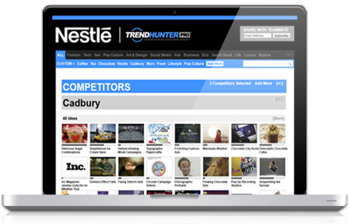
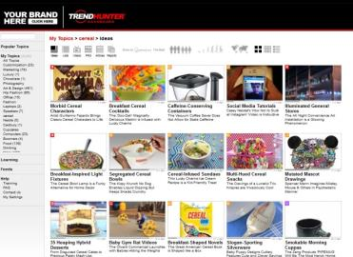
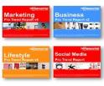
Find Better Ideas, Faster
TM
Join leading brands who supercharge innovation with our Trend Reports and Advisory service. Starting at $9k / year, your team can get monthly curated reports and special access to the world’s #1 trend platform.
Curated Reports
Monthly Reports
Reports & PRO Content 2,000 PRO Trends
Custom Dashboard 180,000 Ideas
1. Find Better Ideas FasterTM
eLearning 2,000 Videos + Optional
Workshops
2. Track competitor innovation
3. Identify emerging opportunities
4. Save time and effort

Slide 3
i. Context & Methodology

Slide 4
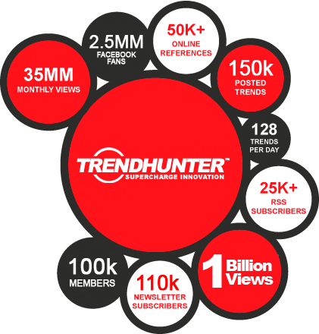
#1 in Trends
Trend Hunter has created the largest, most popular collection of cutting edge ideas, fueled by an enormous community and fan base
Media
Report Clients

Slide 5
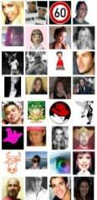
Crowdsourced Insight
TM
Instead of relying on gut instinct, we leverage the ‘power of the crowd’ to find innovative ideas, filter through noise and quantify new opportunity
CROWDSOURCED World’s Largest Trend Network
CROWD FILTERED Unrivaled Methodology
INSIGHT Inspirational Ideas
115,000 Trend Hunters
180,000 Ideas
40,000,000 Pageviews / Month
2,000+ PRO Trends
50+ Trend Reports
&
Like a focus group with 100 stadiums of people, looking for opportunity
Like 6 stadiums full of experts, from 190 countries, hunting ideas for your team

Slide 6
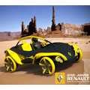
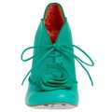
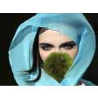
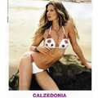
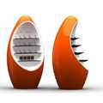
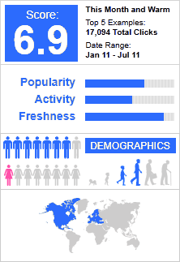
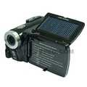
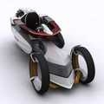
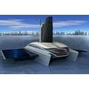
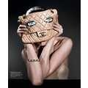
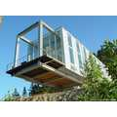
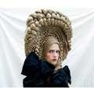
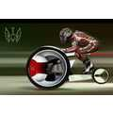
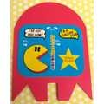
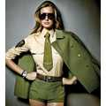
100 Million People = Data
Like a giant focus group, our audience enables us to quantify consumer interest to find patterns of opportunity, categorized by industry and demographic segments
1.4 billion pageviews 100 million visitors 2.5 million Facebook Fans 115k members 190 countries

Slide 7
Report Archive
Your team can gain full access to several thousand PRO Trends and 50 categories of downloadable PowerPoint Trend Reports, which have been used by hundreds of brands to spark innovation
50+ Categories and 1,000+ Topics

Slide 8
Optional Workshops
If you’re looking for more comprehensive advice, our CEO is an award-winning innovation expert who has helped more than 300 clients supercharge innovation. More at: JeremyGutsche.com
Jeremy Gutsche, MBA, CFA, is an innovation expert and award-winning author who specializes in innovation through periods of chaos and change. As a Business Director at a major bank, he led his brand to grow a $1 billion portfolio of market-leading products, driven by the development of an innovation pipeline and a culture of customer obsession. Today, he’s grown Trend Hunter to a 1.4 billion view research lab while with more than 300 clients, including Victoria’s Secret, Sony, Cisco, NBC, Fox, Nestle, Mattel and Crayola.
Key Topics:
- Exploiting Chaos - How to Spark Innovation During Times of Change
- Culture of Innovation - How to Create a Culture of Customer Obsession
- Finding New Opportunity - How to Find Better Ideas, Faster
- Sparking Change - How to Get Creative and Make Innovation Happen
- Infectious Messaging - How to Break Through the Noise and Make Ideas Stick
- Custom Workshops - How to Reinvent Your Brand / Innovation Culture
“An Intellectual Can of Red Bull”

Slide 9
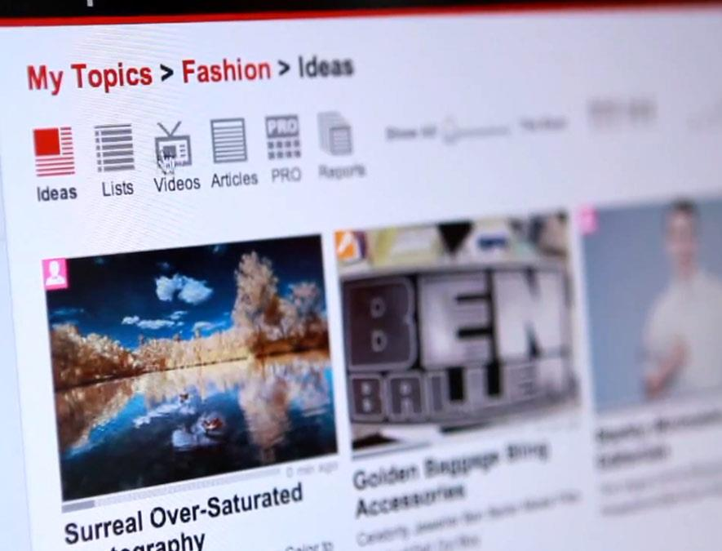
ii. 20 Sample Trends

Slide 10
CONTEXT: How PRO Trends Work
If you view this PowerPoint in Slide Show mode, each example is hyperlinked to a full article, images, and in some cases, videos on TrendHunter.com
Business Implication Each PRO Trend is written in terms of its implications across multiple industries
Hyperlinked Examples Each example is hyperlinked to a full article and images
Demographics & Performance Better filter examples and PRO Trends based on your needs
Online Links
Each PRO Trend links to an online version, which can have up to 100 examples, images & videos

Slide 11
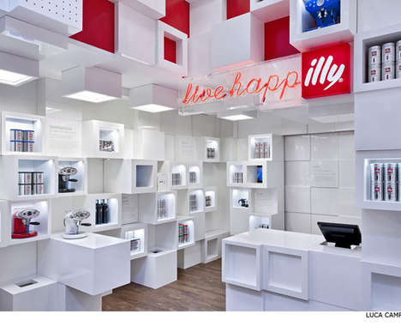
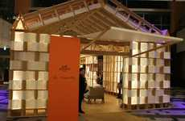
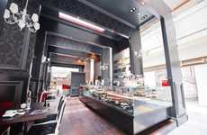
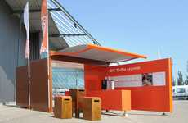
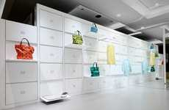
Modular Retail
Fold-away stores allow retailers an easy way to move locations
Implications - Over the past couple of years, pop-up stores have been allowing retailers to quickly test their products with convenience and efficiency in many different areas. Now, store designers are recognizing the importance of modular design when it comes to temporary -- and in some cases, permanent -- retail. Creating a modular physical store allows for it to be deconstructed and reconstructed quickly, which saves time when it comes to [continued online]
Luxury Paper Pop-Ups
Elegant Victorian Dessert Shops
Hermes + Shigeru Ban Pavilion is an Eco-Friendly Design
Carbon Designs Bea's of Bloomsbury Cupcake Kiosk
Modular Cubed Pop-Ups
Vibrant Pop-Up Cafes
Fold-Away Fashion Stores
Art & Design
Illy Temporary Shop by Caterina Tiazzoldi Can Be Adapted to Different Areas
The ING Express Mobile Coffee Bar is an Eye-Catching Modular Establishment
The 24 Issey Mikaye Store Can Easily be Stored Anywhere
Score:
Popularity
DEMOGRAPHICS
5 Ideas + 35 Related Examples
6.4
Activity
http://www.trendhunter.com/id/136825
Freshness
Copyright © TrendHunter.com. All Rights Reserved

Slide 12
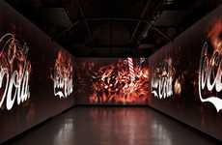
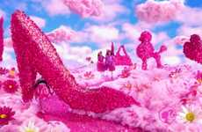
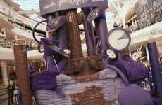
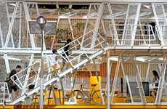
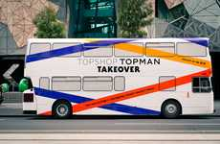
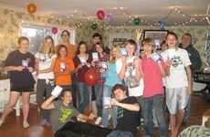
Immersive Branding
Fully engrossing consumers in surrounded campaigns
Implications - A brand can captivate an audience through strong visuals, resonating messages and engaging interaction, but they can go above and beyond that with full immersion, creating a total brand experience in which the customer is surrounded and completely immersed in a brand. Coca-Cola and Cadbury are two brands that are trying out this new form of infectious messaging, in which campaigns include larger-than-life productions, fantasy [continued online]
Immersive Brand Projections
Fantastical Doll Wardrobes
Imaginary Chocolate Lands
Chic Advertising Apartments
Antilop Creates Coca-Cola Future Room for Santralistanbul
The 'See What Happens When You Play With Barbie' Campaign
Cadbury's Joyville Promotes the New Dairy Milk Bubbly
The Billboard House from Apostrophy's is Large and Livable
Creative Incentivized Internships
Branded Bus Rides
Sponsored Social Soirees
Marketing
The Topshop Tour Bus Promotes Opening of Melbourne Store
Brands Can Use 'House Party' to Market Products Directly to Customers
Trainees Must Earn Their Way Up the Mortierbrigade Hotel
Score:
Popularity
DEMOGRAPHICS
7 Ideas + 63 Related Examples
5.1
Activity
http://www.trendhunter.com/id/144015
Freshness
Copyright © TrendHunter.com. All Rights Reserved

Slide 13
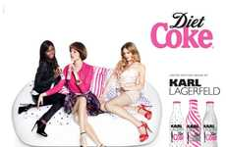
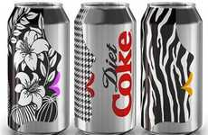
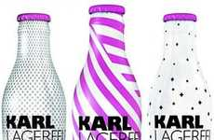
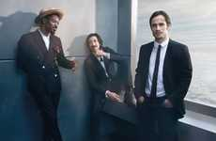
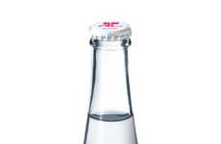
Fashionizing
Rebranding ordinary products to appeal to fashion-focused consumers
Implications - There are just some things that people don't expect to be fashionable -- like soft drinks and razors, for example. But that doesn't mean brands won't get consumer attention when it recreates or markets these ordinary products with a fashionable twist. A lot more people, both men and women, are interested in style these days, and turning a simple item into a stylish one stands to make it more appealing, especially when your tar [continued online]
Couture Cola Campaigns
Posh Pop Packaging
Fashionable Feminine Hygiene
The Karl Lagerfeld Diet Coke 2011 Campaign is Pretty in Pink
The Diet Coke Get Glam Campaign is in Collaboration With Benefit Cosmetics
U by Kotex Limited Edition Designer Series Offers Stylish Protection
Couture Icon Cola Bottles
Dapper Grooming Campaigns
Haute Couture Water Vessels
Marketing
Karl Lagerfeld Diet Coke Bottles Add Fashionable Flair to Soft Drinks
Three Stylish Stars to Represent the Gillette Fusion ProGlide Styler
The Courreges Limited Edition Evian Bottle is Stylishly Vivacious
Score:
Popularity
DEMOGRAPHICS
6 Ideas + 50 Related Examples
5.6
Activity
http://www.trendhunter.com/id/140779
Freshness
Copyright © TrendHunter.com. All Rights Reserved

Slide 14
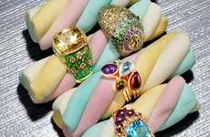
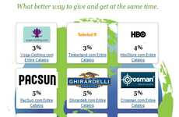
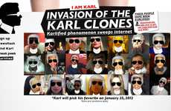
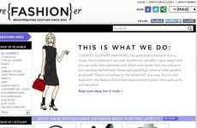
Manufactured Addiction
Gamified shopping keeps customers hooked & coming back for more
Implications - An increasing number of websites are gamifying shopping, which, psychologically, can cause buying addiction. These sites include "flash shopping" sites with limited-time sales that make us feel a thrill when we buy something against a ticking clock, rewards-based sites that offer points in return for purchases, and deal-based sites like Plukka, in which the excitement is based on getting a great deal only if enough people agr [continued online]
Budget-Friendly Fine Jewelry
Charitable Shopping Websites
Interactive Designer Microsites
Online Coupon Trading
The SKEEDKA Website Helps Circulate Group Deals Before They Expire
Plukka Relies on Customer Interest Before Pieces Become Available
'WorldWix' Donates Portions of Profit to Donation of Your Choice
Karl's Kult on Net-a-Porter Offers Mobile Apps and More
Daring Discount Partnerships
Mobile-Driven Discounts
Automaker Daily Deals
Couture Consignment eBoutiques
Social Network Shopping Rewards
Business
Hyundai Becomes the First Automaker to Partner With Groupon
Resell Your Luxury Fashion Pieces on reFashioner
Plink Integrates Facebook Credits and Real-Life Purchases
Score:
Popularity
DEMOGRAPHICS
9 Ideas + 72 Related Examples
4.1
Activity
http://www.trendhunter.com/id/147383
Freshness
Copyright © TrendHunter.com. All Rights Reserved

Slide 15
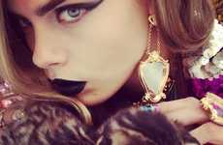
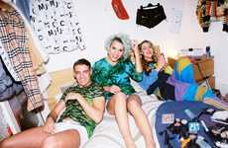
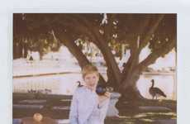
Deliberate Vintage
Growing obsession with making photos look 'antique'
Implications - Although recent years have seen a rise in high-resolution photography and tools, many people are becoming more partial to photography that takes on an antique look, with blurred edges, fuzzy images and faded coloring. This love for antique photography has created a renewed passion for the Polaroid photo as well as contemporary tools like Instagram that allow consumers to instantly turn their digital photos into "vintage" ones. [continued online]
Instagram-Inspired Editorials
Hipster Polaroid-Inspired Shoots
Polaroid Picnic Lookbooks
Retro Polaroid Pictorials
The Band of Outsiders Spring 2012 Catalog Stars Michelle Williams
Davis Ayer Captures Explosive Beauty
Cara Delevingne by Nick Knight Playfully Poses with Baby Pets
The Vice 'Less is a Bore' Editorial Offers Wild & Youthful Prints
Vintage 8-Bit Captures
Nostalgic Social Media Features
Sleepy Celeb Polaroid Shoots
Living Photo Apps
Vintage Polaroid Lookbooks
Fashion
Cinemagraph-Creating Company Flixel is Like Instagram on Steroids
The Band of Outsiders Spring 2012 Collection Features Artist Ed Ruscha
James Franco Covers the Debut Issue of Mister Muse Magazine
Score:
Popularity
DEMOGRAPHICS
9 Ideas + 79 Related Examples
7.3
Activity
http://www.trendhunter.com/id/150522
Freshness
Copyright © TrendHunter.com. All Rights Reserved

Slide 16
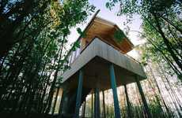
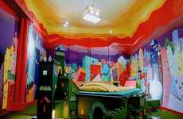
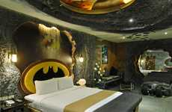
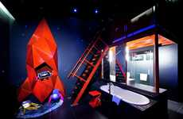
Nostalgic Escape
Adult vacations inspired by childhood let consumers travel back in time
Implications - For some, the ultimate escape is more mental than physical--thus, certain regions are boosting tourism by adding a whimsical element to their attractions, allowing consumers to revisit the more simple times of childhood. These infantile escapes are kid-inspired, yet are meant solely for adults. This provides consumers with a chance for full freedom from grown-up life, encouraging them to let loose and be kids again.
Treetop Suites
Ethereal Lodging Spaces (UPDATE)
Superhero Hotel Rooms
Lumber Lodging in a Tree House in the Hotel Hofgut Hafnerleiten
The Eden Motel Has a Crazy Batman-Inspired Couple's Suite
The Propeller Island City Lodge in Berlin is Visually Intriguing
Graffiti-Inspired Luggage
Experimental Boutique Boudoirs
Luxury Fantasy Ferries
World
Fly in Style With the Tumi & Crash Spring 2011 Capsule Collection
The Prodigious Disney Dream Will Set Sail in January 2011
The Wanderlust Hotel in Singapore is a Surreal Adventure
Score:
Popularity
DEMOGRAPHICS
6 Ideas + 52 Related Examples
5.8
Activity
http://www.trendhunter.com/id/107084
Freshness
Copyright © TrendHunter.com. All Rights Reserved

Slide 17
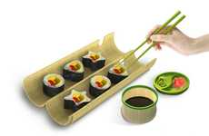
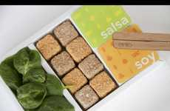
Crossover Cuisine
Food lovers embrace sushi all over the world, devise new interpretations
Implications - Sushi is becoming a globalized cuisine, as more and more Western cultures embrace the food with open arms. While at first Westerners did not particularly understand the concept of eating raw fish and seasoned rice together, over the course of the past few decades, it has become one of most beloved types of cuisine, with an increasing number of sushi restaurants and innovations sprouting up all over North America. According to [continued online]
Lunchbox Maki Makers
Edible Insect Sushi
Sweet Sushi Playthings
Rice Roll-Making Machines
The Wakasu Portable Sushi Maker Molds Homemade Meals into Fun
Ento Uses Creative Branding to Encourage Eating Creepy Crawlers
The Fakir Design Sushi Toy is an Adorable Delight
The Suzumo Inari Sushi Robot is Seriously Efficient
Sweet Maki-Inspired Bites
Zombie Food Treats
Melting Maki Bites
Ridiculously Large Rolls
Ethical Sashimi
Lifestyle
These Sushi Ice Cream Cupcakes are a Cute and Kitschy Way to Beat the Heat
Giant Sushi is Taking Over in Japan Among Diehard Fish Fans
Bamboo Sushi in Portland is a Certified B Corp That Values the Environment
Maki-Inspired Winter Accessories
Score:
Popularity
DEMOGRAPHICS
10 Ideas + 73 Related Examples
6.2
Activity
http://www.trendhunter.com/id/158950
Freshness
Copyright © TrendHunter.com. All Rights Reserved

Slide 18
Dystopia Fascination
Attracted to the faux reality of a repressive futuristic world
Implications - Modern consumers are intrigued by the idea of a future dystopian world, as evidenced by the popularity of the recently released film The Hunger Games, as well as the prevalence of imagery, products and other innovations that suggest a repressive and controlled society operating under the guise of a utopian world. These innovations not only appeal to our fascination and wonder but also serve as reminders that the pursuit of uto [continued online]
Monochromatic Dystopia Paintings
Dystopia Cartoon Mashups
Film-Inspired Photoblogs
Futuristic Dystopian Art
The Hunger Games Characters as Simpsons Stars are Hilarious
Capitol Couture is a Tumblr Based on Fashion from The Hunger Games
Alexandra Damacsek Uses Morbid Photo Manipulation to Create a Dark World
Michael Peck Transports Viewers to Foreboding Worlds
Post-Apocalyptic Pendants
Dystopian Jean Ads
Dystopian Industrial Structures
Surreal Dystopian Illustrations
Avant-Garde Anarchist Captures
Art & Design
The Samitaur Tower Provides Information and Art to its Citizens
Niklas Lundberg Creates Dark and Dramatic Graphic Designs
The Jeff Bark Bullett Magazine Editorial is Dark and Dystopian
Plush Toy Dystopias
Score:
Popularity
DEMOGRAPHICS
10 Ideas + 80 Related Examples
6.4
Activity
http://www.trendhunter.com/id/147253
Freshness
Copyright © TrendHunter.com. All Rights Reserved

Slide 19
Wearable Multitasking
Hi-tech watches that perform more functions than simple time-telling
Implications - Today's on-the-go consumers are constantly looking for products that will help them multitask, and one area in which multi-functionality may influence purchasing decisions is watch design. Because watches can be worn, they provide a convenient method of storing data, connecting to friends, making payments and more. Saving people the time and trouble it takes to find similar functions and apps on their computers, phones or tabl [continued online]
Luxe iPod Nano Watches
Credit Card Timepieces
Remote GPS Watches
Networking Pocket Watches
The ZShock Diamond Lunatik iPod Nano Function Watch Shines
LAKS Watch2Pay System Allows for Contactless Payments
The Citizen Satellite Wave Remains Accurate No Matter Where You Are
Serendipity from Hoang M Nguyen Puts a New Spin on Social Media
Multitasking Wrist Watches
Music-Tracking Time-Tellers
Triathlete Training Watches
Calorie-Counting Wristwatches
Fashion
The imWatch Lets You Stay Connected Online Wherever You Go
The Guitime Function Watch Tells Time & Helps You Fine-Tune Your Sound
The Garmin Forerunner 910XT is Designed for Multisport Training
The Bite Counter is Designed to Help You Cut Down at Dinner Time
Score:
Popularity
DEMOGRAPHICS
8 Ideas + 70 Related Examples
6.4
Activity
http://www.trendhunter.com/id/146768
Freshness
Copyright © TrendHunter.com. All Rights Reserved

Slide 20
IndustREtail
Business interiors go ultra-minimalist with an industrial aesthetic
Implications - Designers have been embracing minimalism throughout the past few years, and now this direction is going to the extreme, with the industrial aesthetic becoming the design go-to for retail and business interiors. Featuring raw wood, concrete materials and other bare-bones, unfinished elements, these industrial-looking retail and business spaces provide consumers with a more subdued sensory experience and offer a clean aesthetic [continued online]
Rustic Industrial Restaurants
Wine Cellar Lounges
Industrial Ice Cream Shops
Ruggedly Raw Boutiques
Carbon Bar Offers an Industrial and Contemporary Atmosphere
Polka Gelato by Vonsung Features a Cool Concrete Design
Hostem Shop in London Offers a Simple & Unfinished Look
Cocotte Presents a Gritty Interior Design
Contemporary Concrete Galleries
Industrial Minimalist Shops
All-Encompassing Jean Retail
Art & Design
The Local Firm's First Concept Store is Straightforward & Stylish
Pitsou Kedem Designs Stylish Showroom for B&B Italia
Levi Strauss's Industrie Denim Store is Complete with "Jean-iuses"
Score:
Popularity
DEMOGRAPHICS
7 Ideas + 61 Related Examples
6.2
Activity
http://www.trendhunter.com/id/150445
Freshness
Copyright © TrendHunter.com. All Rights Reserved

Slide 21
Millennial Madness
Focusing on the Gen Y segment to better understand burgeoning needs & demands
Implications - These days, it's all about marketing to Millennials. This demographic cohort has a higher level of discretionary income relative to prior generations, as well as vastly different preferences and mindsets, such as a greater familiarity with modern technology (and the willingness to spend money on it), lower level of religiosity and an entrepreneurial -- rather than rebellious -- nature. A deeper understanding of Millennials' ne [continued online]
Generational Marketing Guides
Generation Y Foodie Graphs
Doomed Millennial Infographics
The How Millennials Eat Infographic Tracks Cuisine Choices
The Millennials Infographic Breaks Down Gen Y
'Generation Screwed' Outlines Ominous Unemployment Rates
Generation-Focused Autos
Amusing Abbreviation Stationary
Simplified Social Media Manuals
Life-Stages
Chevy Code 130R and Tru 140S Aimed at Millennials
Fred Flare's 'OMG Sticky Notes' Boast Slang Terminology
Tok&Stok Twitter Manual Makes Furniture Assembly a Breeze
Score:
Popularity
DEMOGRAPHICS
6 Ideas + 52 Related Examples
5.0
Activity
http://www.trendhunter.com/id/146767
Freshness
Copyright © TrendHunter.com. All Rights Reserved

Slide 22
Upgraded Ordinary
Rebranding everyday condiments to increase customer awareness
Implications - When you think of spices and condiments like ketchup, you think of the most well-known brand (for example, Heinz) -- or you don't think of any brand at all. In an effort to recreate awareness, brands are rebranding these everyday products with more innovative and eye-catching packaging as well as augmented ingredients. When consumers perceive little difference between ordinary products like condiments, product revamps like the [continued online]
Cute Nudist Branding
Alchemist Spice Branding
Cute Condiment Cartons
Freehand Condiment Branding
Zest Packaging Promises that its Contents Have Nothing to Hide
Sheffield & Sons Packaging Evokes an Ingredient Purity
Temma Packaging has a Delightfully Delicious Disposition
Senor John's BBQ Sauces Packaging Helps the Homeless
Classy Condiment Upgrades
Caulking Branded Condiments
Luxurious Cooking Condiments
Lifestyle
The Heinz Ketchup Balsamic Vinegar is for More Refined Tastes
Montage Saus Packaging Looks More Like Epoxy Applicators
Golden Olive Oil is Infused With Real Flakes of Gold
Score:
Popularity
DEMOGRAPHICS
7 Ideas + 62 Related Examples
5.3
Activity
http://www.trendhunter.com/id/136238
Freshness
Copyright © TrendHunter.com. All Rights Reserved

Slide 23
Sustainitecture
More than just green, these structures are built to sustain themselves
Implications - The last year has seen more and more designs of eco-friendly architecture, the most ambitious of which are sky-scraping towers that can actually, according to their designers, sustain themselves. Through the use of special agricultural systems and alternative energy elements, these structures are built to achieve a level of unprecedented sustainability, based on goals to feed large percentages of urban populations. As unbeliev [continued online]
Sustainable Crystallized Structures
Self-Sustaining Cubitecture
City-Saving Eco Structures
Mile-High Urban Farms
Matrix Gateway Complex is an Astounding Innovative Green Structure
Riparian Urbanism Aims to Revitalize the City of Detroit
The Bionic Arch is the Latest Eco Project from Vincent Callebaut
The London Farm Tower is a Solution to Food Crisis
Actualized Urban Jungles
Sustainable Twin Towers
Manure-Powered Urban Farms
Eco
Vertical Farms for the AWR Competition are the Future of London
Vikas Pawar Designs an Eco-Friendly Set of Towers for Northern India
Gastropolis by All That is Solid Converts Methane Into Energy
Score:
Popularity
DEMOGRAPHICS
7 Ideas + 46 Related Examples
5.0
Activity
http://www.trendhunter.com/id/126204
Freshness
Copyright © TrendHunter.com. All Rights Reserved

Slide 24
Physical Virtual
Providing both an augmented reality and tangible experience in one
Implications - According to Forrester Research, Inc., online shopping in the United States will increase to $327 billion by the year 2016. This is no small number, but while online shopping is convenient, one thing shoppers don't get is a semblance of physicality -- a tangible store experience -- which may make online shopping a less pleasurable experience. However, bridging the gap between the physical retail store and the completely virtua [continued online]
Pop-Up Shopping Pods
Scannable Window Shopping
Virtual Subway Supermarkets
The Nike+ Fuelstations
John Lewis Virtual Shop Lets People Conveniently Click and Collect
Homeplus Uses Clever Marketing Campaign to Become Number One
Scannable Product Deliveries
Real-Life App Stores
Digital Holiday Donations
Business
The Openspace Store is a Physical Retail Shop That Sells Apps
The eBay Give a Toy Store Lets You Donate Toys by Scanning
Walmart and P&G's PGMobile Trucks Offer Convenience & Accessibility
Score:
Popularity
DEMOGRAPHICS
6 Ideas + 53 Related Examples
5.8
Activity
http://www.trendhunter.com/id/158383
Freshness
Copyright © TrendHunter.com. All Rights Reserved

Slide 25
Shoppertainment
Engaging customers through an exciting and entertaining retail experience
Implications - To grab the attention of today's shoppers, retailers are looking for more innovative ways to create an exciting in-store shopping experience. Thus, the era of "shoppertainment" is born, in which stores are readily adding interactive and exciting elements such as theaters, musical displays, digital showrooms and more. IKEA, for example, even hosts slumber parties at its Essex store, giving customers a night of movies, food, man [continued online]
Pop-Up Shopping Pods
Interactive Digital Showrooms
Linguistic Retail Campaigns
Cinematic Couture Shops
The Nike+ Fuelstations
Selfridges 'Words Words Words' Celebrates Power of Written Word
Louis Vuitton 'Roma Etoile' Boutique Will House a Small Theater
Audi City Will Provide Customers With a New Buying Experience
Furniture Store Slumber Parties
Boutique Simulation Games
Musical Retail Displays
Marketing
Stylmee Lets Users Curate & Sell Fashion Products in a Virtual Store
Calvin Klein Sound Installation Offers Customers an Audio Experience
IKEA Sleepover Offers Fans a Night of Fun & Pampering
Score:
Popularity
DEMOGRAPHICS
7 Ideas + 63 Related Examples
5.9
Activity
http://www.trendhunter.com/id/161990
Freshness
Copyright © TrendHunter.com. All Rights Reserved

Slide 26
Benefit Brands
Social cause companies badging themselves with B Corp certification
Implications - B Corp certification is a new accreditation given to companies that use the power of business toward social and environmental issues. The number of B Corps is steadily increasing, with over 450 companies currently certified, and the impetus for the certification is clear: Just as Fair Trade and LEED certifications elevate the appeal of certain products to cause-driven consumers, so too does B Corporation certification elevate [continued online]
Outdoor Gear for Good
1-for-1 Sport Businesses
Mission-Based Investing
Altruistic Law Firms
Patagonia Pays Employees to Volunteer for Eco Nonprofits
One World Futbol Shares Unbreakable Soccer Balls
'Renewal2 Investment Fund' Helps Foster Triple Bottom Line Success
Rimon is a Certified B Corp and Donates 10% Of Its Profits to Charity
Clean Tech for Non-Profits
Purpose-Driven IT Companies
B Corp Commerce
Social Good
Sun Light & Power Offers Photovoltaic and Solar Thermal Energy
Better The World is a B Corporation Using Technology for Social Good
Dharma Merchant Services Makes Credit Cards Greener, More Philanthropic
Score:
Popularity
DEMOGRAPHICS
7 Ideas + 52 Related Examples
4.7
Activity
http://www.trendhunter.com/id/146536
Freshness
Copyright © TrendHunter.com. All Rights Reserved

Slide 27
Shoptimization
Innovative tools and apps helping shoppers maximize benefits and discounts
Implications - With so many choices available in today's marketplace, shoppers are beginning to realize that paying full price isn't always necessary and that with fierce competition among retailers, there is always some reward or discount from which a shopper can benefit. Thus, a slew of tools and apps helping shoppers get the most out of their shopping experience -- whether it be through sale notifications or helping consumers optimize rew [continued online]
Personalized Virtual Boutiques
Price Drop Tracking Tools
In-Store Discount Apps
Eyeona App Scans Receipts and Alerts You of Money-Saving Opportunities
The Brouha App Reminds Users of Deals the Second They Step Into the Store
Boutine Lets You Create Your Own Outfits, Shop Looks & Earn Money
Personalized Supermarket Prices
Sale-Monitoring Shopping Apps
Reward-Optimizing Payments
Business
Wallaby Card Helps You Take Advantage of Credit Card Benefits
Kroger Rewards Gives Customers Discounts Based on Shopping History
Hukkster Will Notify You When a Desired Item Goes on Sale
Score:
Popularity
DEMOGRAPHICS
6 Ideas + 50 Related Examples
4.7
Activity
http://www.trendhunter.com/id/164824
Freshness
Copyright © TrendHunter.com. All Rights Reserved

Slide 28
Subscription World
Busy consumers look to on-demand niche services for convenience
Implications - Food subscription services and home deliveries gained ground in 2009. Since then, a new wave of subscription-based services have hit the marketplace, offering all types of products and packages catered to different consumer groups. In today's world of busy schedules and on-the-go living, such targeted subscription services are exactly what convenience-minded consumers are looking for.
Pantyhose Subscriptions
Curated Ethical Boxes
Global Farmers' Markets
Beauty Sample Subscriptions
Hoseanna Makes Sure That You Never Have Ruined Stockings
Monthly Blissmoboxes are Packed With Social Goodness
Liga Masiva Lets You Buy Coffee Straight from the Source
The Birchbox Haute Box Bridges Online and In-Store Shopping
Water Equipment Subscriptions
Book Borrowing E-Readers
Creative Council Packages
Customized Beef Services
Subscription-Based Food Matches
Lifestyle
Artrepreneur Kits Help Artists Transition From School to the Real World
Mycow Lets Customers Choose Where Their Meat Comes From
Subscription-Based Bakeries
The Turntable Kitchen Pairings Box Delivers New Food and Music
Score:
Popularity
DEMOGRAPHICS
10 Ideas + 90 Related Examples
4.0
Activity
http://www.trendhunter.com/id/132858
Freshness
Copyright © TrendHunter.com. All Rights Reserved

Slide 29
Wellness Gaming
Enhancing health and providing treatment through games
Implications - Video games are still considered by many consumers to be a waste of time, and while that might be the case for some games, there is a growing market for wellness-based games, which actually help to enhance a person's quality of life. These games, whether they're used for stress-relief, treatment, fitness or overall mental health, are products that appeal to people who would never classify themselves as typical "gamers." And th [continued online]
Real-Life Video Games
Patient Empowering Video Games
Vibration-Sensitive Racing Apps
Therapeutic Entertainment
The Explorence App Provides Activity Incentives Through Races and Wagering
'How Games Saved My Life' Shines a Light on the Positivity of Gaming
PE Interactive Hopes to Strengthen the Resolve of Cancer Victims
Fit Freeway App Allows Users to Speed to the Winning Diet
Geriatric Gaming Treatments
Motivational Well-Being Games
Stress-Relieving Games
Combative Motion Gaming
Tech
Neuroscientist Stuart Smith Finds Medical Potential in Video Games
Biofeedback Technology is Helping Build Anxiety-Fighting Video Games
'Self Defense Training Camp' Teaches Lifesaving Fighting Skills
Mindbloom Life Game Helps You Improve Your Quality of Life
Score:
Popularity
DEMOGRAPHICS
8 Ideas + 62 Related Examples
3.0
Activity
http://www.trendhunter.com/id/141075
Freshness
Copyright © TrendHunter.com. All Rights Reserved

Slide 30
Want More?
Contact trendreports@trendhunter.com to learn more about our reports, workshops and advisory service, or watch a video at: http://TrendHunter.com/advisory

