Slide 1
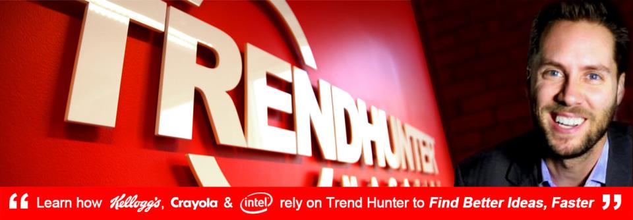
- Jeremy Gutsche, MBA, CFA
CEO & Award-Winning Author
2014
#1
IN
TRENDS
The world's most popular,
most updated collection
of cutting edge Ideas.
SAMPLE REPORT

Slide 2
This Includes 20 Hot Trends for 2014 & 5 Ways Leaders Rely on us to Spark Change
“I don't need to spend hours searching in Google anymore"
"I use the Trend Hunter Platform all the time. I really appreciate everything Trend Hunter does. I love the PRO Trends and it makes our jobs a lot easier."
"The winners will be those who get to the future first. Trend Hunter gets you out of the blocks fast."

Slide 3
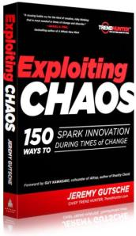
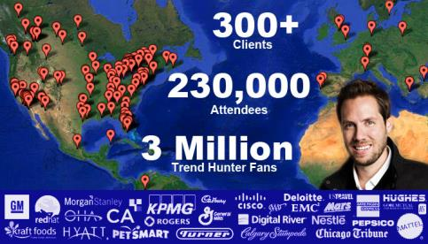
Context: Our CEO Grew a $1Bn Business Based on the Hunt for Custom Opportunity
We realize you need custom, specific insight to win, and no traditional trend service satisfies that need
Grew Capital One a $1 Billion Portfolio
Promoted to Lead Struggling Business Line
Goal: Only Shrink by 20%
Idea Pipeline
Filtering Chaos
$1 Billion Portfolio
Innovation Workshops With 300+ Brands, Billionaires and CEOs

Slide 4
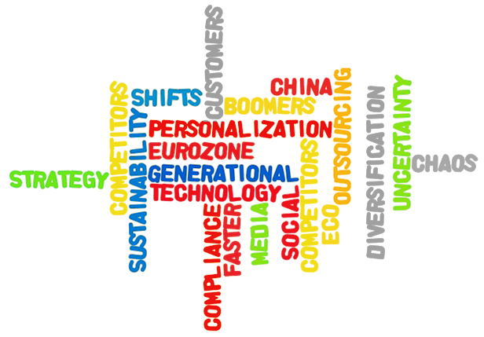
1. We Use Science to Filter Chaos & Find Custom Ideas for Your Team
Inspiration has become distracting and overwhelming. We help your team save time and effort by filtering research specific to your needs
?
?
?
Your Team
?
?
130,000 Hunters
100,000,000 Person Focus Group
Dedicated Advisors
?
?

Slide 5
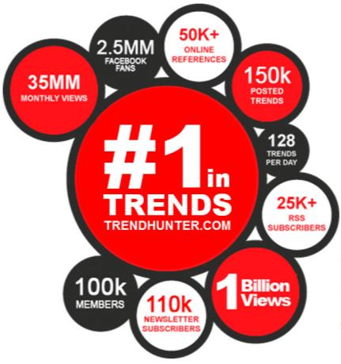
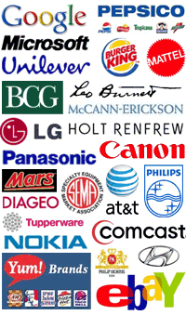
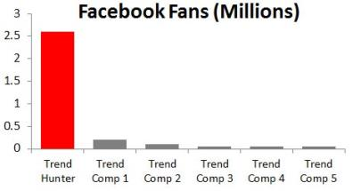
2. You’ll Compete Using the #1 Trend Platform
Create advantage using the largest, most-powerful, most-updated trend platform. There is no other consumer trend company capable of the insight we create
Media
Report Clients
Facebook Fans (Millions)
#1 Largest Trend Spotting Network (by 50x) #1 Most Popular Trend Website (by 10x) #1 Largest Database of Ideas (by 20x)

Slide 6
3. Our Approach is Custom Because We Believe Generic Advice Causes Brands to Miss Out
Traditional guru trend services sell the same insight to all of your competitors, which causes brands to miss out on opportunity that is specific to your needs
Google & Twitter Randomness, News & Fads
Your Team (Expensive Time)
Expensive Consultants
Custom
Trend Hunter 1-4 year Opportunities for Your Team
Old-School Gurus Same ‘gut instinct’ reports to all clients
Customization
Unrelated Innovation
Generic
Magnitude
Fads / Search Today
Ideas
1 Year Out
Clusters
1-4 Years Out
Megatrends
5-10 Years Out

Slide 7
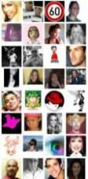
3. Get Six Stadiums Hunting For You
Imagine having 130,000 experts hunting for your ideas, and a crowd-filtered research lab to find the best ideas and patterns of opportunity for your specific topics
#1 Largest Network
#1 Largest Idea Database
Crowd Filtering
Clusters of Opportunity
Your Next Idea
Editing & Curation
Proprietary Algorithms
Research Experts
2,000 PRO Trends
100,000,000 People &
1.5 billion views
120,000 Trend Hunters & 3,000,000 Fans
200,000 Micro-Trends
Our Proprietary Crowdsourced InsightTM Explained: With more than 1,500,000,000 views of data from 100,000,000 visits, we use the power of the crowd to quantify consumer interest, idea freshness, interaction and related ideas. Then, we use proprietary tools and formulas to identify clusters of opportunity. Unlike ‘old-school’ gurus, we use science!

Slide 8
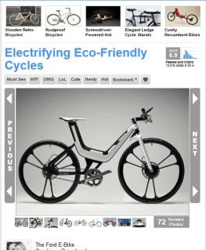
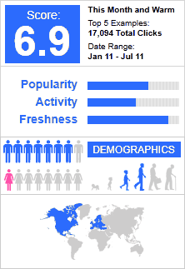
4. Increase Certainty With a 100,000,000 Person Focus Group
Instead of relying on gut-instinct, we measure consumer choice-based interest. We’ve measured 200,000 ideas with 1.5 billion choices from 100 million people.
200,000
Ideas / Experiments
100,000,000
People = Giant Focus Group
25
Choices / Visit

Slide 9
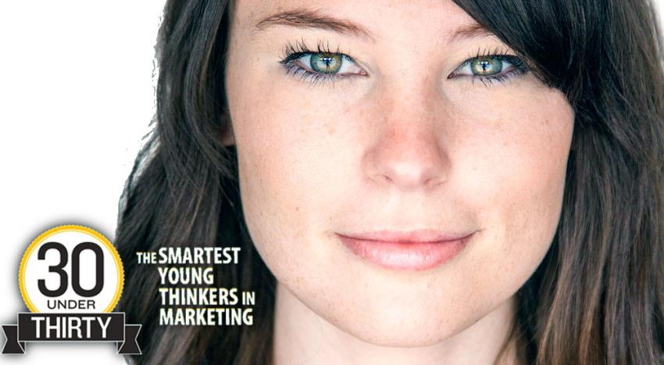
5. Save Effort w/ Dedicated Advisors
You’ll work directly with our research team, including our award-winning President of Research, who will hunt and filter specific ideas based on your month topics
Shelby Walsh, our President and Head of Research, has overseen 1 billion views of traffic and the publication of 150,000 ideas. She delivers trend workshops for brands like Nestle and Labatt and has been called one of “The Smartest Young Thinkers in Marketing”

Slide 10
Get a Discounted Trial or Library
Let’s schedule a call to chat about how you can join leading brands who rely on our dedicated advisers and a custom version of the world’s #1 trend platform
Library
Option 1: Advisory Trial - $24k > $9k
Unlimited Users (Full Access) + 12 Custom Reports (1/Month)
Option 2: 2014 Trend Library Only - $2k / User

Slide 11
20 Hot Trends For 2014
The following sample features 20 of our 2,000 PRO Trends. For full access or custom reports, contact us of special offers at: TrendReports@TrendHunter.com

Slide 12
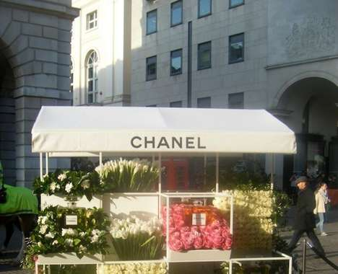
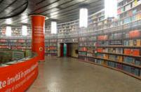
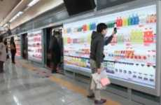
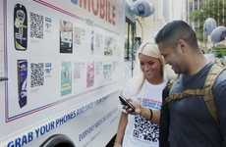
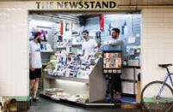
Micro-Adaptation
Retailers adjust to the lack of space in large cities with micro pop-up stores
Implications - Traditionally used as a way to create urgency among consumers, pop-up shops are now becoming a necessity in largely populated cities across the world. As a result, companies are opening small, temporary locations in seemingly odd places, such as subways or parked trucks. This satisfies the consumer desire for convenience, while ensuring companies adapt to today's (figuratively and literally) crowded market.
Scannable Subway Libraries
Virtual Subway Supermarkets
The Physical Digital Library in Bucharest Subway Lets Passengers Read
Homeplus Uses Clever Marketing Campaign to Become Number One
Couture Street Vendors
Scannable Product Deliveries
Hipster Pop-Up Newsstands
Walmart and P&G's PGMobile Trucks Offer Convenience & Accessibility
This Newsstand Pop-Up Business Supports Independent Publications
Business
The Chanel Vending Cart in London's Covent Garden is Glam
Score:
Popularity
DEMOGRAPHICS
5 Ideas + 45 Related Examples
7.7
Activity
http://www.trendhunter.com/id/215508
Freshness

Slide 13
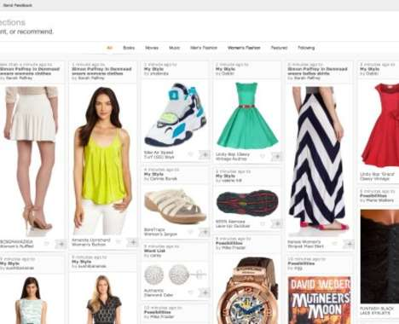
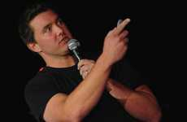
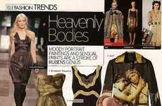
Social Commerce
Social media influences e-commerce in a way that encourages community buying
Implications - Social media has not only changed the way consumers communicate, but the way they shop as well. Recently, the world of e-commerce has begun mimicking its communication-based digital counterpart of social media, resulting in online community-enabled purchasing. This social commerce speaks to consumers' need to stay connected to their peers during purchase decisions, providing reassurance in their decision and satiating the need [continued online]
Social Media Shopping Platforms
Captivating E- Commerce Experiments
Nathan Hubbard is Looking to Introduce Twitter Shopping
Elle has Taken to Social Media to Revolutionize E-commerce
Pinboard Web Shops
Rights-Based Organic Food
Social Media Shopping Catalogs
Social Good
'Amazon Collections' is a Pinterest Look-Alike
Grocerybunny Makes Quality Produce More Accessible and Affordable
Pickie is a Personalized Magazine Based on Your Online Interactions
Score:
Popularity
DEMOGRAPHICS
5 Ideas + 43 Related Examples
7.1
Activity
http://www.trendhunter.com/id/215517
Freshness

Slide 14
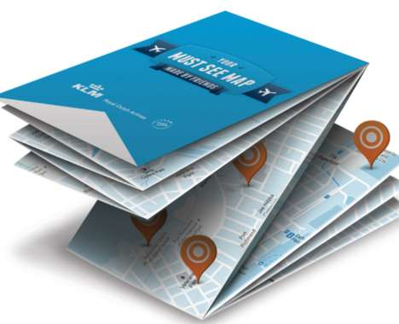
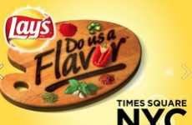
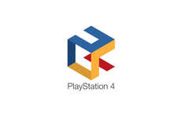
Consumer-Controlled Innovations
Involving consumers in the creation of products boosts branding
Implications - A step above crowdsourcing, consumer-controlled innovations allow customers to take part in the creation of actual products. This signifies a shift in the consumer-company dynamic, as it becomes clear the best way to ensure customer satisfaction, is to give the customer control of the brand.
Crowdsourced Chip Contests
Community Crowdsourced Beer
Lay's 'Do Us a Flavor' Challenge Asks Americans to Get Creative
Meantime Brewing's Hop Harvest is Happening Across the City of London
Crowdsourced Travel Maps
Gaming Logo Mockups
Crowdfunded Show-Reviving Sites
Business
KLM's Must See Map Lets You & Friends Create Maps by Selecting Must-Sees
This Contest Invites Designers to Mockup the Playstation 4 Logo
The Reupp Platform Lets Users Pledge Money to Revive TV Shows
Score:
Popularity
DEMOGRAPHICS
5 Ideas + 45 Related Examples
6.6
Activity
http://www.trendhunter.com/id/215490
Freshness

Slide 15
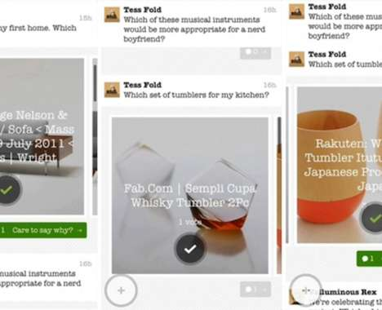
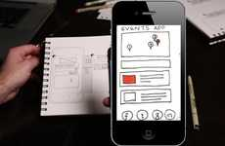
Gamble Economics
Today's fast pace means less conceptualizing and more testing
Implications - Most startups had clued in to the value of quick testing years ago, with large companies lagging behind and aiming for perfection before execution. Recently, however, it seems companies are learning this valuable lesson the hard way, especially during the recession. With both large and small corporations understanding the value of soft launches, a demand for devices, apps, or platforms that make testing easier can be observed.
Newbie-Friendly App Development Platforms
Kid-Friendly Crowdfunding Platforms
AppSeed Turns Sketches into Functioning Prototypes
'Piggybackr' Teaches Youth the Power of Crowdfunding
Binary Decision Retail Apps
Crowdfunded Loan Platforms
Business
The 'A/B' App Lets You Split-Test Purchase Decisions Among Friends
The 'hellomerci' Platform Helps You Get a Loan While Avoiding the Bank
Score:
Popularity
DEMOGRAPHICS
4 Ideas + 30 Related Examples
5.8
Activity
http://www.trendhunter.com/id/215538
Freshness

Slide 16
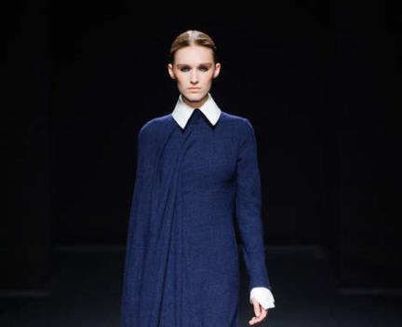
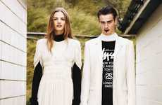
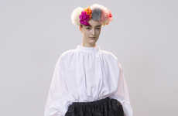
Modest-Chic
The rise of conventional couture redefines what it means to be attractive
Implications - The fashion industry had its roots planted in sexuality for quite some time; however, this changes as the definition of what's attractive shifts away from explicit physicality and more toward intellect. Resulting in more modest, yet modern apparel, this movement changes more than just the fashion industry. Companies from all industries can benefit from putting less emphasis on physical sexuality in advertising and marketing st [continued online]
Amish-Inspired Streetwear Editorials
Chic Conservative Fashion Captures
The Aitken Jolly Exit Fashion Story Shows Urban Attire
The 'Amish' Fashion Series Incorporates Neutral Ton
Romantic Goth Girl Apparel
Comfy Modest Female Fashion
Artist Homage Catalogs
Fashion
The Stéphane Rolland AW14 Collection Channels Wednesday Addams
The Kelly Love AW 2013 Collection is Full of Simple Flirty Fashion
The Eudon Choi Autumn/Winter 2013/2014 Collection Channels Frida Kahlo
Score:
Popularity
DEMOGRAPHICS
5 Ideas + 45 Related Examples
7.5
Activity
http://www.trendhunter.com/id/204330
Freshness

Slide 17
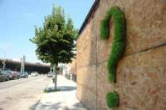
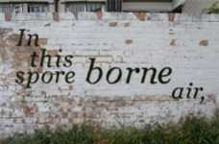
Edgy Environmentalism
Consumers are responding to more subversive calls to action
Implications - Though the dialogue around environmentalism has never been more ubiquitous, those invested in the cause are turning to more unexpected ways of getting the message across, like graffiti. This edgy approach is not only more intriguing to viewers, but creates an appealing air of exclusivity to those invested in environmentalism by attaching itself to a sub-culture.
Grassy Street Art
Sustainable Public Graffiti Art
Muddy Urban Art
Mosstika Urban Greenery Decorates Urban Landscapes in Eco-Conscious Ways
London's Mossberger Project by Anna Garforth
Eco Graffiti Uses Mud, Not Spray Paint, to Convey a Message
Off-Putting Tree Sculptures
Vibrantly Crude Street Art
Vintage Revolver Bottle Openers
Eco
Giuseppe Penone's Trees Play with the Limits Between Man and Nature
The Etam Cru Collective Produces Brilliant Four-Story Murals in Poland
These Cast Iron Accessories Will Pop Your Brews in Style
Score:
Popularity
DEMOGRAPHICS
6 Ideas + 53 Related Examples
7.2
Activity
http://www.trendhunter.com/id/202535
Freshness

Slide 18
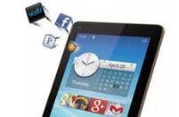
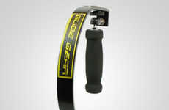
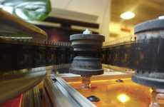
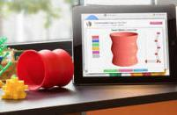
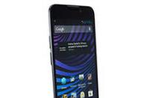
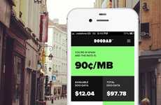
Omnipresent Connectivity
Consumers are seeking out a more accessible way to stay connected
Implications - The ubiquity of tech culture and tech products is influencing a consumer demand for more affordable goods. Whether it be lightweight tablets or smartphones designed for long-term value, the tech industry, previously seen as somewhat elite and inaccessible, is making a turn for the inexpensive. This affordability not only applies to the tech market, but could more broadly influence typically high-end markets like fashion or auto.
Inexpensive Luxury Tablets
Gliding iPhone Video Gear
DIY Film Digitizers
The Hisense Sero 7 Pro is an Affordable High-Speed Tablet
The Glide Gear SYL1000 Smooths Shakiness in iPhone Videos
The Kinograph Digitize Film on the Cheap
Budget-Friendly 3D Printers
Long-Lasting Smartphones
Economical Adventurer Sim Cards
Tech
The Buccaneer is the Most Budget-Friendly 3D Printer
The ZTE Vital Sprint Smartphone Has Extended Battery Life
The 'DOODAD' SIM Card Gives You Cheap Data Rates Worldwide
Score:
Popularity
DEMOGRAPHICS
6 Ideas + 54 Related Examples
5.4
Activity
http://www.trendhunter.com/id/203753
Freshness

Slide 19
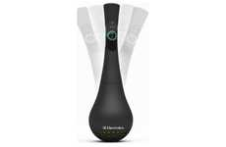
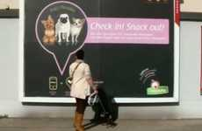
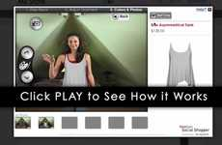
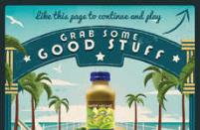
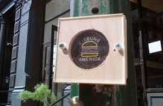
Sampletising
Brands are using high-tech innovations to allow consumer to try before buying
Implications - Offering consumers more peace of mind with the equivalent of a "test drive" for a range of goods, sampling is becoming a more and more pervasive approach to promoting products. To streamline this process and make it easier for consumers, brands are adopting technologically advanced ways of enhancing sampling experiences.
Extremely Tedious Sampling Machines
Taste-Testing Spoons
Social Media Feeders
The Electrolux Ingresure&#8232; Examines the Balance of Flavors in Your Recip
Granatapet Develops a Billboard With Foursquare That Releases Dog Food
The Delite-O-Matic Shows How Dedicated Humans Can Be
Virtual Fashion Sampling
Smoothie Sampling Games
Sidewalk Sound Sampling
Business
Webcam Social Shopper by PrestShop Creates an AR Fitting Room
Naked Juice 'Grab Some Good Stuff' Campaign Offers Arcade-Like Fun
Kitsune's Sound Graffiti Campaign Features Music-Listening Stations
Score:
Popularity
DEMOGRAPHICS
6 Ideas + 57 Related Examples
6.1
Activity
http://www.trendhunter.com/id/202027
Freshness

Slide 20
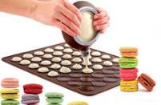
Pseudo Domestic
Recipes using ready-made ingredients make for seemingly expert cuisine skills
Implications - In this age, very few have the time to create truly impressive cuisine, resulting in pseudo-domestic recipes that allow for corners to be cut. Modern foodies are steering less toward homemade ingredients and more toward the ready-made, time-saving options. Ultimately, consumers will appreciate any opportunity to save time, especially if they're still able to feel the pride that comes with cooking one's own dish.
Macaron Baking Kits
Strawberry Chocolate Chip Cookies
This Set Includes Everything You Need to Make Finicky Pastries
The Cake Mix Cookies From Sally's Baking Addiction are Ado
Homemade Hybrid Cronuts
Corner Store Cake Recipes
Lifestyle
The Banana Cream Pillsbury Crescent Doughnuts is a Delicious Knock-Off
This Vanilla Cake Recipe is Made with Layered Twinkies
Score:
Popularity
DEMOGRAPHICS
4 Ideas + 36 Related Examples
6.7
Activity
http://www.trendhunter.com/id/202597
Freshness

Slide 21
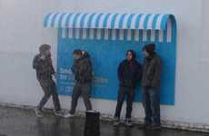
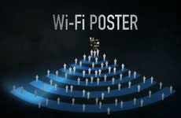
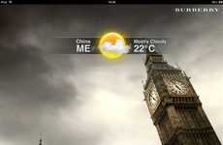
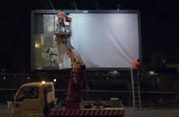
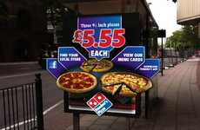
Functional Out-of-Home
Brands are adopting useful physical advertisements to benefit consumers
Implications - Instead of mundane billboards or bus stop ads, these experiential campaigns take things to a tangible level, giving consumers a reason to engage with a brand's message physically and mentally, creating a higher likelihood of unaided awareness. Whether it be protection from the rain or added ease of travel, functional out-of-home ads are a memorable and powerful form of advertising.
Functional Outdoor Billboards
Internet Connection Film Campaigns
Climate-Based Fashion Campaigns
Sunscreen-Dispensing Signage
The IBM Smart Ideas for Smarter Cities Campaign Leads by Example
This SunSmart Australia Campaign Encourages Skin Protection
CJ Entertainment's Wi-Fi Ad Draws Attention Back to the P
Burberry Digital Weather Billboards Alert Brits to the Temperature
Bug-Trapping Billboards
Poster Food Orders
Sheltering Charity Billboards
Marketing
The Ad Agency Publicis Milan Has Turned a Billboard into a Bug Trap
Domino's Pizza Ordering App Lets People Get Pies From Their Phones
The Other Side Campaign Creates Shelter for the Poor from Billboards
Score:
Popularity
DEMOGRAPHICS
7 Ideas + 57 Related Examples
6.3
Activity
http://www.trendhunter.com/id/200603
Freshness

Slide 22
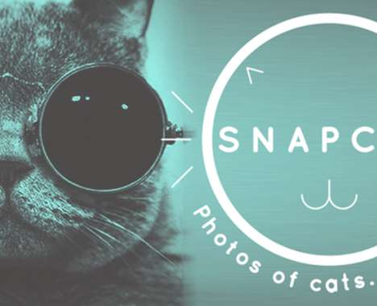
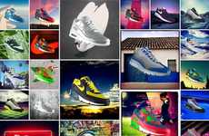
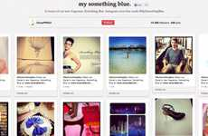
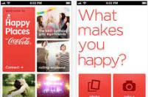
Ocular Social
Sites like Pinterest and Instagram introduce visual-only social media
Implications - Though Twitter's text-based communication proves the preferred form of social media for many, visual-focused sites like Instagram introduce the concept of photocommunication. Faster and more instantly gratifying than words, photos are the next step in streamlining media. This prompts companies in all industries to place more focus on visual branding.
Customizable Social Media Kicks
Social Media Fragrance Campaigns
The Nike Photo ID Project Allows You to Customize Using Instagram
The Oscar De La Renta Something Blue Tool Promotes Its Perfume
Cat Selfie-Enabling Apps
Soft Drink Photo Apps
Privacy Protecting Smartphone Apps
Social Media
The Snapcat App Lets Kitties Take Selfies by Pawing at the Screen
Coca-Cola Happy Places Lets You Share Joyful Filmed Moments With Friends
Snapchat Allows Users to Safely Send Scandalous Captures
Score:
Popularity
DEMOGRAPHICS
5 Ideas + 46 Related Examples
6.3
Activity
http://www.trendhunter.com/id/201708
Freshness

Slide 23
Food-Focused Getaways
Consumers are indulging in food-focused vacations as a total getaway
Implications - Indulgent as could be, food-focused vacation innovations allow consumers to embrace their favorite cuisine in an all-encompassing way. Since foodie culture has become a lifestyle, experiences like this help consumers define themselves by making their vacations more immersive.
Indulgent Cake Hotels
Cartoon Cat Cuisine
Rejuvenating Beer Baths
The World's First Cake Hotel Has Opened in London
The Hello Kitty Dreams Restaurant Opens in Beijing
Hotel Bahenec Offers Guests the Chance to Bathe in Premium Lager
Scrumptious Candy Getaways
Chocolate-Inspired Accommodations
24 Karat Gold Teas
World
The Chocolate Boutique Hotel is a Delicious Dream Come True
London's 51 Buckingham Gate Offers a Truly First Class Dining Experience
The Concept Hotel in Brussels Offers Rustic Luxury
Score:
Popularity
DEMOGRAPHICS
6 Ideas + 53 Related Examples
6.9
Activity
http://www.trendhunter.com/id/200568
Freshness

Slide 24
Simulated Home
The feeling of true comfort is created through residential-inspired design
Implications - Though escapism has reigned supreme for consumers for quite some time, it sees a backlash in simulated home. Those in the design and hotel industries are now realizing that though exoticism provides a rush, consumers are most comfortable in spaces that feel and look like a more familiar space. The appeal of home-inspired public design lies in its nostalgia factor as well as a desire for true relaxation.
Residential-Style Accommodations
IKEA-Furnished Lodgings
The Moxy Hotels Has a High-End Appearance on a Low-End Budget
The James Chicago Hotel Boasts a Warm and Modern Design
House-Like Lodgings
Rest-Focused Retailers
Life-Sized Dollhouses
Art & Design
The Wiesergut Hotel is at Once Luxurious and Homey
The Takeo Kikuchi Flagship Store Focuses on Customer Comfort
Abandoned Farmhouse Transformed Into Giant Playhouse
Score:
Popularity
DEMOGRAPHICS
5 Ideas + 39 Related Examples
8.0
Activity
http://www.trendhunter.com/id/200031
Freshness

Slide 25
Kit Culture
Consumers flock to the holistically ready-made for convenience
Implications - In the age of instant gratification, consumers crave easy, quick solutions to life's problems. This desire has birthed a kit culture based in ready-made systems assembled to solve various problems. Effectively rendering planning and conceptualizing unnecessary, kits allow consumers to enjoy the benefits of problem solving, without the effort.
Heartbreak Emergency Kits
Compact Catastrophe Canisters
Macho Necessity Sets
Masculine Gift Baskets
Love Hurts by Melanie Chernock Provides Comfort and Giggles
The Gentleman's Survival Kit is Full of Essentials for Men
A Man Crate Put Everything a Guy Would Want into One Awesome Present
The Fort Standard Mini Survival Kit is a Tiny Life-Saving Tool Set
Modular Meal Prep Sets
Breast Milk Management Systems
Survivalist Beauty Kits
Ego-Boosting Potions
Unique
The Snapware Collapsible Kitchen Kit Unfolds to a Flat Stack 1-inch Thick
The '7 Necessities' Exhibition Creates a Survival Kit
The Feel Better Kit Contains Ego Boosting Mixtures
Nutriflex Brings Brings Efficiency to Busy Breastfeeding Mothers
Score:
Popularity
DEMOGRAPHICS
8 Ideas + 68 Related Examples
7.3
Activity
http://www.trendhunter.com/id/197704
Freshness

Slide 26
Villain Worship
The bad guy takes the place of the hero as the go-to idol
Implications - Heroes represent the part of the human psyche focused on progress and doing the right thing. For many, the hero figure is more of an aspiration than a reality. The villain, however, represents the more indulgent, self-serving side of the human condition. In today's selfcentric society, the villain is simply easier to relate to.
Fantasy Villain Footwear
Evil Queen Cosmetic Tutorials
Metal-Controlling Winter Headgear
Kobi Levi's New Line Will Help You Become the Fairest of Them All
The Maleficent Makeup Transformation is a Great Halloween DIY
The Magneto Helmet Beanie Salutes the Ultimate X-Man Villain
Villainous Crocheted Masks
Retro Movie Criminal Captures
Evil Antagonist-Inspired Makeup
Pop Culture
This Crocheted Bane Mask is Essential for Woolly Battles with Batman
Jempix's Photos of Batman Bad Guys Mimic 1920s Mug Shots
The MAC Venemous Villains Line Takes Cues From Disney Bad Guys
Score:
Popularity
DEMOGRAPHICS
6 Ideas + 54 Related Examples
6.5
Activity
http://www.trendhunter.com/id/196336
Freshness

Slide 27
Malleable Mania
Products are now literally bending to the will of the consumer
Implications - The vision of a completely customized lifestyle is one that is highly sought after. Looking for products that can be tailored to the exact taste of the individual, consumers are asserting their desire for uniqueness by demanding products that are malleable in form and customizable according to taste and lifestyle.
Malleable Wrist-Worn Mobiles
Innovative Audio Colonies
Malleable Sensory Mobiles
The Whooom Sound System Lets You Share the Same Beats Amongst Buddies
Morph by Jarkko Saunamaki is a Fluid Device with Cutting-Edge Functions
The Limbo Transformable Smartphone Switches from Handset to Timepiece
Malleable Multipurpose Containers
Malleable Smartphone Accessories
Metallic Malleable Dishware
Art & Design
The Facetat Serving Dish is a Bowl Molded From a Geometric Sheet
Flex Boxes Store Assorted Items of All Shapes and Small Sizes
The iPooding Cases Can Be Squished and Tampered With
Score:
Popularity
DEMOGRAPHICS
6 Ideas + 56 Related Examples
6.3
Activity
http://www.trendhunter.com/id/192847
Freshness

Slide 28
Meme Celebrity
Online phenomenons are becoming real-world power influencers
Implications - Online memes are now catapulting regular people and pets into fully-fledged stardom. Grumpy Cat, Psy (from Gangnam style) and various other online sensations are launching books, product lines and are even appearing on major broadcast networks. While the lifespan of these web celebrities in pop culture may be short-lived, their influence at the their peak is intense.
Meme-Based Nominee Depictions
Celebrity Feline Paintings
Cat Meme-Tributing Treats
Dancing Pistachio Viral Ads
Aja Immortalizes the Memes of Grumpy Cat and Lil Bub in Paintings
These Grumpy Cat Cookies by Whipped Bake Shop Will Make Sourpusses Smile
This Psy Super Bowl Commercial Re-Visits Gangnam Style
This Year's Oscar Nominees Get Memed in These Redone Posters
Three-Dimensional Meme Moldings
Optimistic Meme Toys
13 Viral Gangnam Style Sensations
Viral Korean Pop Manicures
Pop Culture
The Ryan Kittleson Success Kid Figurine Celebrates Victory
Show off Your Sweet Moves While Wearing Gangnam Style Nail Art
This Piece of Grumpy Cat Art is Finely Crafted from Clay
From Move-Busting Cyborgs to Pop Music Prisoners
Score:
Popularity
DEMOGRAPHICS
8 Ideas + 58 Related Examples
6.8
Activity
http://www.trendhunter.com/id/190018
Freshness

Slide 29
Infinite Design
The appeal of optical illusions in everyday products creates consumer buzz
Implications - Using mirrors, illusionary tricks or continuous movement, a variety of industries are looking to appeal to more modern sensibilities using infinite design. Travel, art and entertainment are among the first industries to offer consumers products and experiences that have a seemingly "perpetual" aesthetic.
Cityscape Infinity Pools
Continually Spiraling Staircases
Magestic Mountain-Top Infinity Pools
Infinitely Mirrored Installations
The Marina Bay Sands Pool Overlooks the Entire Singapore Skyline
'The Phoenix Is Closer Than It Appears' Exhibit is Surreal
The Olafur Eliasson Infinite Staircase is Full of Twists and Turn
The Barcelona Grand Hotel Central Pool Overlooks the City
Opulent Overflowing Tubs
Surround-Image Technology
Perpetual Wave Pools
Art & Design
The Blanc 5 Infinity Spa Sends Luxury and Relaxation Over the Edge
Infinity-by-Nine Expands the Viewer's Peripheral Vision in Theaters
The Kelly Slater Wave Co. is a Surfer's Dream Destination
Score:
Popularity
DEMOGRAPHICS
7 Ideas + 64 Related Examples
6.0
Activity
http://www.trendhunter.com/id/189273
Freshness

Slide 30
Internet Slang Marketing
The language of the Internet is being used in campaigns and branding
Implications - Those who are active on social media know that the Internet has its own special language. Companies with their finger on the pulse of pop culture are now taking techspeak beyond the screen and into the real world by incorporating things like hashtags and Internet slang into branding. This establishes a connection with Gen Y, making these brands seem like peers to the Digital Natives.
Hashtag Hangover Purses
Acronym Ending Crusades
These Kate Spade Totes Offer Playful Sayings
The 'Anti-YOLO' Campaign Puts Things in Perspective
Gen Z Vocabulary Charts
Emoticon Flower Arrangements
Cat Meme Tweet Translators
Pop Culture
The Infographic Helps You Fast Track Your Way to Generation Z Lingo
Twitter Recently Launched a New LOLCat Language Setting
FocusDriven.Org Tries to Raise Texting and Driving Awareness
Score:
Popularity
DEMOGRAPHICS
5 Ideas + 44 Related Examples
6.4
Activity
http://www.trendhunter.com/id/185314
Freshness

Slide 31
Social Good Subscriptions
Businesses are providing more convenient ways for consumers to donate
Implications - Subscriptions to everything from wine to fashion and home decor have become more commonplace and have laid the foundation for businesses to give back more conveniently. Subscription services for social good are the perfect way for consumers to contribute to a meaningful cause without having to dedicate a large amount of time to it.
Great Deals for Good
Global Farmers' Markets
DealGooder Facilitates Group Buying and Giving, Donating 50% of Profits
Liga Masiva Lets You Buy Coffee Straight from the Source
Hunger-Fighting Food Packages
Sustainable Food Subscriptions
School-Supporting Digital Newsletters
Social Good
The Love with Food Group Donates a Meal for Every Box Purchased
Door to Door Organics Delivers Fresh Natural Groceries to Your Door
Red Tricycle Donates Funds To Underserved Organizations
Score:
Popularity
DEMOGRAPHICS
5 Ideas + 45 Related Examples
4.6
Activity
http://www.trendhunter.com/id/184095
Freshness

Slide 32
Ask for a Sample Custom Report
We’ll be happy to send you a sample custom report. Our reports are topic specific, filled with ideas, and they feature high level trends as well as detailed examples:
i. PRO Trends
10 Pages, 60 Examples
Kidaptive Design
Foodcessories
Candy Couture
Chocolate Ideas
For 7-12 Year Old Girls
70 Pages, 430 Examples
Filtered down from 1,700 chocolate ideas, 11,000 food innovations, 21,000 marketing trends,
45,000 lifestyle trends
ii. Clusters
40 Pages, 350 Examples
59 Creative Chocolate Confections
50 Girly Chocolates Creations
100 Eggcellent Easter Desserts
70 Cartoon Character Desserts
iii. Micro-Trends 20 Pages, 20 Examples
DIY Chocolate Treats
Panda Cupcakes (& Princess Cakes)
Harry Potter Chocolates

Slide 33
Let’s Chat About How to
Find Better Ideas, Faster
TM
Schedule a call to chat about how leading brands supercharge innovation with our custom reports, advisory service, and the world’s #1 trend platform
Custom Reports – Save time & effort with a dedicated research expert customizing monthly reports on your topic. Harness the power of 125,000 people hunting ideas for you and a virtual focus group with 100,000,000 people!
Trend Report Library - Gain access to 50+ categories of premium reports and PRO Trends.
Custom Dashboard - Deep dive into the world’s largest database of ideas (now 200,000+ ideas!) with special tools for filtering and creating reports.
E-Learning & Workshops - 100+ courses and 2,000+ videos curated from world leaders, experts and CEOs. Plus, optional workshops which have supercharged 300+ clients, from Victoria’s Secret, Crayola and Coca-Cola to Hughes Aerospace, ABC and IBM.
Feel free to contact me with suggestions!
Jeremy Gutsche, MBA, CFA
CEO, TrendHunter.com (jeremy@trendhunter.com) Award-Winning Author

Slide 35
Let’s Chat!
Schedule a call or ask a question: TrendReports@TrendHunter.com
Copyright Trend Hunter Inc. - All Rights Reserved. 'Trend Hunter' is the legally registered trademarks of Trend Hunter Inc.

